Slide 1
Cancer Bio Course
Session 1: Introduction to course and basic techniques applied in basic cancer research
July 19, 2023
Álvaro Quintanal-Villalonga, PhD Assistant Attending Biologist, Lab co-director
Department of Medicine
quintaa1@mskcc.org

Slide 2
Who’s this guy?
BSc in Biotechnology
MSc in Molecular Genetics and Biotechnology
PhD in Molecular Biology, Biomedicine and Clinical Research
(University of Sevilla)

Slide 3
Who’s this guy?
PhD in Molecular Biology, Biomedicine and Clinical Research
(CNIO, Spanish National Cancer Research Center, Madrid)

Slide 4
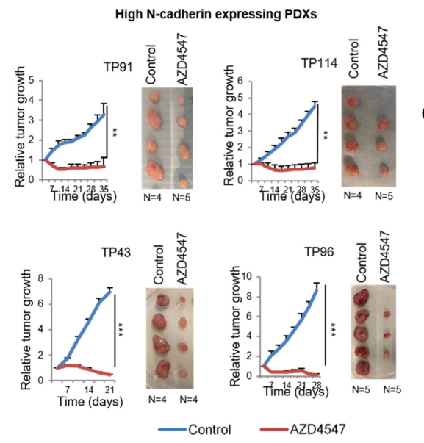
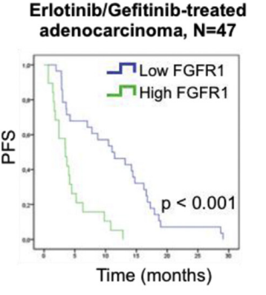
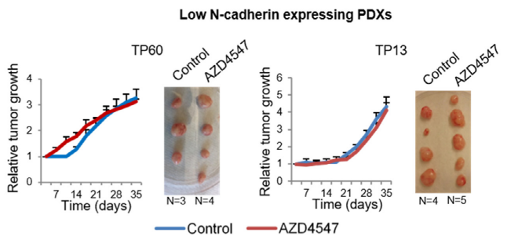
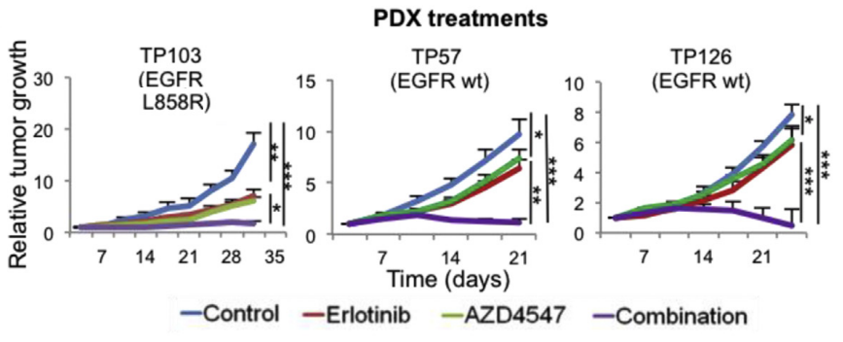
Who’s this guy?
PhD work: Role of FGFR1 in lung cancer
Quintanal-Villalonga et al., eBiomedicine 2020
Quintanal-Villalonga et al., JTO 2019
PhD in Molecular Biology, Biomedicine and Clinical Research
(Paz-Ares Lab, CNIO, Spanish National Cancer Research Center, Madrid)

Slide 5
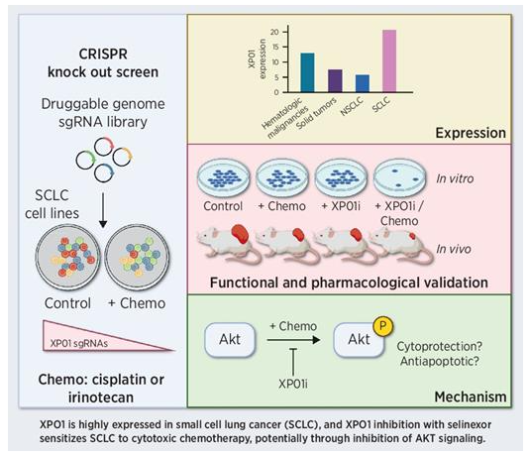
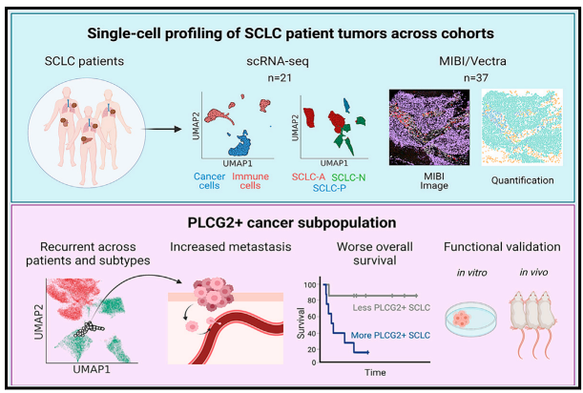
Who’s this guy?
Postdoc work: SCLC biology and therapeutics
Exportin 1 inhibition sensitizes SCLC to chemotherapy
Mechanism of metastasis in SCLC
Chan*, Quintanal-Villalonga* et al., Cancer Cell 2021
(MSKCC, New York)
Quintanal-Villalonga et al., Cancer Research 2022

Slide 6
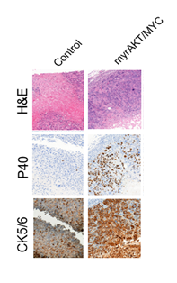
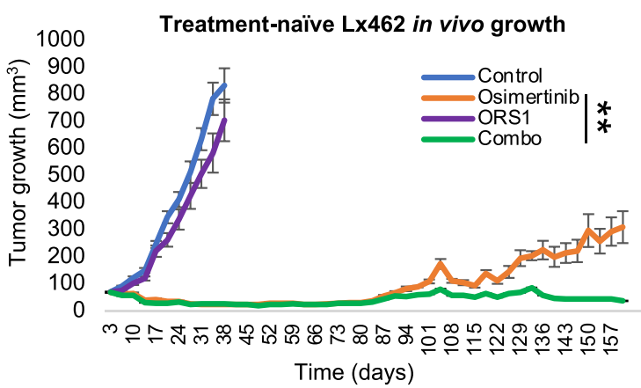
Who’s this guy?
Postdoc work:
Drivers and therapeutic targets for lineage plasticity
Drivers and therapeutic targets to prevent targeted treatment resistance in tumors undergoing histological transformation
(MSKCC, New York)
Quintanal-Villalonga et al., Cancer Discovery 2021
Quintanal-Villalonga et al., J Hematol Oncol 2021

Slide 7
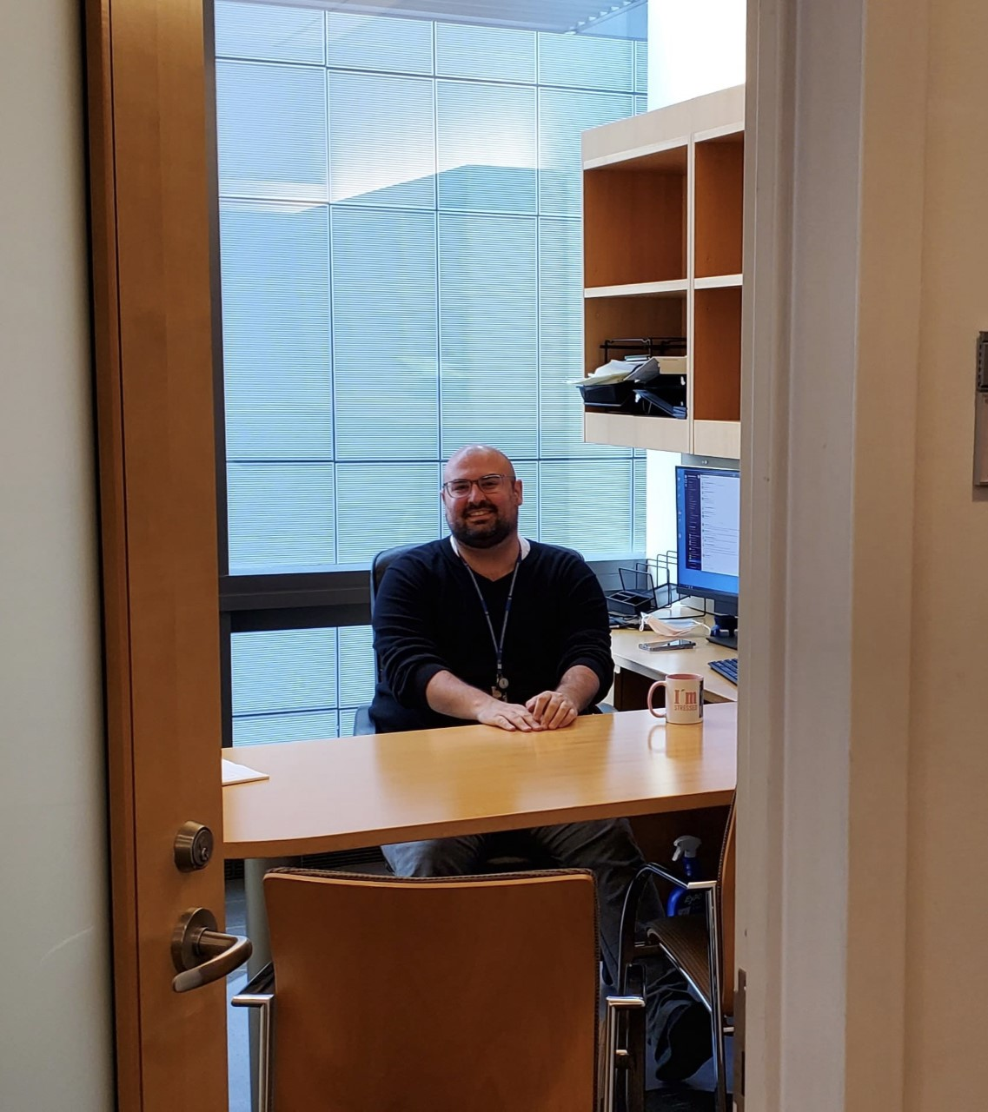
Who’s this guy?
Ongoing work: Lung Cancer Therapeutics
Therapeutic targets for SCLC
Therapeutic targets for LUSC
Drivers and therapeutic targets for lineage plasticity
Epigenetic mechanism of resistance to RET inhibitors
Mechanism of resistance to ALK inhibitors
Therapeutic targets for MPM
Establishment and characterization of lung cancer PDXs (LCNECs, LUSC)
(MSKCC, New York)

Slide 8
Course structure
Scientific topics covered will include:
• Cancer as a disease
• Genetic and epigenetic mechanisms
• Computational biology and oncology
• Cancer signaling
• Cancer metabolism
• Metastasis
• Tumor modeling and heterogeneity
• Cancer types and microenvironments
This course will:
• Provide a review of advanced concepts in cancer biology
• Expose students to techniques and experimental design applied to basic-translational cancer research
• Potentiate the ability to perform critical analysis of basic-translational research
• Strengthen capacities to develop a research project
RECORDED LECTURES
IN-PERSON
ACTIVITIES

Slide 9
Course structure
In-person activities:
• Session 1 – Introduction to course and basic techniques applied in basic cancer research
• Session 2 – Paper discussion
• Session 3 – Paper discussion
• Session 4 – Paper discussion
• Session 5 – Guided live research activity
- Explanation of the question under research - why on earth did they decide to do this?
Discussion figure by figure – why is this paper not as good as authors think?:
What is the point of each figure?
Are there any missing experimental conditions?
Are results interpretable?
Do the results support the conclusions by the authors?
Would you have done anything differently?
Are there any missing experiments?
What are the limitations of the work?
What experiments could be done as a follow-up to the paper?

Slide 10
Course evaluation
Class participation and attendance (33%)
• All scholars are expected to attend all sessions. A scholar must notify the Bridge team and instructor prior to class if they will absent. This notice should be sent by email.
Take Home (67%)
• A research question (project) will be assigned to you, in groups of 2-3 people.
• You will have to propose a series of experiments to address that research question (i.e. a light version of the Research Strategy section of a grant) – Max. 2 pages
• Due date is September 13, 2023
• Your work will be reviewed and feedback will be provided by September 27, 2023. You will have the chance to made modifications according to the comments provided (due October 11, 2023).
• Your revised work will be graded.

Slide 11
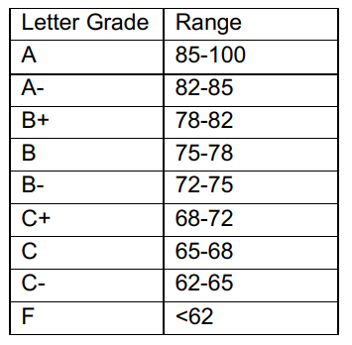
Course evaluation

Slide 12
Cancer 101: Tumor initiation and progression
Metastasis
Neoplastic cells
Malignant tumor
Pre-neoplastic cells
Normal cell
“Initiated cell”
Molecular alterations
Molecular alterations
Molecular alterations
Molecular alterations
Molecular alterations
Tumor
microenvironment cells

Slide 13
Cancer 101: Cancer is a genetic disease
(Proto-)Oncogene
Gene with the potential to promote cancer
Overactivation of proto-oncogenes
Malignant tumor
Normal cell
Tumor suppressor gene
Gene whose loss/dysfunction contributes to cancer
Inactivation of tumor suppressor genes

Slide 14
Cancer 101: Main Molecular alterations
DNA
GENOMICS
Mutations
Transcription
DNA Structural changes leading to dysregulation
of mRNA expression
EPIGENOMICS
RNA
Dysregulation of mRNA expression/processing
TRANSCRIPTOMICS
Translation
Protein
Dysregulation of mRNA expression/activation
PROTEOMICS

Slide 15
Cancer Genes

Slide 16
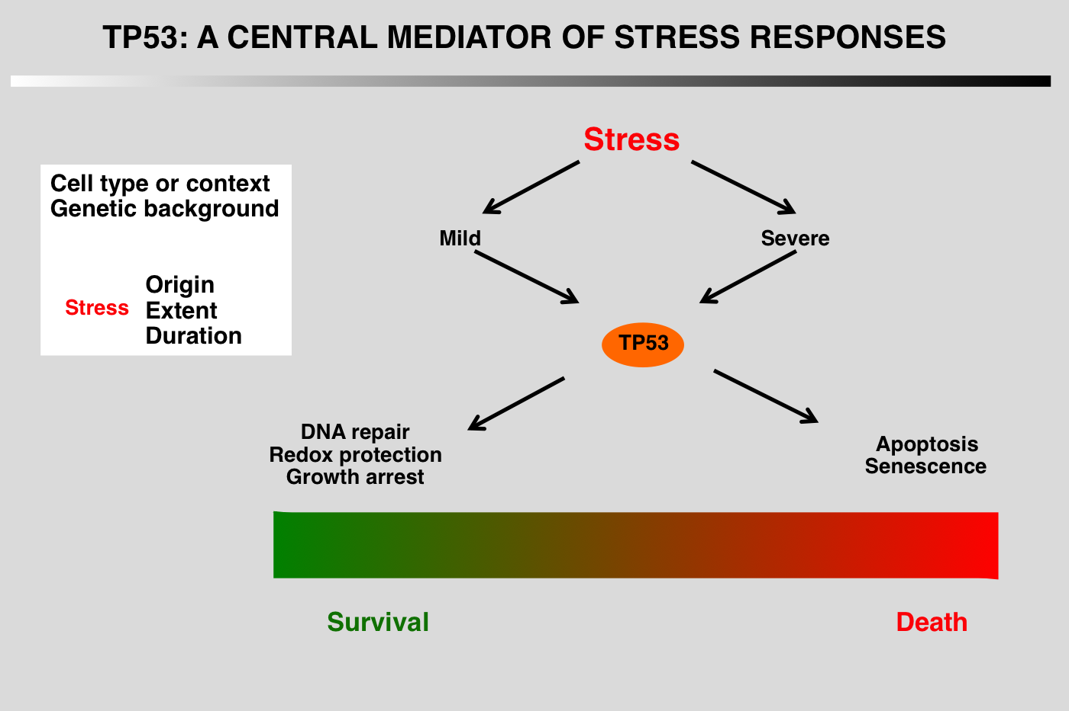
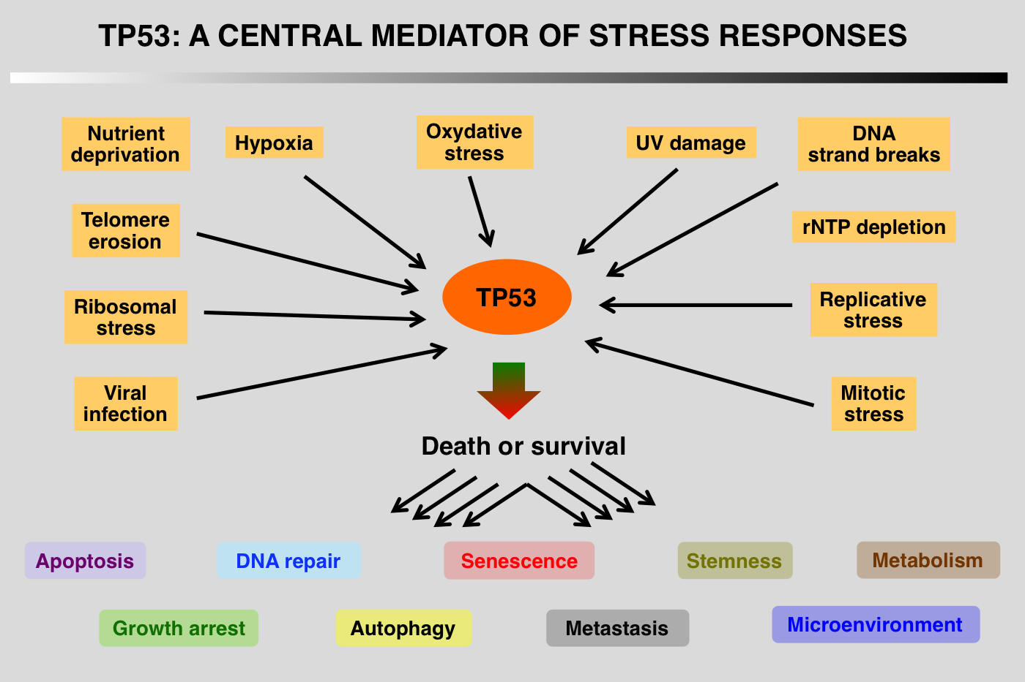
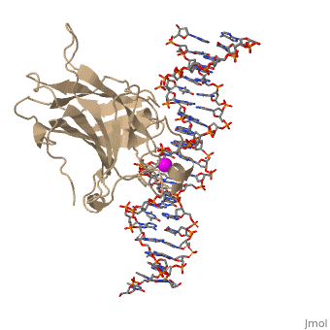
Cancer genes
Adenosquamous transformation
TP53: The guardian of the genome
The P53 website

Slide 17
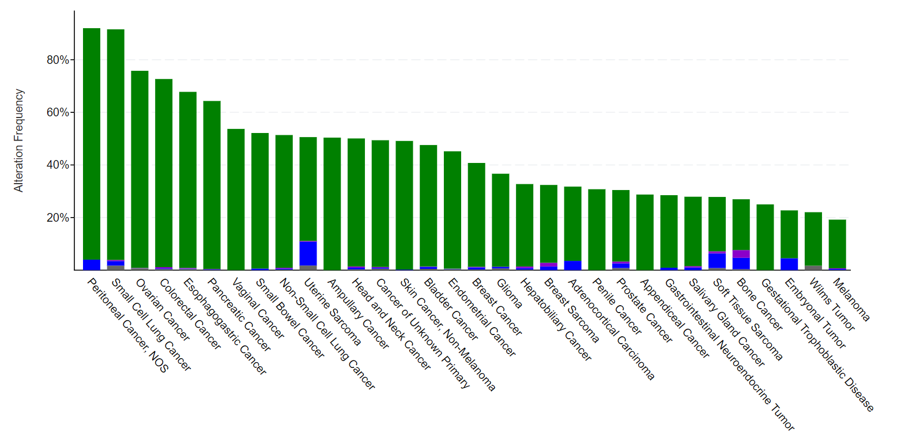
Cancer genes
Adenosquamous transformation
TP53: The guardian of the genome
TP53 genomic alterations
Loss of TP53 function is a major oncogenic event, occurring at high frequency in human tumors of any origin
The P53 website

Slide 18
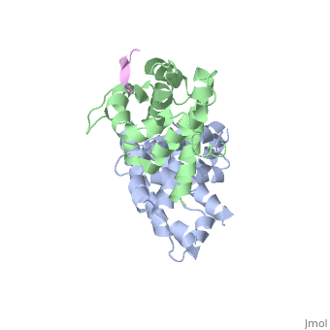
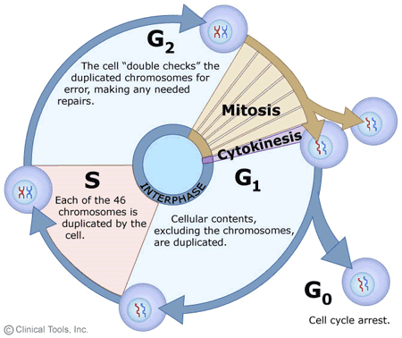
Cancer genes
Adenosquamous transformation
RB1
RB1 inactivation in cancer
Adapted from Indovina et al., Oncotarget 2015
Notes:
A. In G1 phase, the active hypophosphorylated form of RB1 binds to E2F transcription factors to repress the expression of cell cycle and apoptotic genes. In S phase, RB1 is inactivated by phosphorylation (P) and releases most E2Fs to induce transcription of cell cycle genes. A fraction of RB1-E2F1 complexes persist at the promoters of apoptotic genes, thus repressing their expression. B. In cancer, RB1 can be inactivated by either mutations or hyperphosphorylation. RB1 loss leads to de-repression of both cell cycle and apoptotic genes, whereas hyperphosphorylation causes de-repression only of cell cycle genes. Thus, in cells lacking RB1, tumorigenesis can occur only if survival pathways protect cells from RB1-loss induced apoptosis by limiting E2F1 proapoptotic activity or if a second alteration, such as the abrogation of the p53 proapoptotic pathway, occurs (18) (PDF) RB1 dual role in proliferation and apoptosis: Cell fate control and implications for cancer therapy. Available from: https://www.researchgate.net/publication/279986806_RB1_dual_role_in_proliferation_and_apoptosis_Cell_fate_control_and_implications_for_cancer_therapy [accessed Jan 29 2021].

Slide 19
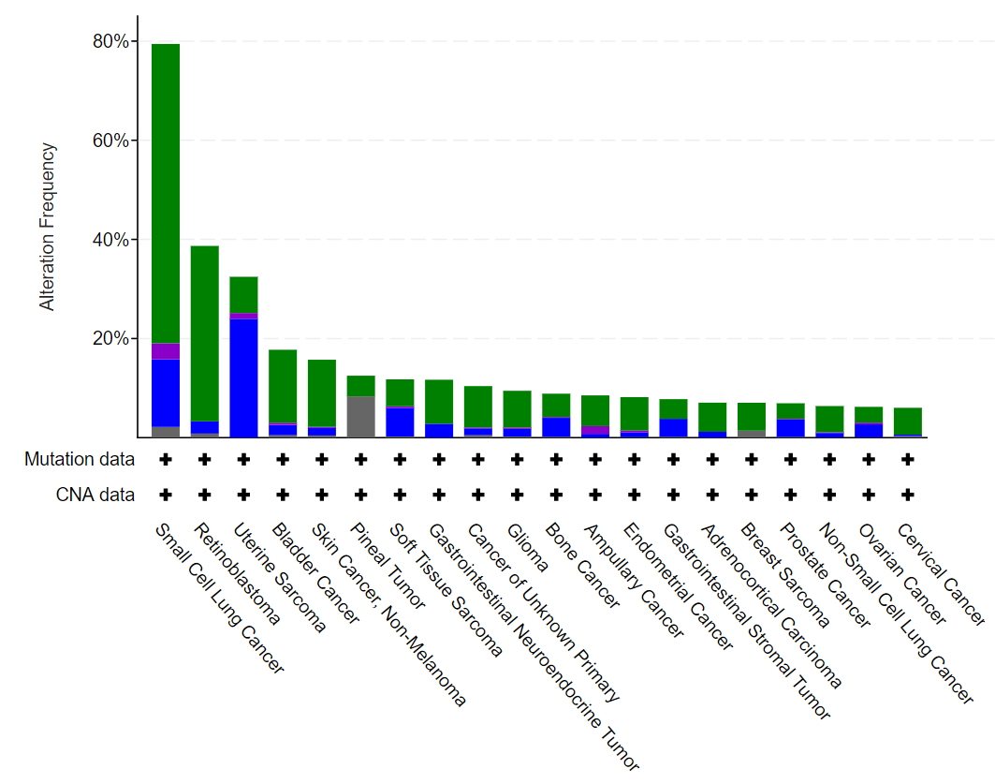
Cancer genes
Adenosquamous transformation
RB1
RB1 genomic alterations
Notes:
A. In G1 phase, the active hypophosphorylated form of RB1 binds to E2F transcription factors to repress the expression of cell cycle and apoptotic genes. In S phase, RB1 is inactivated by phosphorylation (P) and releases most E2Fs to induce transcription of cell cycle genes. A fraction of RB1-E2F1 complexes persist at the promoters of apoptotic genes, thus repressing their expression. B. In cancer, RB1 can be inactivated by either mutations or hyperphosphorylation. RB1 loss leads to de-repression of both cell cycle and apoptotic genes, whereas hyperphosphorylation causes de-repression only of cell cycle genes. Thus, in cells lacking RB1, tumorigenesis can occur only if survival pathways protect cells from RB1-loss induced apoptosis by limiting E2F1 proapoptotic activity or if a second alteration, such as the abrogation of the p53 proapoptotic pathway, occurs (18) (PDF) RB1 dual role in proliferation and apoptosis: Cell fate control and implications for cancer therapy. Available from: https://www.researchgate.net/publication/279986806_RB1_dual_role_in_proliferation_and_apoptosis_Cell_fate_control_and_implications_for_cancer_therapy [accessed Jan 29 2021].

Slide 20
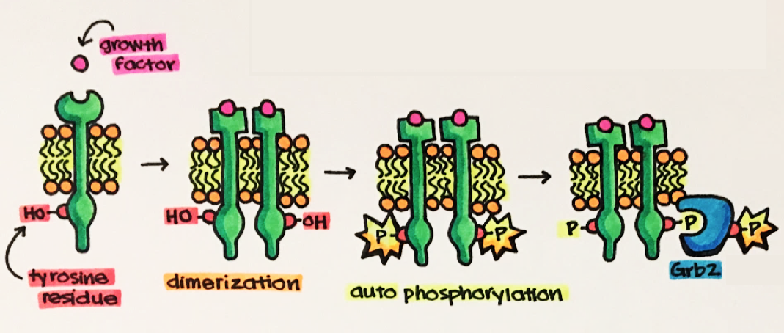
Cancer genes
Adenosquamous transformation
Receptor tyrosine kinases (RTKs)
RTK activation
Adaptor proteins
Signaling cascade
Activation/deactivation of TFs
Transcriptomic changes
https://www.ncbi.nlm.nih.gov/books/NBK26822/
Adapted from Palmerini et al., Exp Rev of Anti-ineffective Ther 2014)

Slide 21
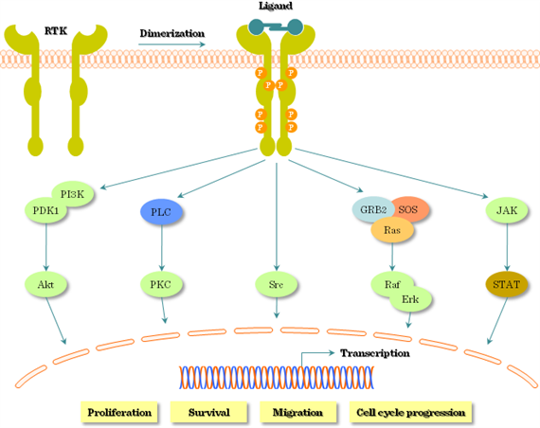
Cancer genes
Adenosquamous transformation
Receptor tyrosine kinases (RTKs): Pathways activated by RTKs
RAS/MAPK pathway
Some signaling pathways activated by RTKs
Cell growth, cell cycle regulation
Cell migration
Angiogenesis
PI3K/AKT pathway
RAS/MAPK pathway
Cell proliferation
Apoptosis
Metabolism
Angiogenesis
JAK/STAT pathway
JAK/STAT pathway
PI3K/AKT pathway
Cell proliferation
Apoptosis
Immune response / inflammation
Angiogenesis
Metastasis
Adapted from Palmerini et al., Exp Rev of Anti-ineffective Ther 2014)

Slide 22
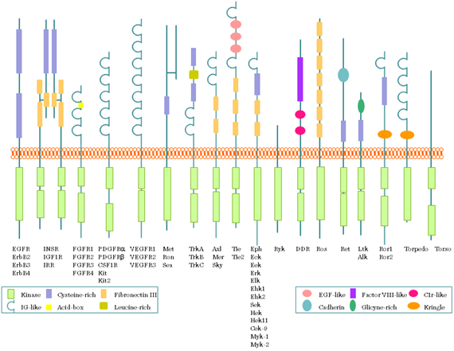
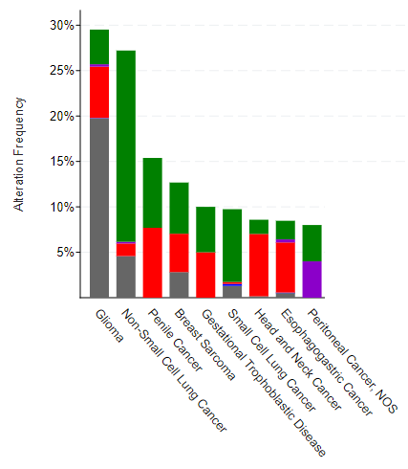
Cancer genes
Adenosquamous transformation
Receptor tyrosine kinases (RTKs): RTK families
FGFR
VEGFR
EGFR genomic alterations
EGFR
IGF1R
MET
A lot of RTKs, classified in families, with different functions and involvement in cancer
Domains
(Adapted from Critchley et al., Cells 2018)

Slide 23
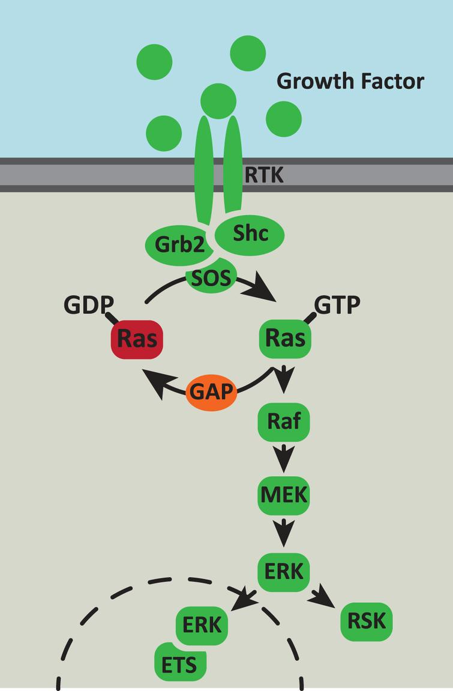
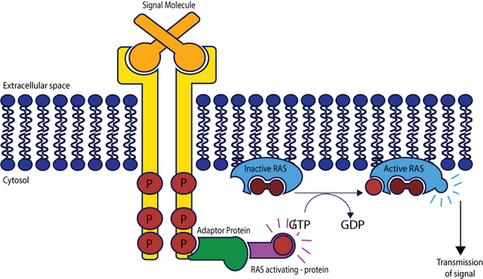
Cancer genes
Adenosquamous transformation
RAS (KRAS, NRAS, HRAS…)
Involved in…cellular proliferation, differentiation, and survival
RAS pathway
RAS activation
Nucleus
(Adapted from Addgene and Slack, Nutrition and healthy aging 2017)
Notes:
Mention that all pathways have many components that can be altered leading to pathway overactivation.

Slide 24
Take home messages
Adenosquamous transformation
1. Cancer is a disease with a strong genetic component. Molecular alterations leading to loss of function of tumor suppressors (e.g. TP53, RB1) or to overactivation of proto-oncogenes (e.g. RAS, RTKs) may facilitate the occurrence of cancer or induce it.
Notes:
A. In G1 phase, the active hypophosphorylated form of RB1 binds to E2F transcription factors to repress the expression of cell cycle and apoptotic genes. In S phase, RB1 is inactivated by phosphorylation (P) and releases most E2Fs to induce transcription of cell cycle genes. A fraction of RB1-E2F1 complexes persist at the promoters of apoptotic genes, thus repressing their expression. B. In cancer, RB1 can be inactivated by either mutations or hyperphosphorylation. RB1 loss leads to de-repression of both cell cycle and apoptotic genes, whereas hyperphosphorylation causes de-repression only of cell cycle genes. Thus, in cells lacking RB1, tumorigenesis can occur only if survival pathways protect cells from RB1-loss induced apoptosis by limiting E2F1 proapoptotic activity or if a second alteration, such as the abrogation of the p53 proapoptotic pathway, occurs (18) (PDF) RB1 dual role in proliferation and apoptosis: Cell fate control and implications for cancer therapy. Available from: https://www.researchgate.net/publication/279986806_RB1_dual_role_in_proliferation_and_apoptosis_Cell_fate_control_and_implications_for_cancer_therapy [accessed Jan 29 2021].

Slide 25
Molecular alterations in cancer

Slide 26
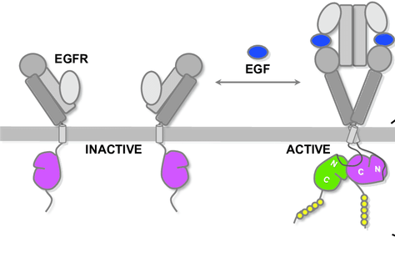
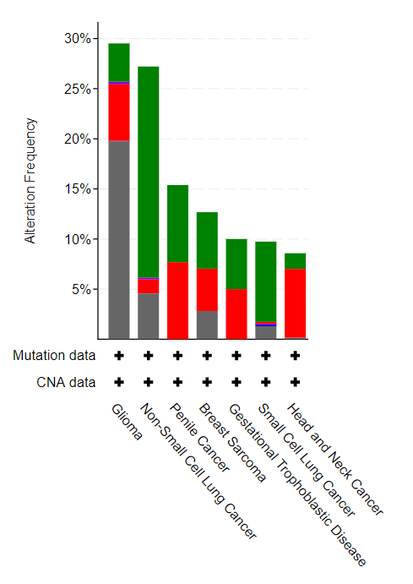
Genomic alterations
Adenosquamous transformation
- Mutations
Gene
Example:
Epidermal growth factor receptor (EGFR): Receptor tyrosine kinase whose activation promotes cell proliferation and other oncogenic features
KRAS
AKT
STATs
Cell proliferation, metastasis, …
Adapted from Zhan et al., Oncotarget 2016

Slide 27
Genomic alterations
Molecular alterations in cancer genes 101: Genomic alterations
- Amplifications
Gene
Gene
Gene
Example:
Epidermal growth factor receptor (EGFR): Receptor tyrosine kinase whose activation promotes cell proliferation and other oncogenic features
Amplification may result in increased expression, which induce EGFR receptor dimerization and constitutive activation.
KRAS
AKT
STATs
Cell proliferation, metastasis, …
Adapted from Zhan et al., Oncotarget 2016

Slide 28
Genomic alterations
Adenosquamous transformation
- Insertions and deletions
Gene 1
Gene 2
Insertion
Gene 1
Gene 2
Example:
Epidermal growth factor receptor (EGFR) deletions on exon 19, which is an “inhibitor domain” of the receptor.
Example:
Epidermal growth factor receptor (EGFR) insertions on exon 19 or 20, which lead to a 3D structure causing EGFR overactivation.
Deep deletion
Gene 1
Gene 2
EGFR
Example:
Retinoblastoma (RB1), negative regulator of cell cycle. Important tumor suppressor.
Local deletion
Adapted from Harrison et al., Seminars in Cancer Biology 2020

Slide 29
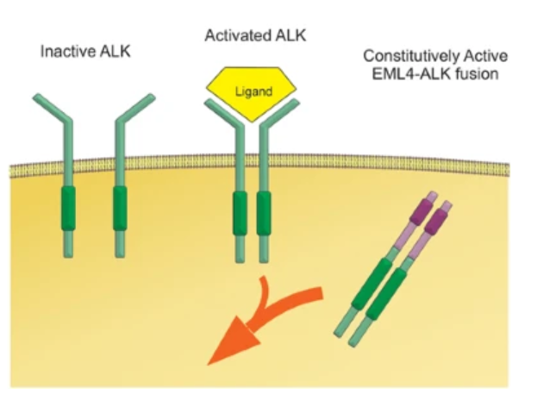
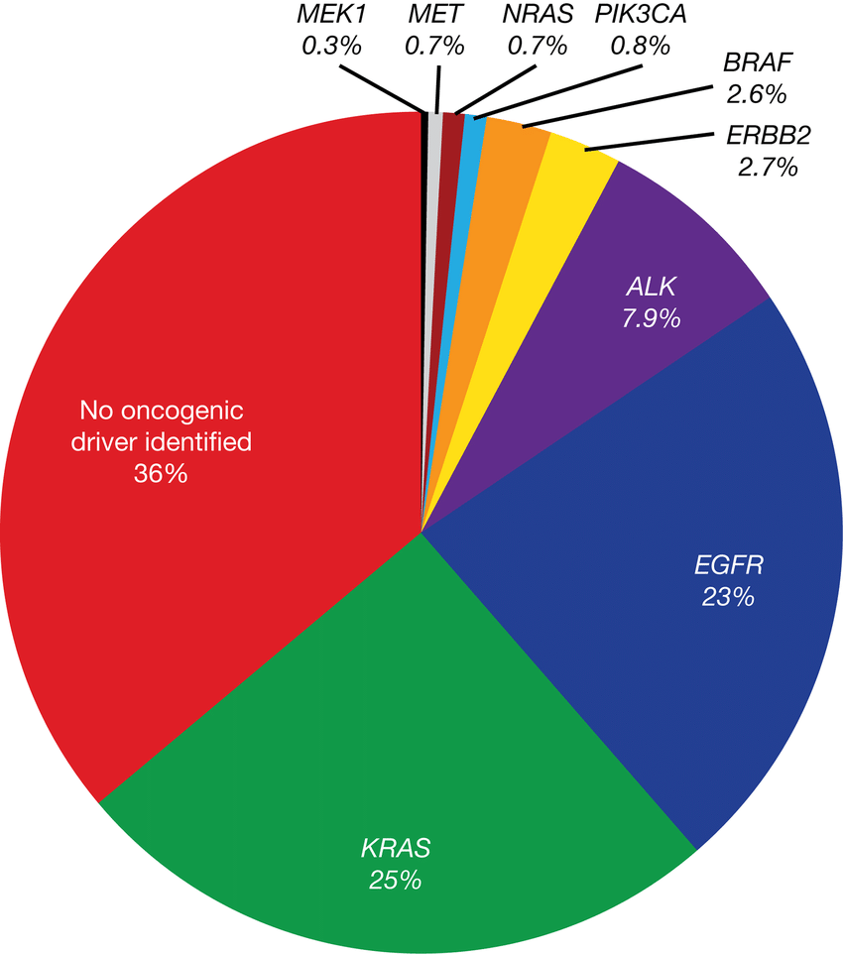
Genomic alterations
Adenosquamous transformation
Translocations/fusion proteins
Gene 1
Gene 2
Example:
Echinoderm microtubule-associated protein-like 4 (EML4) + Anaplastic lymphoma kinase (ALK) = EML4-ALK fusion
ALK is a receptor tyrosine kinase whose activation promotes cell proliferation and other oncogenic features
The EML4-ALK fusion results in a constitutively active ALK protein
KRAS
STATs
AKT
Adapted from Rosembaum et al., Modern Path 2018

Slide 30
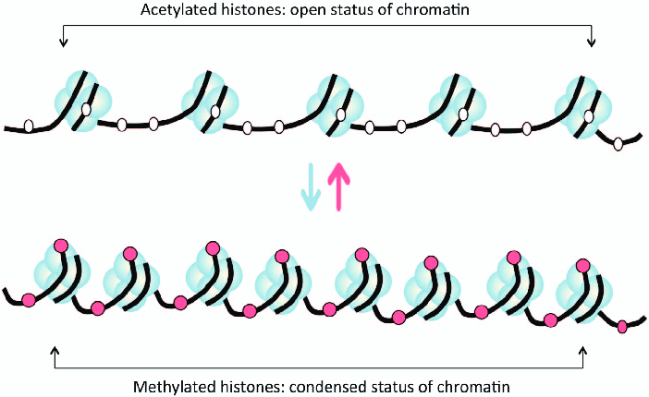
Alterations at the epigenetic/transcriptomic level
Gene 1 Expression
TF
Gene 1 Expression
TF
TF
Gene
TF
Open chromatin
(Transcription factor can access DNA and induce gene expression)
Gene
Condensed chromatin
(Transcription factor cannot access DNA)
TF
Adapted from Wu et al., Cell & Mol Immunology 2018)

Slide 31
Adenosquamous transformation
Interaction among different molecular alterations
Example 1:
mutation on a transcription factor (TF) leading to inefficient DNA binding capacity (and then gene expression induction)
Gene expression
TF
TFm
Gene
Example 2:
mutation on enzymes responsible to make the chromatin compact leading to open chromatin and increased expression of genes in those genomicloci
Condensed chromatin
TF
Open chromatin
Gene
Adapted from Wu et al., Cell & Mol Immunology 2018

Slide 32
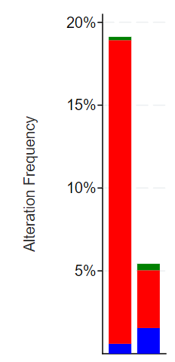
Adenosquamous transformation
Question for the class:
We have observed that a subset of patients with lung cancer harbor tumors with dramatic amplification of a receptor tyrosine kinase.
This receptor tyrosine kinase is a known proto-oncogene.
We have a drug that inhibits the function of that receptor tyrosine kinase and it is safe
Do you think the drug will be effective on these tumors?
Lung adenocarcinoma
Lung squamous carcinoma
Thinking time!

Slide 33
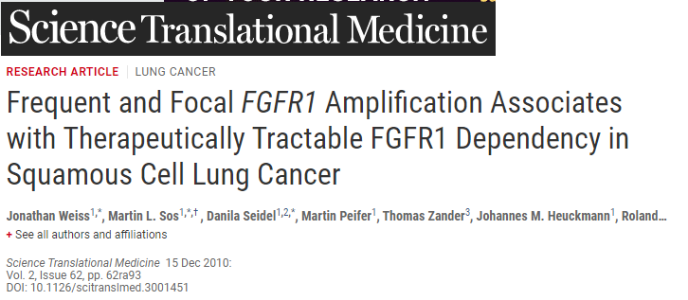
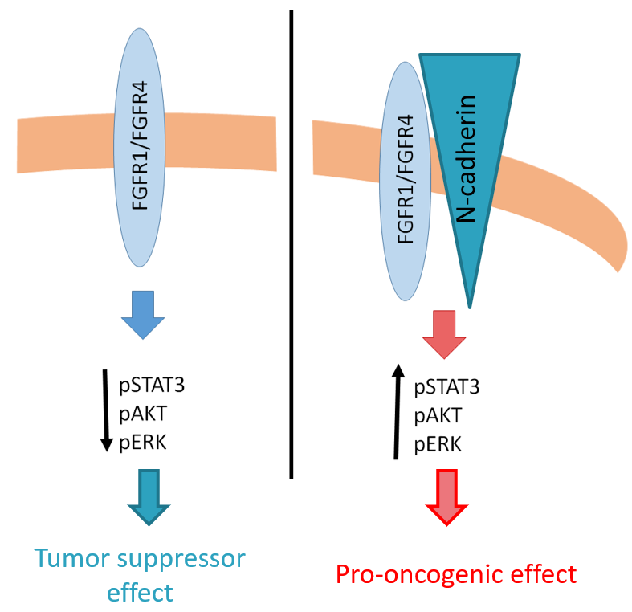
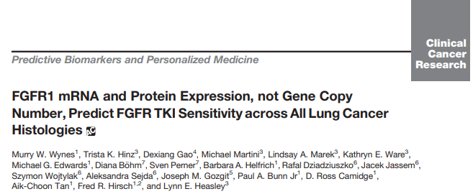
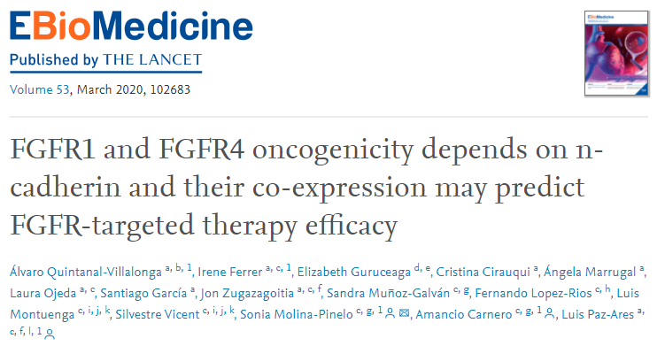
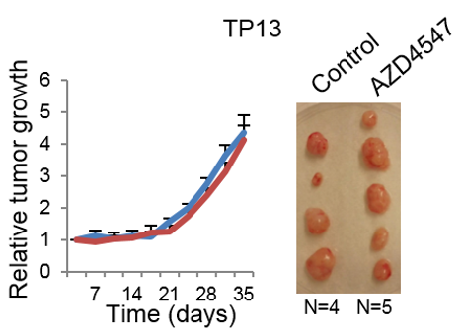
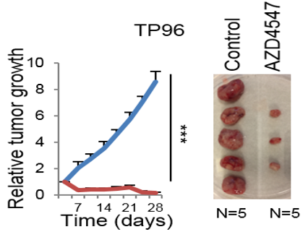

Slide 34
Question for the class:
We have one tumor with two mutations:
Activating mutation in the RTK EGFR
Activating mutation in KRAS
Mutated EGFR
Mutated KRAS
Do you think an EGFR inhibitor will be effective in this tumor?
Thinking time!
Notes:
Mention that, even if this situation is possible, it is relatively unlikely due to the overlap of pathways (as a hint for the question that comes later).

Slide 35
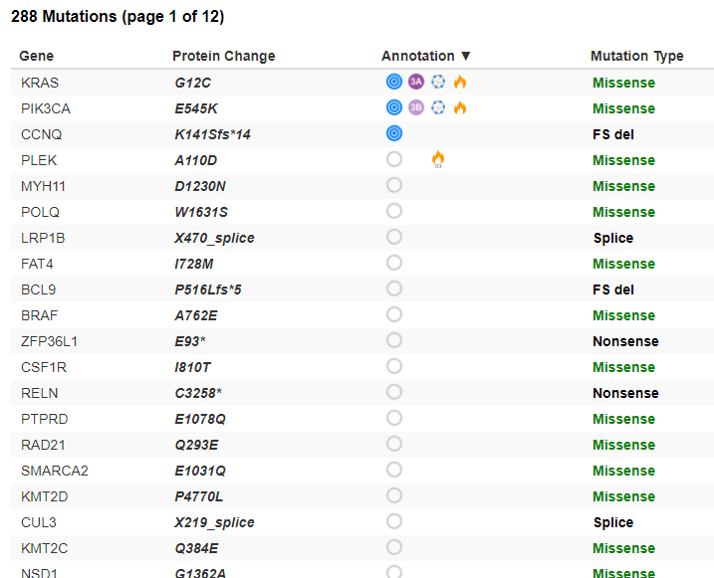
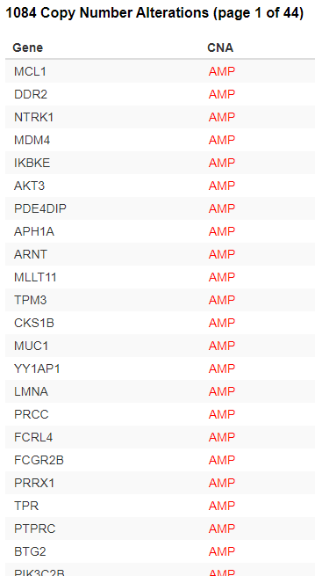
Driver versus passenger molecular alterations
A driver alteration is that causing an advantage in terms of growth or progression to cancer cells
Mutations
Copy number alterations
A passenger alteration is that not significantly provideing an advantage in terms of growth or progression to cancer cells
Why do you think this distinction might be important?
Thinking time!

Slide 36
Take home messages
Adenosquamous transformation
1. Cancer is a disease with a strong genetic component. Molecular alterations leading to loss of function of tumor suppressors (e.g. TP53, RB1) or to overactivation of proto-oncogenes (e.g. RAS, RTKs) may facilitate the occurrence of cancer or induce it.
2. Tumors usually exhibit a number of different molecular alterations (genomic, epigenomic, transcriptomic,…) in a variety of genes, but not all of them contribute significantly to the oncogenic phenotype. It is important to identify which are driving the oncogenic phenotype (drivers) and study the molecular biology behind it (mechanism).
Notes:
A. In G1 phase, the active hypophosphorylated form of RB1 binds to E2F transcription factors to repress the expression of cell cycle and apoptotic genes. In S phase, RB1 is inactivated by phosphorylation (P) and releases most E2Fs to induce transcription of cell cycle genes. A fraction of RB1-E2F1 complexes persist at the promoters of apoptotic genes, thus repressing their expression. B. In cancer, RB1 can be inactivated by either mutations or hyperphosphorylation. RB1 loss leads to de-repression of both cell cycle and apoptotic genes, whereas hyperphosphorylation causes de-repression only of cell cycle genes. Thus, in cells lacking RB1, tumorigenesis can occur only if survival pathways protect cells from RB1-loss induced apoptosis by limiting E2F1 proapoptotic activity or if a second alteration, such as the abrogation of the p53 proapoptotic pathway, occurs (18) (PDF) RB1 dual role in proliferation and apoptosis: Cell fate control and implications for cancer therapy. Available from: https://www.researchgate.net/publication/279986806_RB1_dual_role_in_proliferation_and_apoptosis_Cell_fate_control_and_implications_for_cancer_therapy [accessed Jan 29 2021].

Slide 37
Adenosquamous transformation
Molecular alterations in cancer genes 201: Interaction among different molecular alterations
Driver versus passenger molecular alterations
Example: Lung adenocarcinoma: occurrence of genomic alterations in KRAS, and the RTKs EGFR and ALK
Do you observe anything that calls your attention in the plot?
Thinking time!

Slide 38
Tumor heterogeneity, plasticity and evolution
Fittest clone
with a particular
genomic alteration
Intratumoral heterogeneity
Cell of origin
Tumor
Transdifferentiation
Clone permissive for plasticity
(epigenetic reprogramming)
Fully transdifferentiated tumor
Selective pressure
(Growth advantage, treatment, hypoxia…)

Slide 39
Techniques to identify and study cancer genes

Slide 40
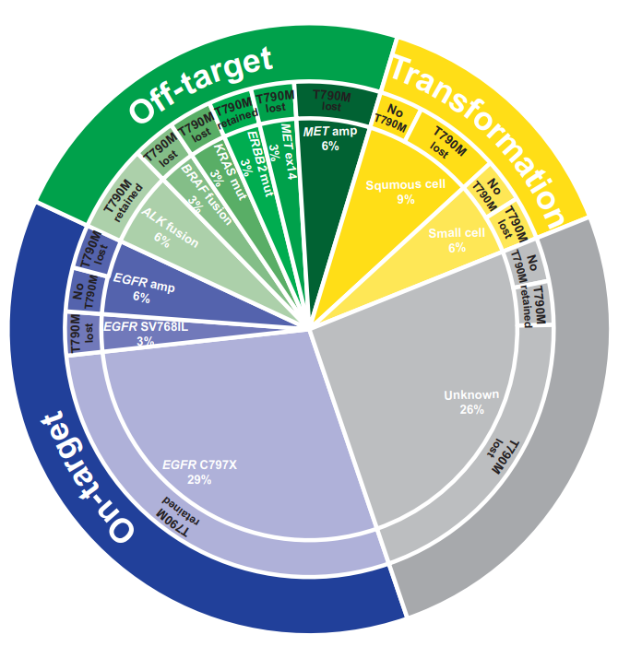
Techniques to identify and study cancer genes
Genomic analysis
Genomics
IMPACT, WES, WGS, Tapestri/DLP (single-cell genomics),…
EGFR
EGFR mutations occur in ~25% lung adenocarcinomas
Schoenfeld et al., CCR 2020

Slide 41
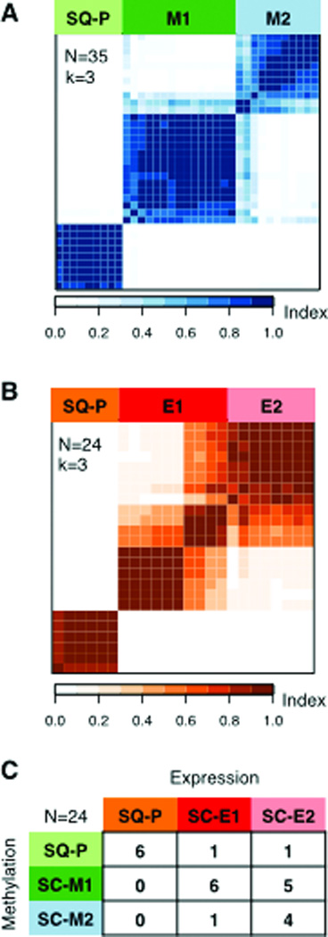
Techniques to identify and study cancer genes
Epigenomic analysis
Epigenomics
ATACseq, snATACseq (single-nucleus ATACseq), methylation sequencing,…
DNA methylation in small cell lung cancer defines distinct disease subtypes and correlates with high expression of EZH2
Poirier et al, Oncogene 2015

Slide 42
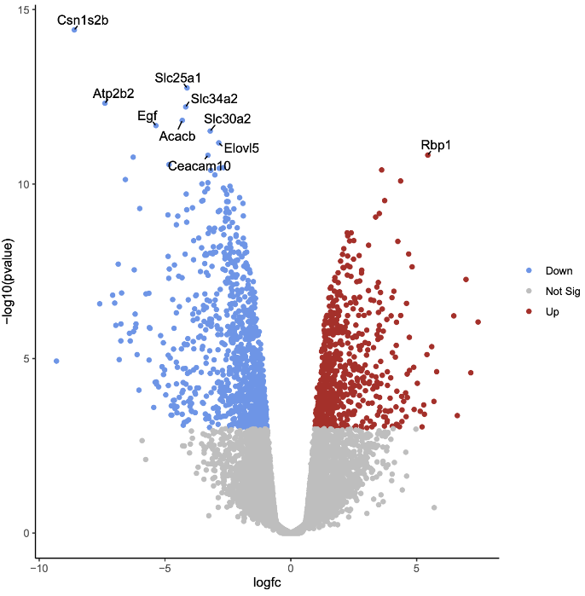
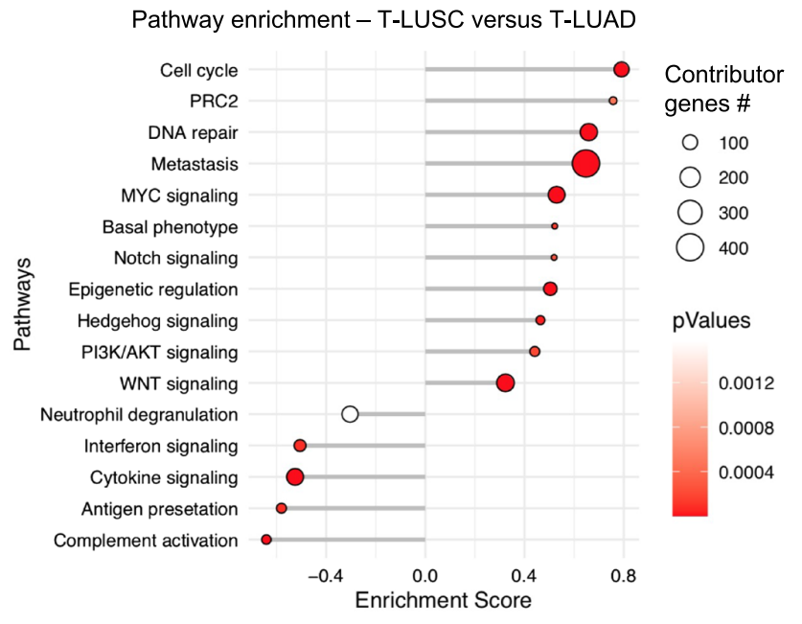
Techniques to identify and study cancer genes
Transcriptomic analysis
Transcriptomics and imaging
RNAseq, scRNAseq, spatial transcriptomics,…
mRNA expression
In small cell lung cancer, it has been described that the RNA expression of 4 transcription factors (ASCL1, NEUROD1, POU2F3 and YAP1) define the existence of 4 SCLC subtypes with different characteristics.
Rudin et al. Nat Rev Cancer 2019
Quintanal-Villalonga et al., J Hematol Oncol 2021

Slide 43
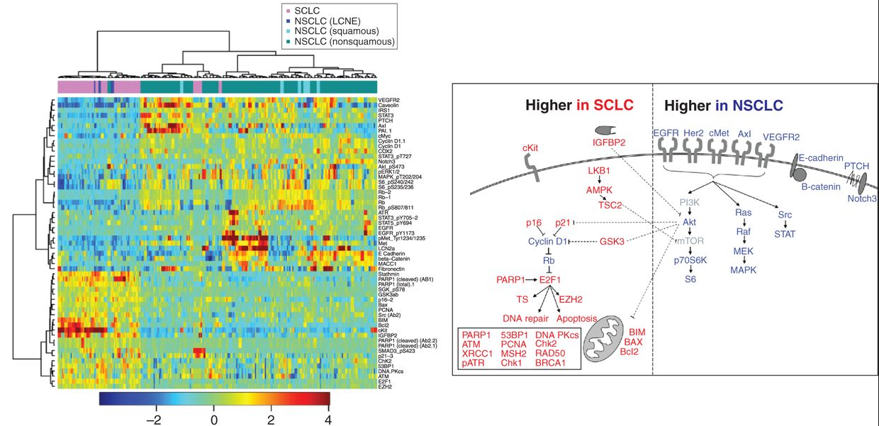
Techniques to identify and study cancer genes
Proteomic analysis
Proteomics
Label-free, TMT…
Byers et al., Cancer Discov 2012

Slide 44
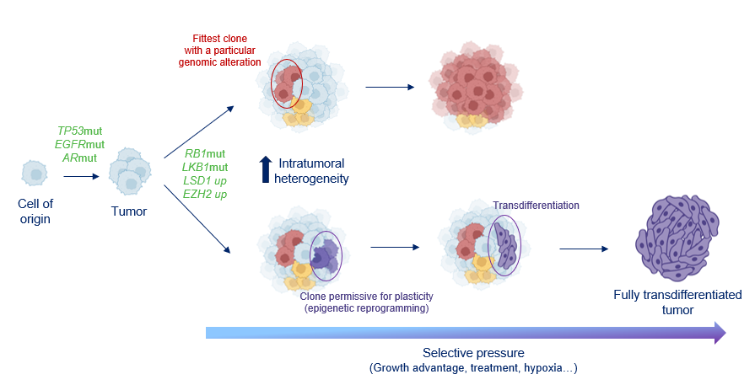
Intratumoral heterogeneity
Single-cell and spatial characterization

Slide 45
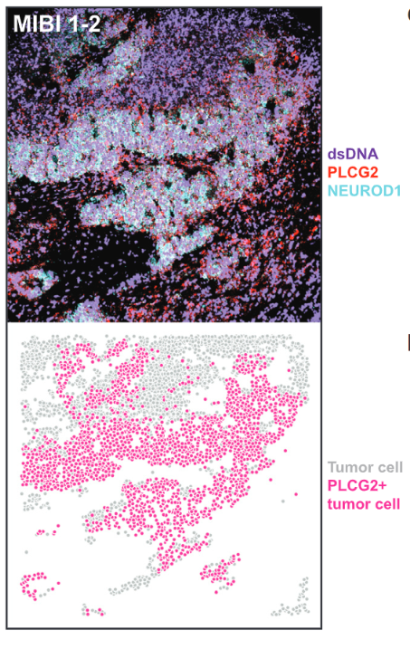
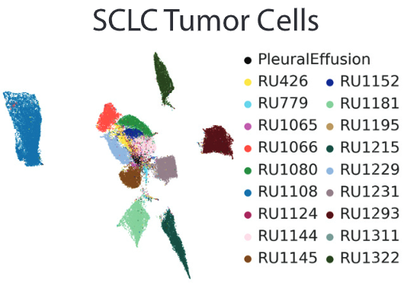
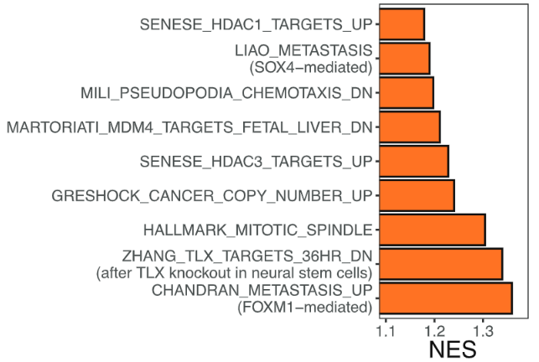
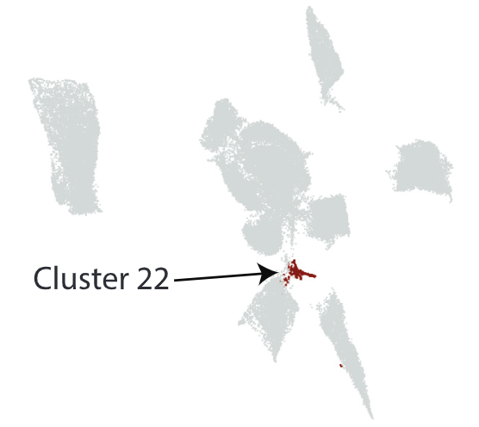
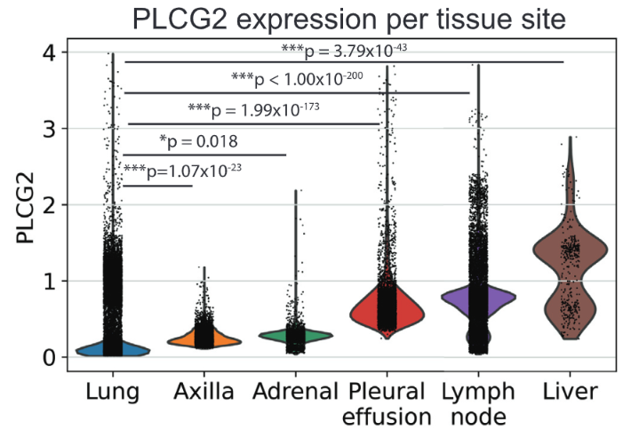
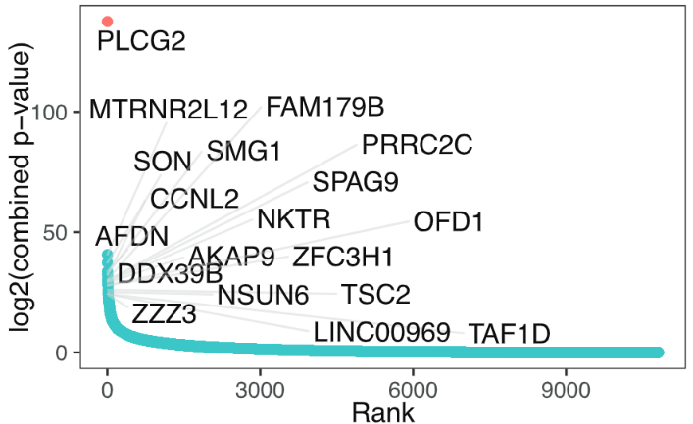
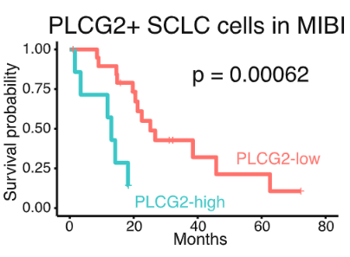
Intratumoral heterogeneity
Single-cell and spatial characterization: EXAMPLE
Chan*, Quintanal-Villalonga* et al., Cancer Cell 2021

Slide 46
Preclinical validation

Slide 47
Basics about preclinical validation
We have these results…now what?
Chan*, Quintanal-Villalonga* et al., Cancer Cell 2021

Slide 48
Basics about preclinical validation
Preclinical models
In vivo models
Patient-derived xenografts
(3D system)
Genetically engineered mouse models (GEMMs)
Cell line (2D system)
Organoids (3D system)
Cell line xenografts
(3D system)
In vitro models

Slide 49
Basics about preclinical validation
Some pros and cons
In vitro models
In vivo models
Cell lines
Very easy to work with, quicker and cheaper
Allow easy genetic manipulation
Very simplified model, 2D, no tumor microenvironment (TME)
Patient-derived xenografts (PDXs)
Reproduce very well the behavior of tumors (specially in treatment response)
As close as you can get to an actual human tumor
No TME
Expensive, time-consuming
Very difficult genetic manipulation
GEMMs
Can reproduce well the biology of human tumors
TME
Expensive and time-consuming
Not human!
Organoids
Relatively easy to work with, quick and cheap.
Allow relatively easy genetic manipulation
3D system that reproduces fairly well the behavior of tumors
Simplified model, no TME
Cell line xenografts
Allow easy genetic manipulation (cell line) and in vivo study (xenograft)
No TME
Derived from a very simplified model (cell line)

Slide 50
Basics about preclinical validation
Is PLCG2 a driver of metastasis?
PLCG2 mRNA
***
Assessment of metastatic potential in cell lines
***
Low
metastatic
Highly
metastatic
Metastatic potential
PLCG2 mRNA
***
Low
PLCG2
High
PLCG2
Metastatic gene signature

Slide 51
Basics about preclinical validation
Correlation versus causation
Overexpression
Model X
High PLCG2
Intermediate PLCG2
Low
PLCG2
No
PLCG2
Knockdown
Knockout
Isogenic models

Slide 52
Basics about preclinical validation
Dysregulating gene expression in cell lines
Overexpression
Downregulation
Knock out
Control
Control
Control
Gene of interest
(protein)
Loading control
Overexpression vectors,
CRISPRa
CRISPR/Cas9 KO
shRNA/
siRNA,
CRISPR-repression

Slide 53
Basics about preclinical validation
shRNA/siRNA technology for gene expression downregulation
siRNA/mRNa complex
mRNA
Degraded mRNA

Slide 54
Basics about pre-clinical validation
CRISPR-Cas9 technology for gene knock out
Addgene

Slide 55
Basics about pre-clinical validation
Other applications of CRISPR technology
Gene expression upregulation*
Gene 1
Gene expression downregulation*
Gene 2
Gene 1
Gene 2
DNA loci visualization*
Gene 1
Gene 2
Loss of function (KO)
(as in previous slide)
Gene 1
Gene 2
*For these applications, different Cas9 variants with no cutting function are used
Introducing mutations
Generation of fusion genes/proteins
Adapted from New England Biolabs webpage

Slide 56
Basics about preclinical validation
Genetic engineering of cells
Plasmid with element of interest
Element of interest to be expressed:
Gene
shRNA
Cas9
Plasmid needed to produce virus
Transfection
Transfection/
electroporation
Cells
DNA Plasmid
Viruses
Transduction (infection)
Other elements:
- Constitutive promoter
Inducible promoter
Genetic elements to generate virus
Selection marker:
Gene for a fluorescent protein
Gene for antibiotic resistance

Slide 57
Basics about preclinical validation
Basic techniques to identify and study cancer genes
Western blots to check signaling pathway activation
In vitro drug sensitivity
+ Growth factor
Condition 1
Control
Condition 2
Active downstream effector
Active RTK
Loading control

Slide 58
Basics about preclinical validation
Basic techniques to identify and study cancer genes in vitro
Migration and invasion
Proliferation
Wound healing
Condition 1
Condition 2
Condition 2
Condition 1
Soft agar
Condition 1
Condition 2

Slide 59
Basics about preclinical validation
Basic techniques to identify and study cancer genes in vivo
Intracardiac injections (xenografts)
Tumor growth (cell line xenografts)
Condition 2
Condition 1
PDX treatments

Slide 60
Basics about preclinical validation
Is PLCG2 a driver of metastasis?
PLCG2 mRNA
***
Assessment of metastatic potential in cell lines
***
Low
metastatic
Highly
metastatic
Metastatic potential
PLCG2 mRNA
***
Low
PLCG2
High
PLCG2
Metastatic gene signature

Slide 61
Basics about preclinical validation
Is PLCG2 a driver of metastasis?

Slide 62
Basics about preclinical validation
Example of application:
FGFR1 Cooperates with EGFR in Lung Cancer Oncogenesis, and Their Combined Inhibition Shows Improved Efficacy
FGFR1
Control
FGFR1 overexpression in EGFR-mutant cell lines increases EGFR activation (=phosphorylation)
FGFR1 overexpression in EGFR-mutant cell lines increases tumor growth in vivo
FGFR1 overexpression in EGFR-mutant cell lines increases proliferation in vitro
EGFR inhibitor resistance
Analysis of clinical data shows that FGFR1 overexpression correlates with worse response to EGFR inhibitors
Combination of EGFR inhibitor (erlotinib) and FGFR inhibitor (AZD4547) is very effective in delaying tumor growth in PDXs
FGFR1 overexpression in EGFR-mutant cell lines increases resistance to EGFR inhibition

Slide 63
Thanks for your attention! Any questions?

