Slide 1
HOPP SEP Lecture “Liquid Tumors”
Omar Abdel-Wahab, MD
HOPP & Leukemia Service,
Director, MSK Center for Hematologic Malignancies

Slide 2
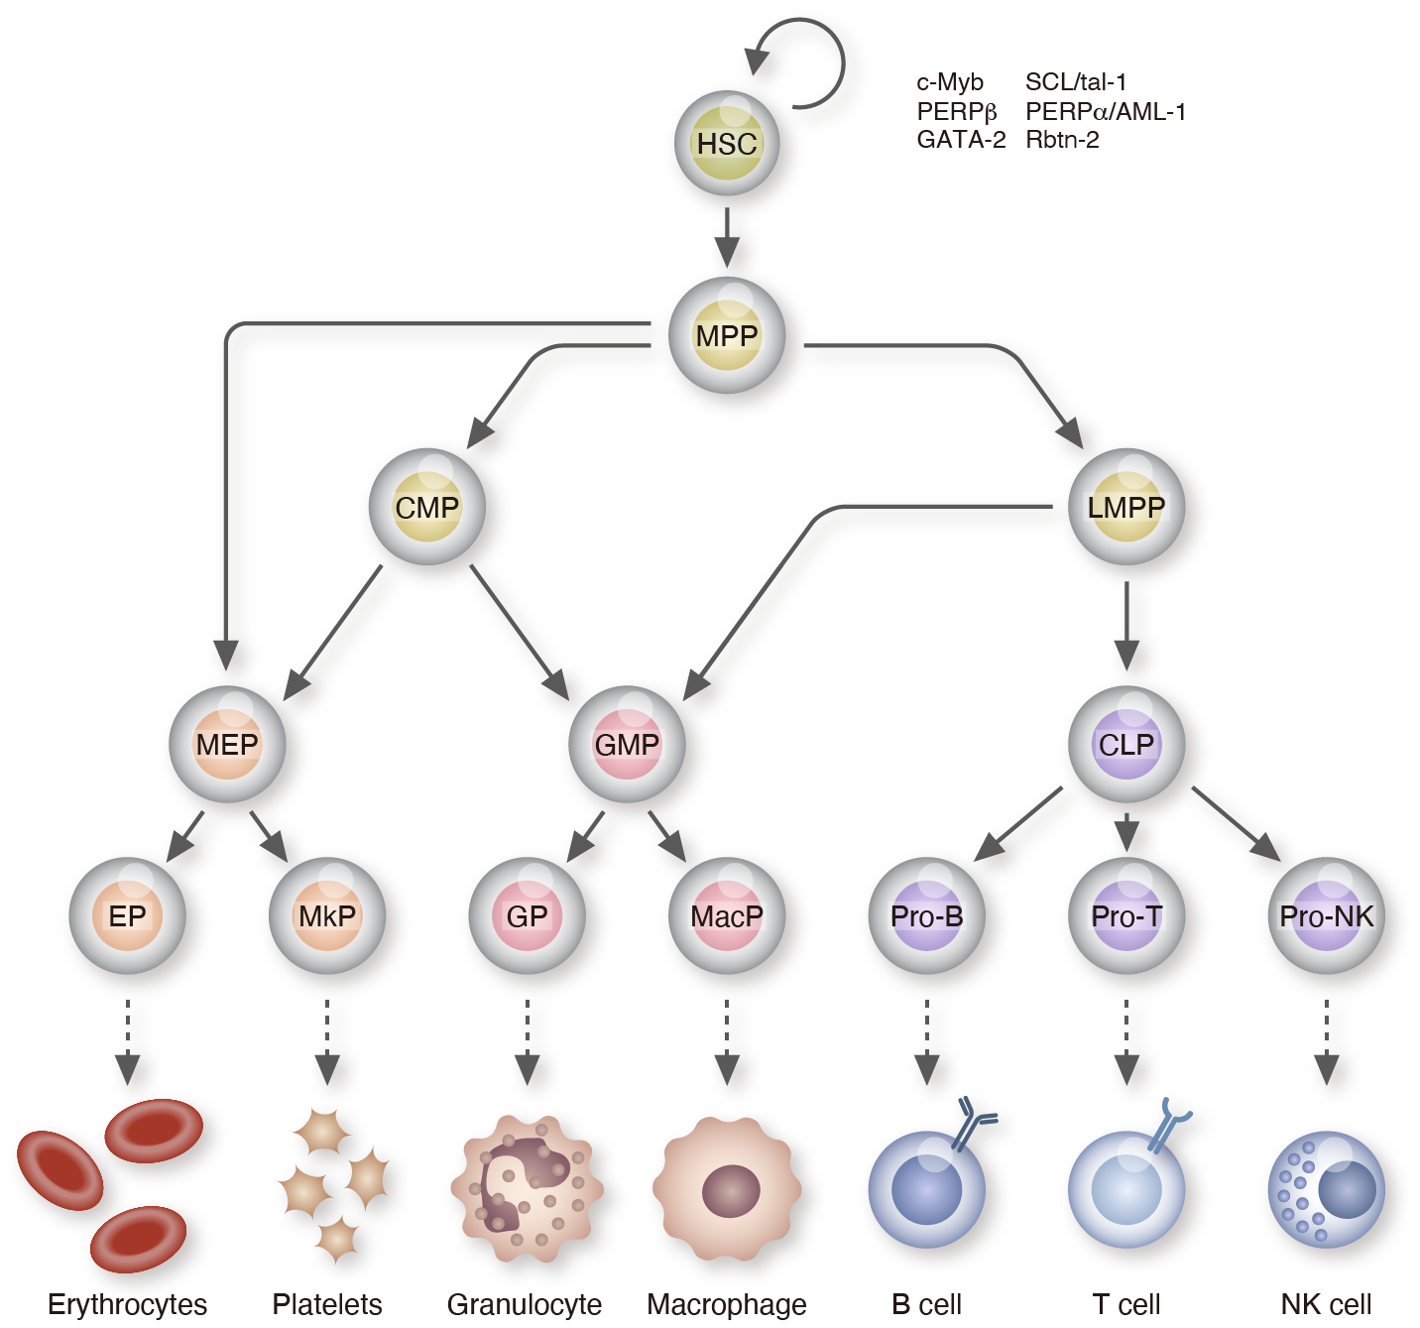
Hematopoiesis

Slide 3
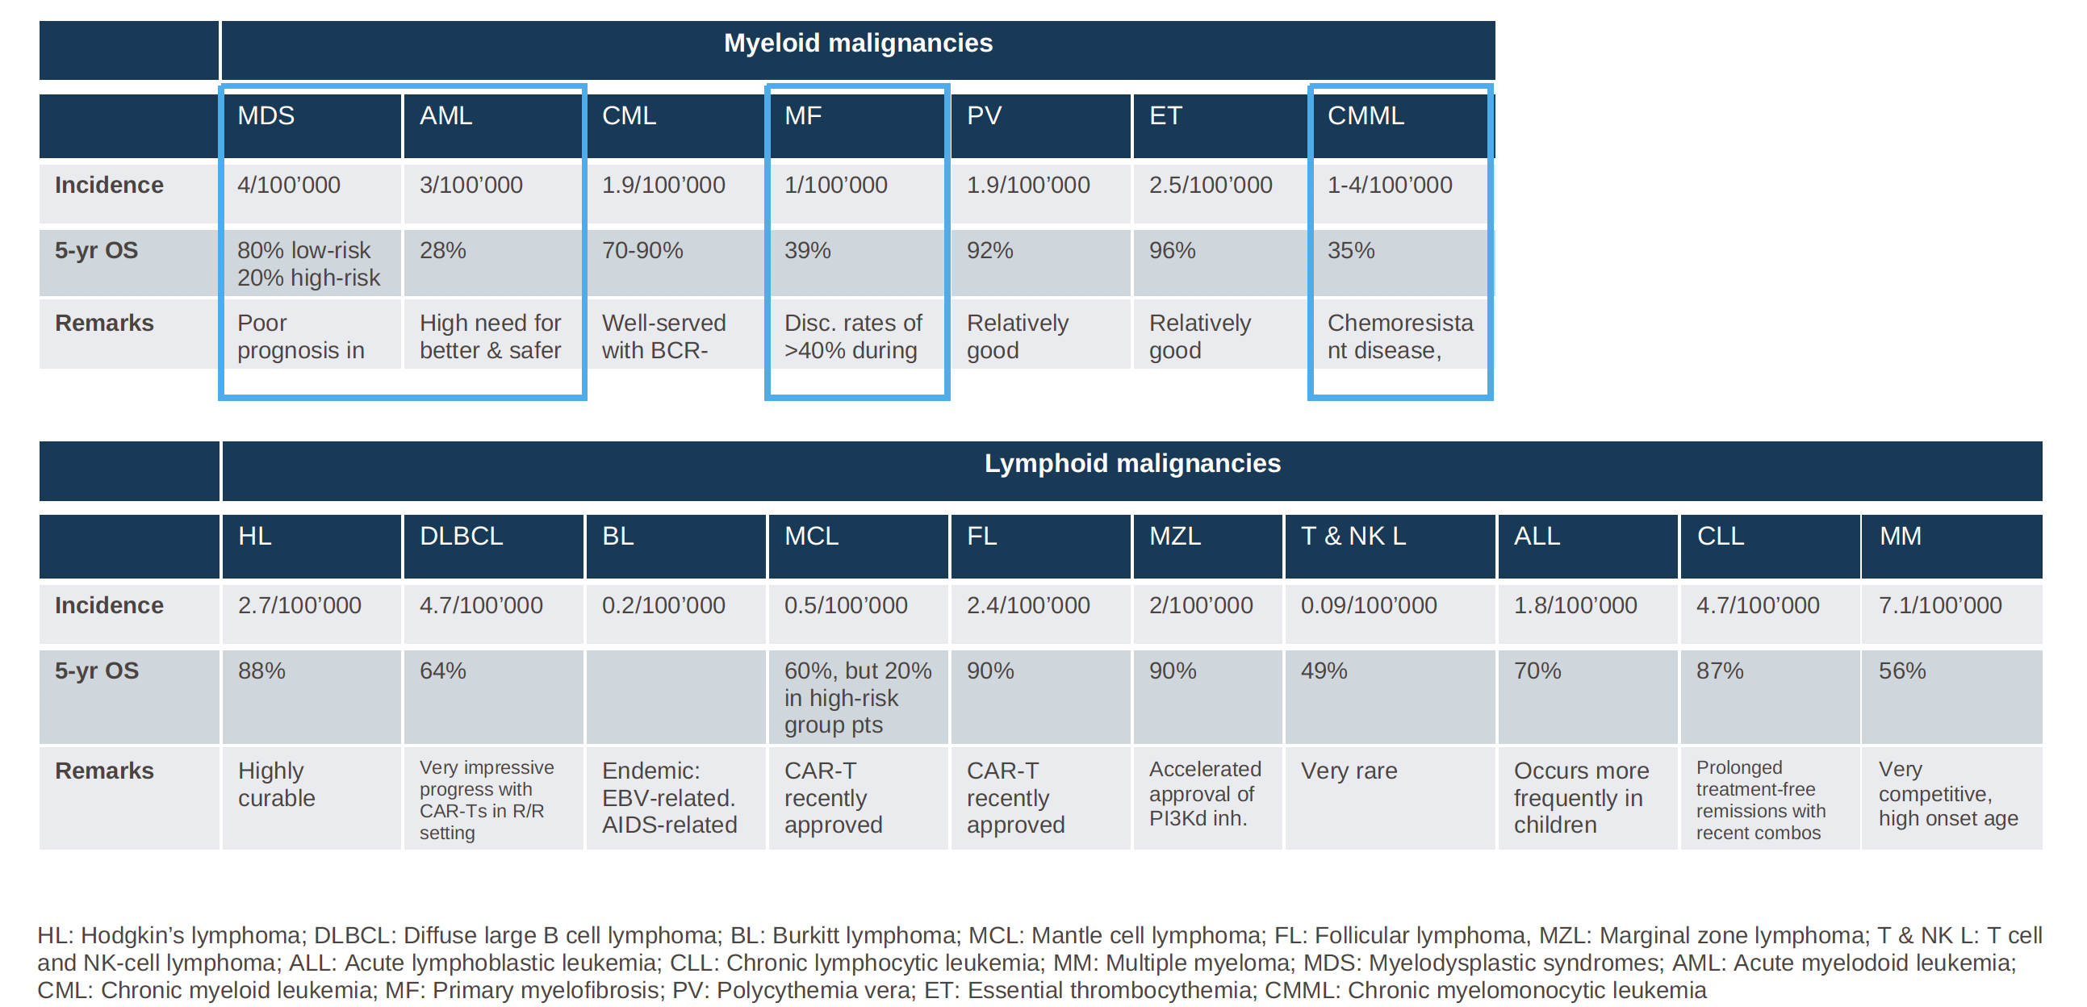
The Main Hematologic Malignancies

Slide 4
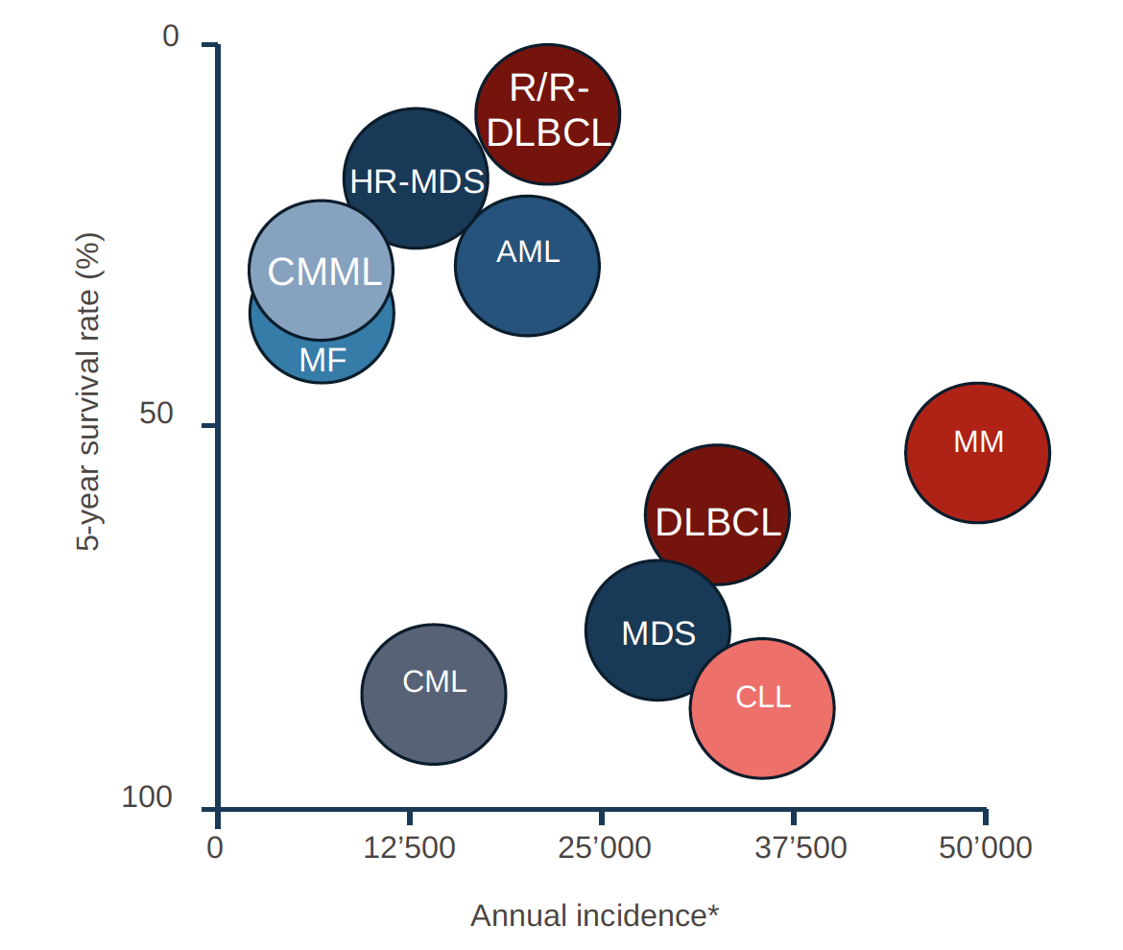
The Main Hematologic Malignancies

Slide 5
Comparison of Leukemias by Survival Rate,
Age of Onset & Incidence
* Bubble size proportionate to new incidence

Slide 6
Myeloid
Leukemias
Lymphoid
Leukemias
MPN MDS/MPN MDS AML
overlap
Acute Chronic
CLL, HCL
B-ALL
T-ALL
Ph+ B-ALL
Ph- B-ALL

Slide 7
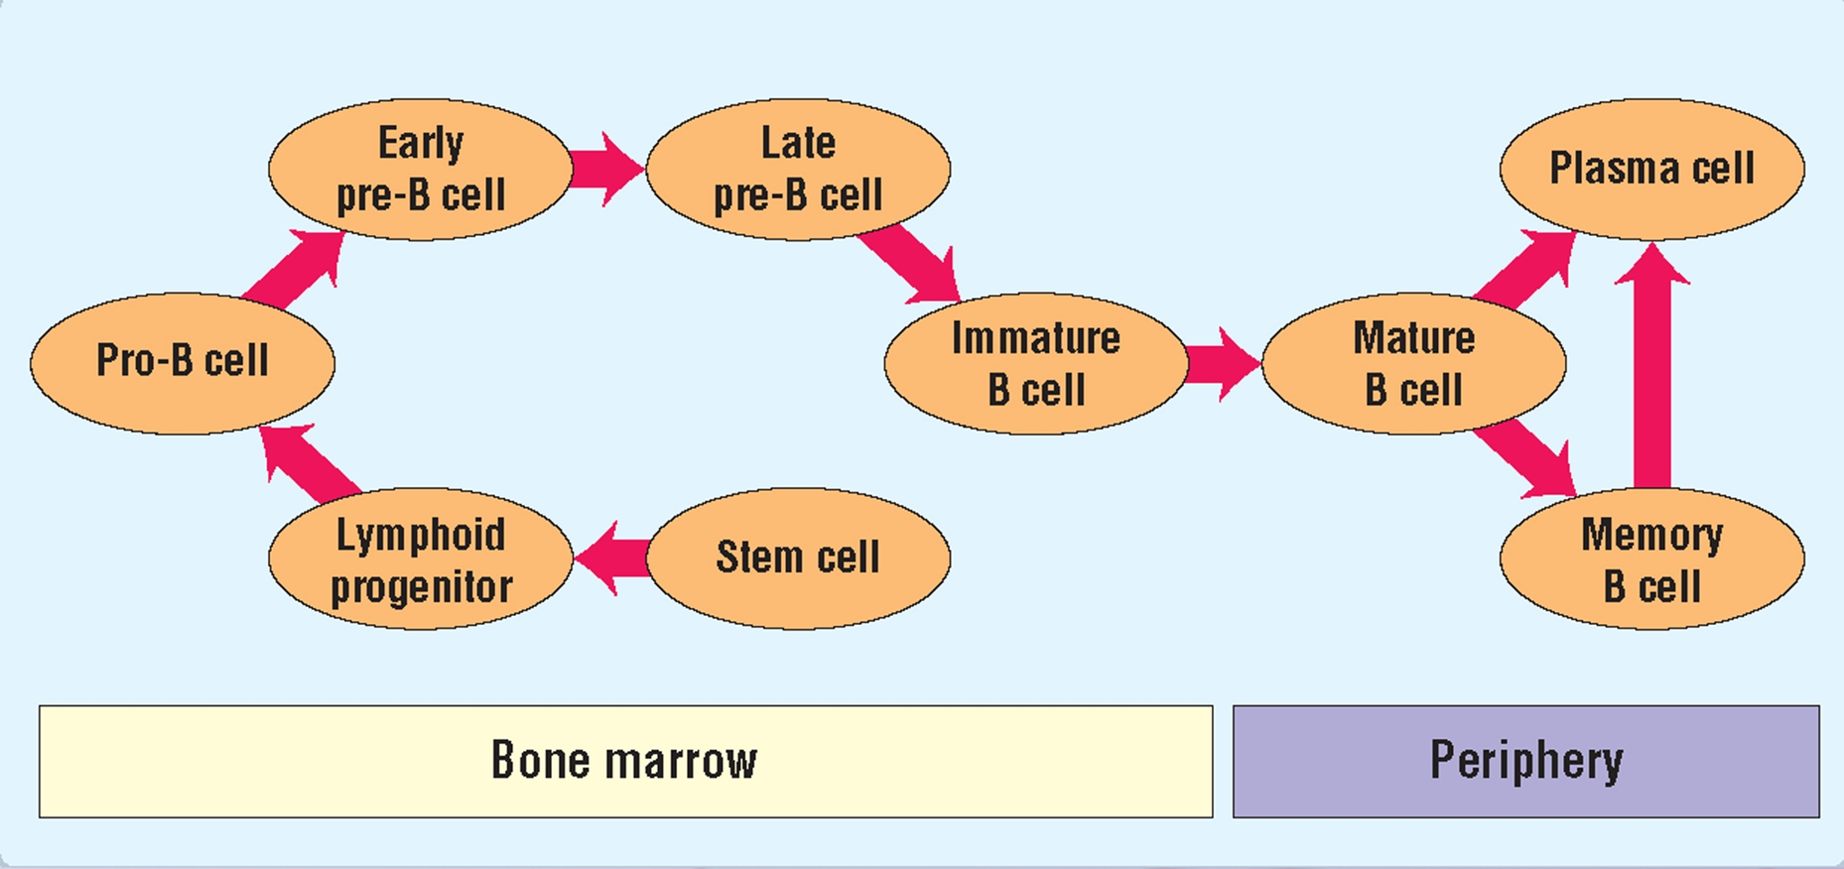
B-ALL and T-ALL
Thymus

Slide 8
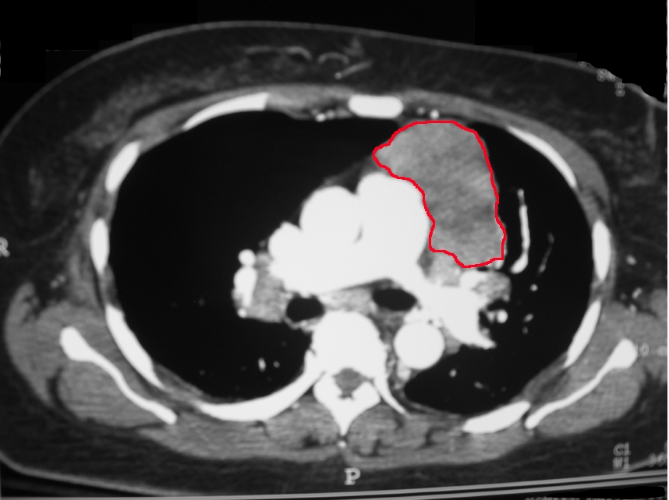
Anterior Mediastinal Mass: 4 T’s
Thymoma
Teratoma
Thyroid CA
Terrible Lymphoma
(T-ALL, Thomas Hodgkin
Lymphoma)

Slide 9
Diagnosis B-ALL vs T-ALL
-> 20% Blasts in any compartment (BM or PBLD) and/or extramedullary
accumulation of blasts.
-Flow cytometry essential for diagnosis: B/T-ALL is +TdT and –MPO
(whereas AML is +MPO and –TdT).
B-ALL
T-ALL
+CD19, CD20, CD22, CD79a
And – CD3 (pan T-cell marker)
surface CD3
CD7, CD2, CD5, CD1a, CD4, CD8
CD10 (“CALLA”) seen in B or T-ALL but not in AML

Slide 10
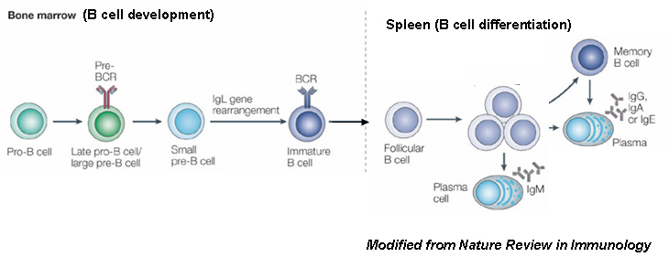
B-ALL Subtypes
Early precursor B (pro B-ALL): CD19, CD79, cytoplasmic CD22
Common ALL: CD10+
Late pre-B ALL: CD20+, cytoplasmic mu heavy chain

Slide 11
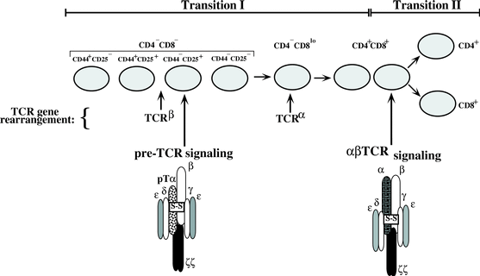
T-ALL Subtypes
Early or pro-T: CD2, CD7, CD38, cytoplasmic CD3
Common thymocyte: CD4/CD8 double-positive
Late thymocyte: CD4 or CD8 single positive

Slide 12
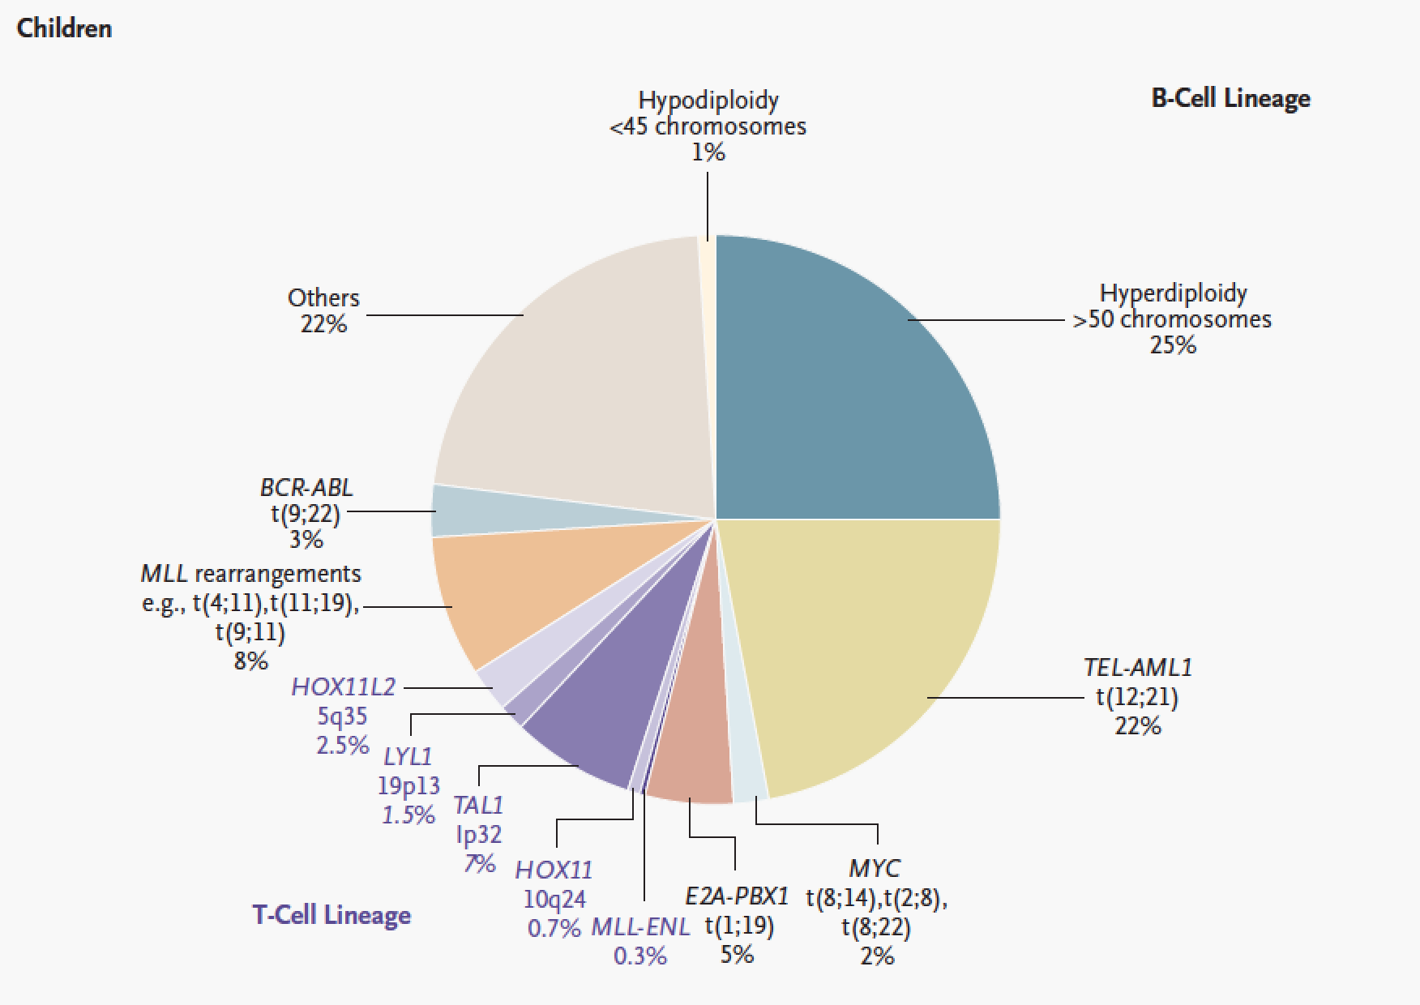
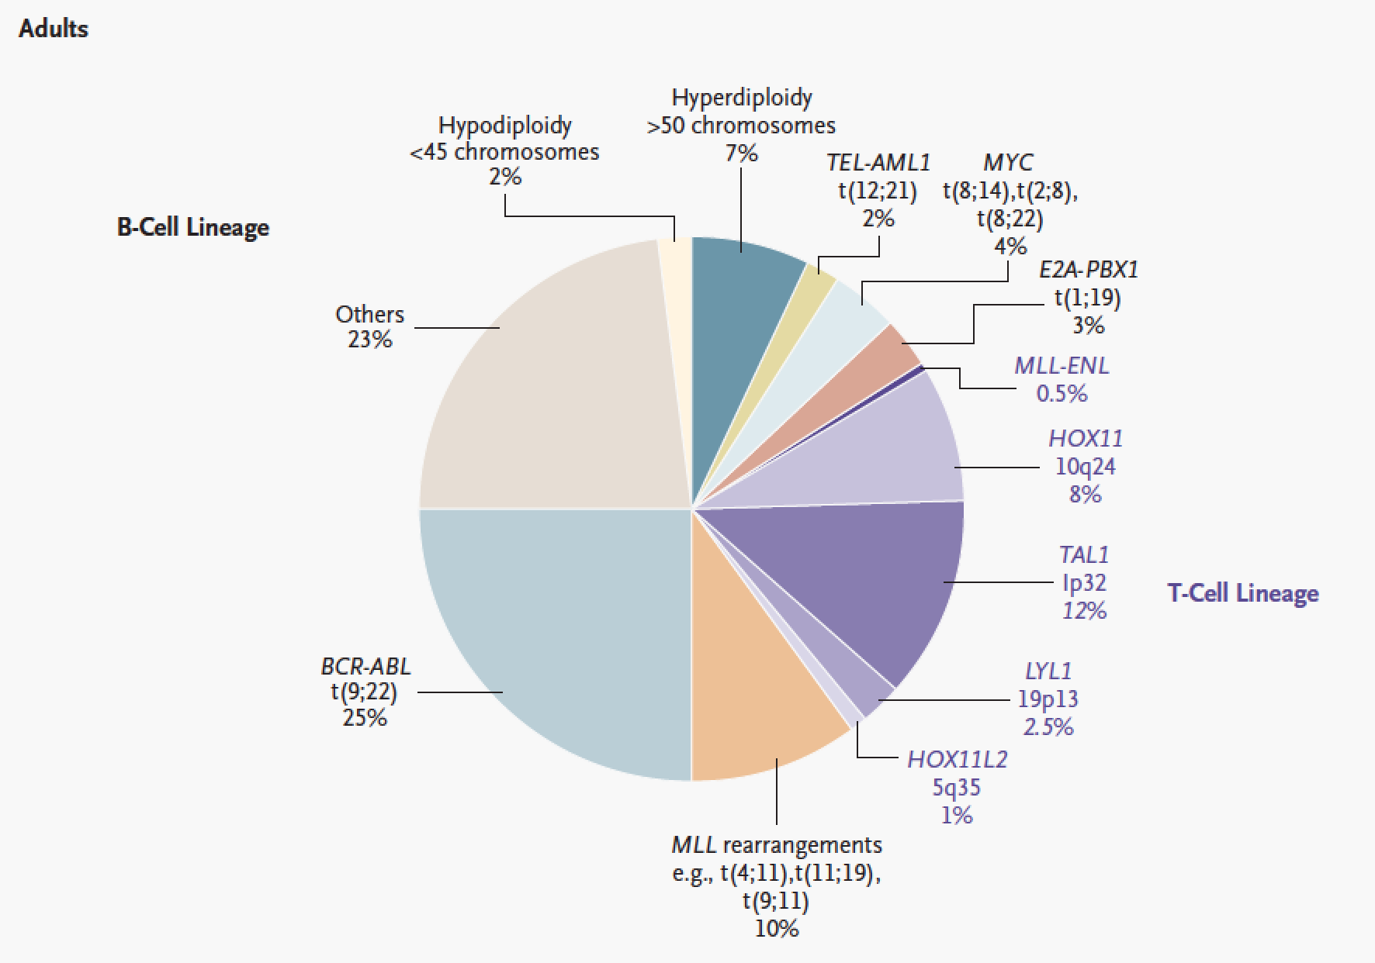
Cytogenetic Alterations in ALL
T(9;22) = BCR-ABL = Philadelphia Chromosome = BAD PX
Hyperdiploidy (> 50 chromosomes) = GOOD PX
TEL-AML1 (t12;21) = GOOD PX; often co-occurs with hyperdiploidy
HYPOdiploidy (<45 chromosomes) = BAD PX
MLL translocations (11q23) = BAD PX

Slide 13
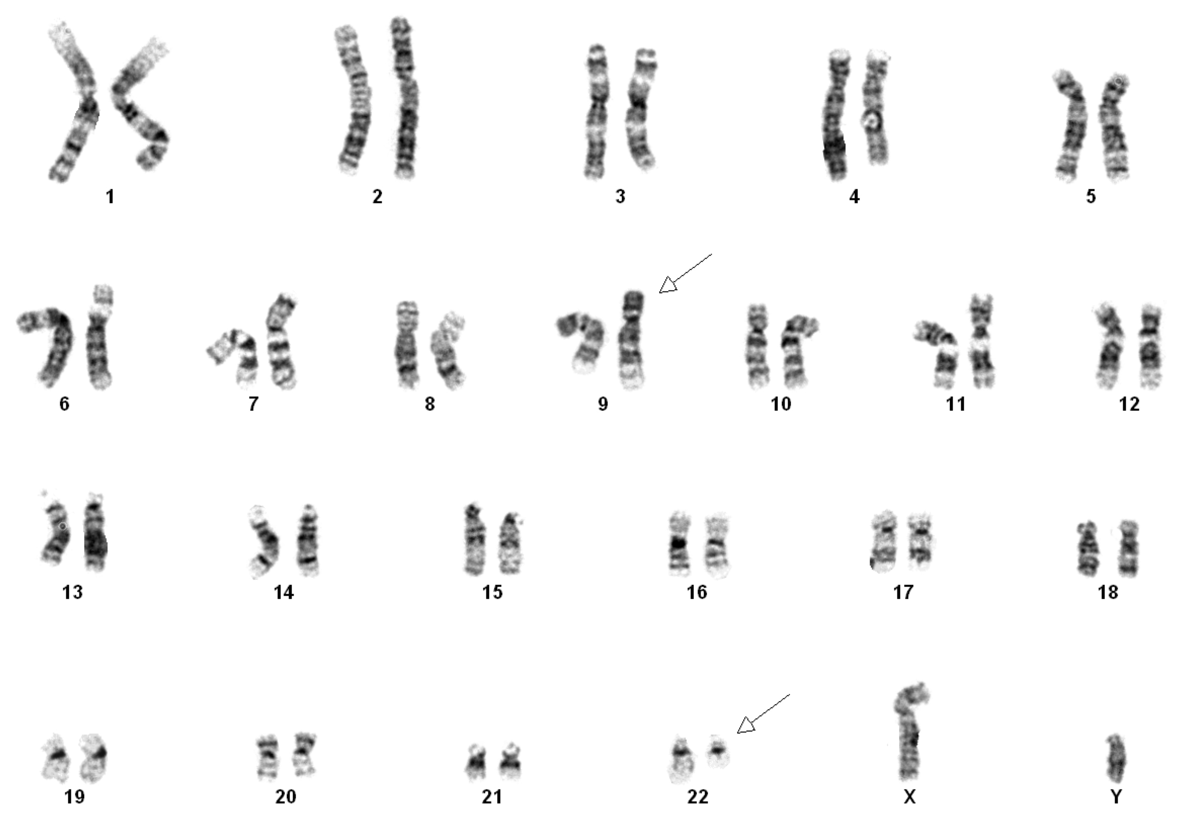
Cytogenetics vs FISH t(9;22) on cytogenetics

Slide 14
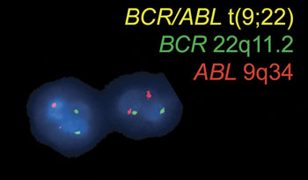
Cytogenetics vs FISH t(9;22) FISH

Slide 15
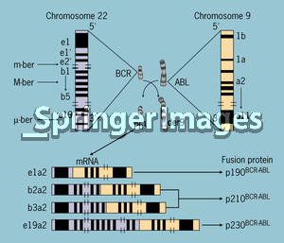
BCR-ABL translocations
p190: only seen in ALL
p210: CML and ALL
p230: rare, only seen in CML

Slide 16
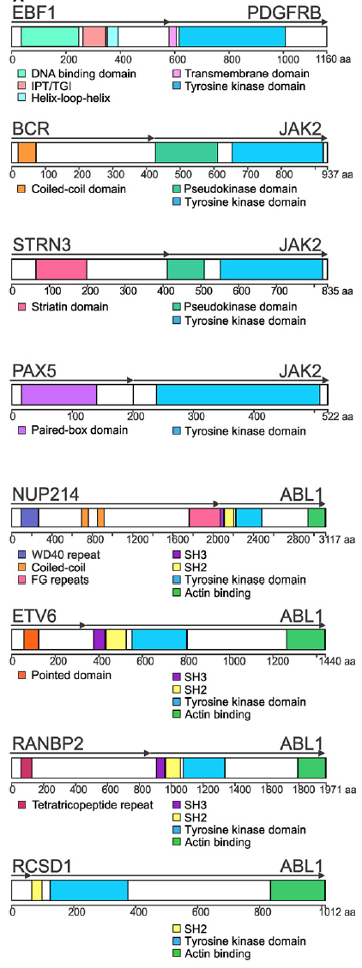
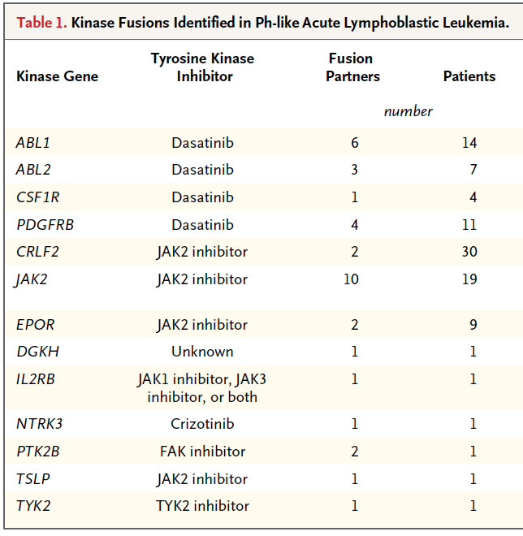
“BCR-ABL Like ALL” harbor frequent kinase fusions and mutations

Slide 17
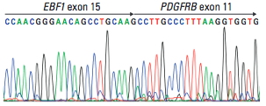
ALL Case
Clinical Presentation: 10-year-old M p/w 3-week low-grade fever and fatigue. Pancytopenic and BMA revealed 89% lymphoblasts. FISH revealed no recurrent ALL fusions but karyotype was complex.
Initial Therapies: He was treated with IT cytarabine, vincristine, daunorubicin, PEG-asparaginase, and oral prednisone. Initial cytogenetic and molecular analyses for recurring translocations in ALL were negative.
Disease Course:
Poor response to conventional chemotherapy through day 29 of induction.
Targeted RNA-seq analysis identified an
EBF1-PDGFRβ fusion.
Imatinib at a dose of 260 mg/m² per
day was started.

Slide 18
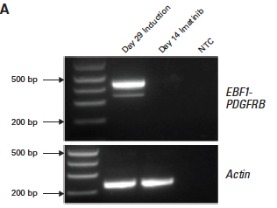
ALL Case (Cont’d)
Diagnosis
On Imatinib

Slide 19
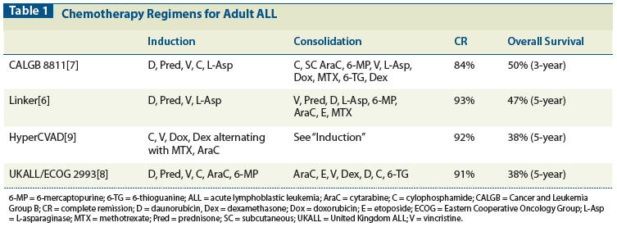
Initial therapy of T or B-ALL
Ph-negative B-ALL Or T-ALL
COMBINATION CHEMOTHERAPY + PPX IT CHEMOTHERAPY
A large # of complex regimens have been developed
None have been tested against another prospectively
Entry into clinical trial always preferable option
Vincristine, Corticosteroids, Anthracycline, and IT chemo
Are present in nearly all protocols
EXAMPLES:
ECOG E2993 Protocol
HYPER-CVAD
CALGB 8811 or 9111
Etc.
Achievement of CR with induction in ALL is good: 70-90%
But death occurs due to high-risk of relapse.
Achieving CR in relapsed/refractory ALL is less likely than
In initial therapy.
INDUCTION
Achieve morphologic remission
POST REMISSION THERAPY
Eliminate minimal residual disease
CONSOLIDATION + MAINTENANCE CHEMO
OR
ALLO SCT

Slide 20
Prognostication in ALL
WBC at diagnosis
>30,000 B-ALL
>100,000 T-ALL
BCR-ABL +
T(4;11)
Pro-B cell immunophenotype: CD19, CD79a, CD22, but not CD10
Age >60

Slide 21
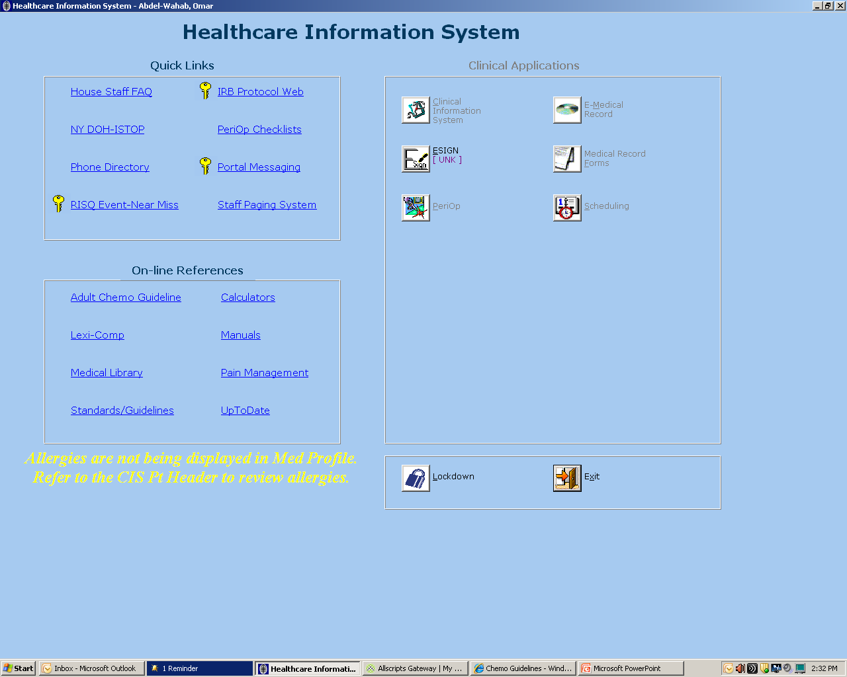
Finding chemo regimen details at MSKCC

Slide 22
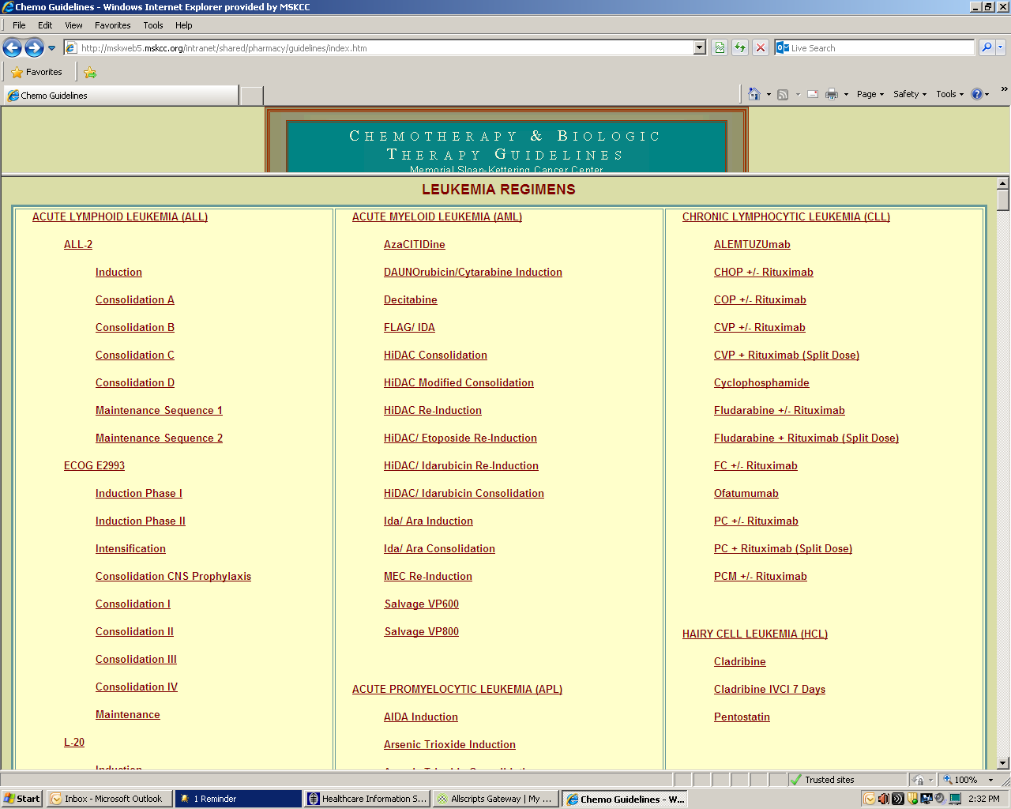
ALL-2 regimen

Slide 23
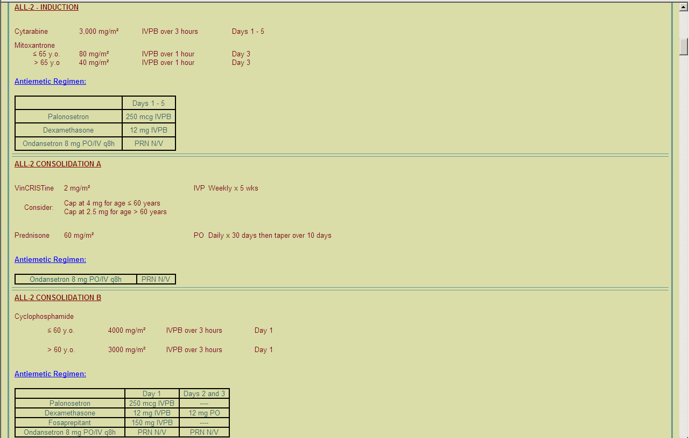
ALL-2 regimen

Slide 24
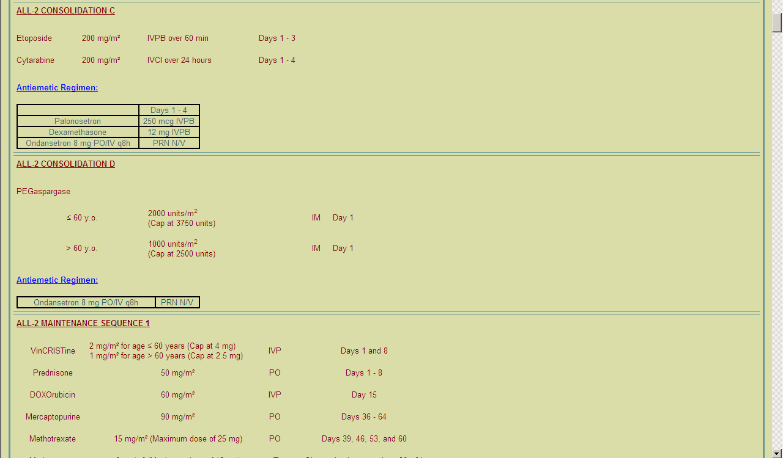
ALL-2 regimen

Slide 25
ALL-2 regimen

Slide 27
Initial therapy of Ph+ B-ALL
No head-to-head comparison of chemo vs chemo+TKI
Has been performed in Ph+ALL, all comparison is with historical controls but differences are very clear:
Chemo alone, median survival is ~9 months.
Chemo + Imatinib (phase II study) 2yr OS was 36-43%.
Optimal chemo regimen to use with TKI is not known.
Optimal TKI is not known:
--most experience is with imatinib BUT
--dasatinib is more potent than imatinib BUT
--neither imatinib nor dasatinib works for T315I mutant disease.
Ph-positive B-ALL
INDUCTION + TKI
Achieve morphologic remission
POST REMISSION THERAPY
Eliminate minimal residual disease
MAINTENANCE

Slide 28
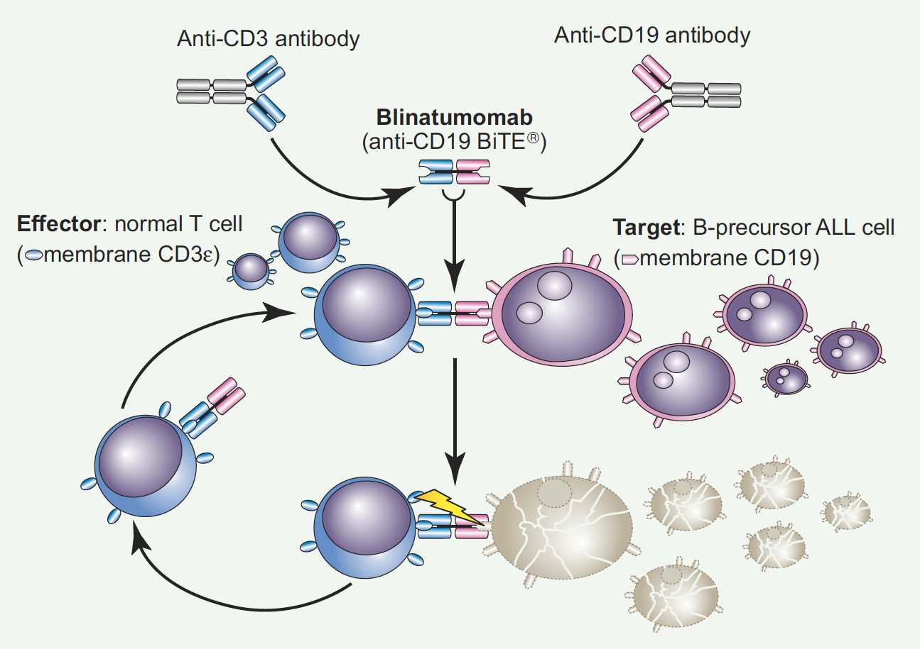
Novel therapies in ALL
Therapy | Information
Blinatumomab | BiTE Ab– CD3 and CD19 engaging; Continuous IV infusion for >4 weeks Phase II study in R/R B-ALL: Hematologic CR was achieved in 72%.
Liposomal Vincristine | 2012 FDA approval for relapsed Ph-negative B-ALL. 20% CR rate.
Anti-CD19 Chimeric Antigen Receptor (CAR) T cell immunotherapy | Studies ongoing at UPENN, MSKCC, FHCRC, NCI in R/R B-ALL.
Ionotuzumab Ozogamicin | Anti-CD22 Ab conjugated to calicheamicin
Nelarabine | 2005 FDA approval for R/R T-ALL. 20-50% CR rate
4-week continuous infusion

Slide 29
Ionotuzumab Ozogamicin for B-ALL

Slide 30
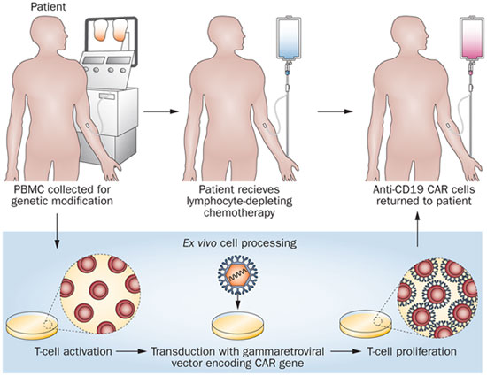
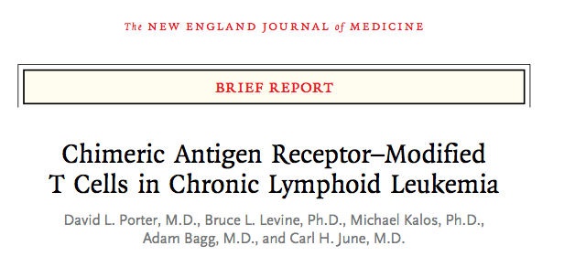
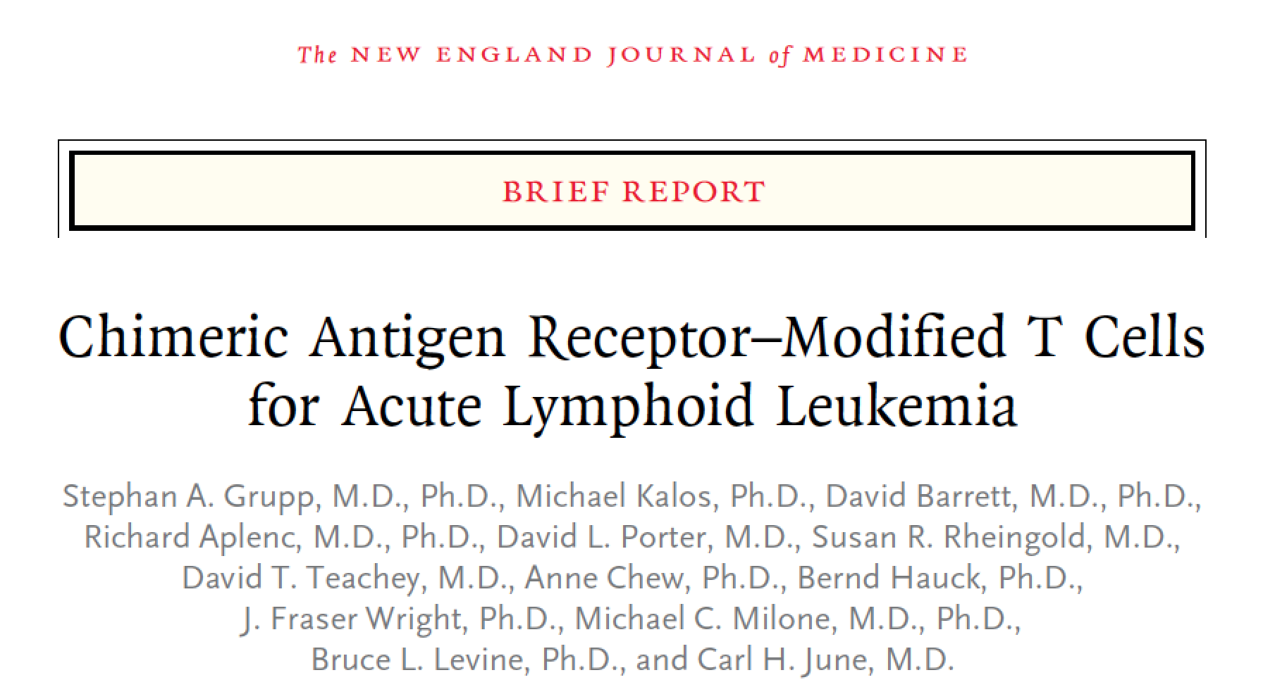
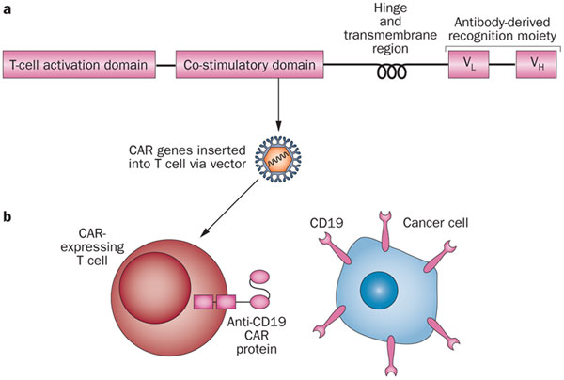
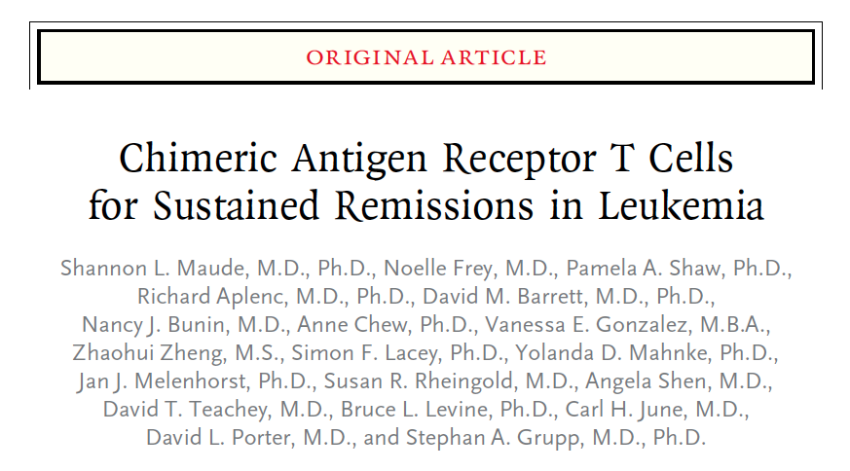
CAR T Cell Immunotherapy

Slide 31
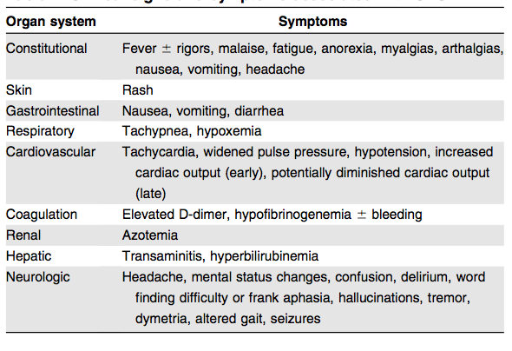
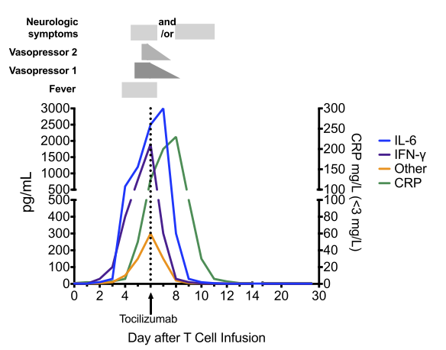
Cytokine Release Syndrome

Slide 32
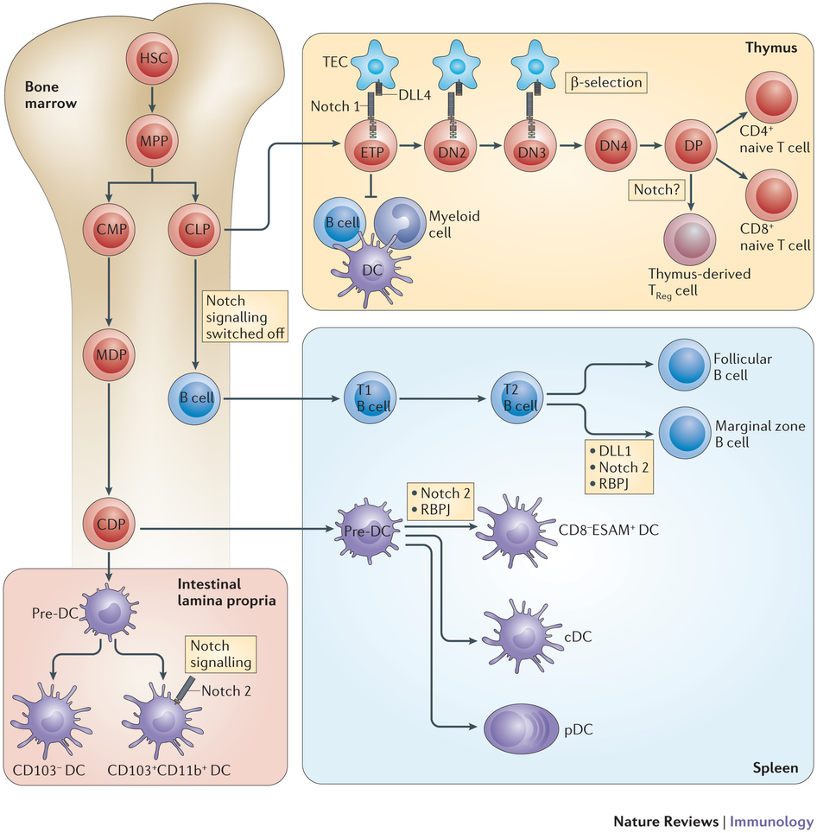
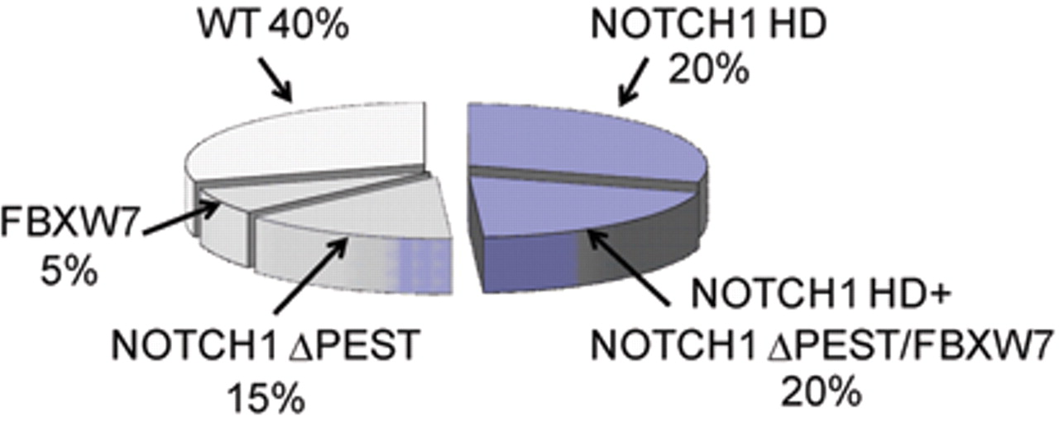
Molecular Genetics of T-ALL

Slide 33
Chronic Lymphocytic Leukemia
-Accumulation of clonal functionally incompetent B lymphocytes
-CLL is the same exact disease as “SLL” (small lymphocytic lymphoma)
-Median age @ diagnosis is 70
-Most common leukemia in Western World in terms of prevalence (AML is #1
In incidence), #2 cause of leukemia death in adults (after AML).
-Median survival time from diagnosis: 10 years
-Highly heterogenous clinical course: death from initial dx ranges from 2 to 20 years
68yM presents for routine PCP outpatient visit, you notice CBC has
Consistently shown following result over last 2 years:
12
25
180

Slide 34
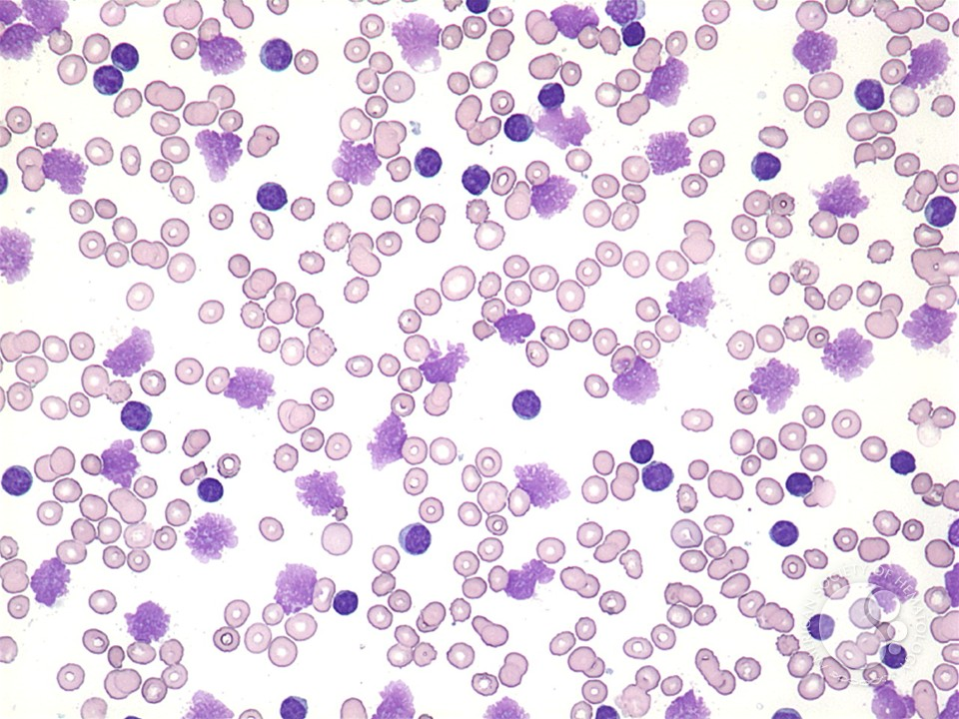
Chronic Lymphocytic Leukemia
”Smudge cells” on blood smear

Slide 35
CLL Peripheral Blood Immunophenotype
CLL: Absolute B lymphocyte count > 5,000/uL
Monoclonal B lymphocytosis (MBL): “pre-CLL”, Absolute B lymphocyte count < 5,000/uL,
No symptoms/cytopenias/LAD/organomegaly; follow patients annually; only a minority
Actually progress to CLL.
CLL | CD19+ CD20+ CD5+ | CD23+ | sIg weak
Mantle Cell | CD19+ CD20+ CD5+ | CD23 negative | sIg ++ T(11;14) Cyclin D1+

Slide 36
CLL Staging Systems
Rai stage
 |  | Median survival | % pts at presentation
Low Risk | Lymphocytosis only | 150 months | 25%
Int. Risk | LAD, organomegaly | 70-100 months | 50%
High Risk | Anemia, thrombocytopenia | 19 months | 25%
Binet stage
 |  | Median survival
A | < 3 involved LN sites | Comparable to age-matched controls
B | > 3 LN sites | 80 months
C | Anemia, thrombocytopenia | 24 months
(CT Scans, PET not routinely performed in CLL outside of clinical trial)

Slide 37
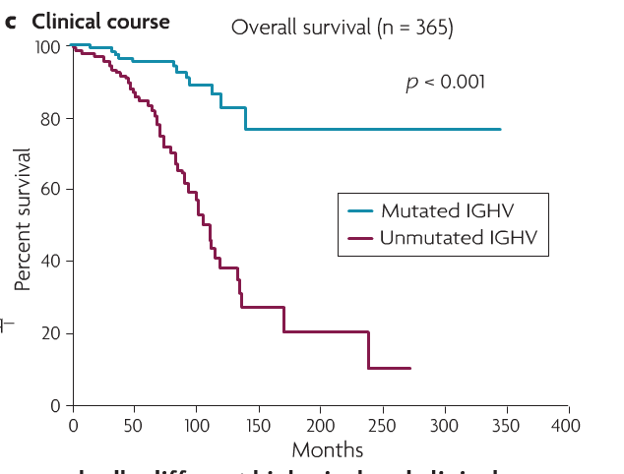
Additional Prognostic Info in CLL
-Lymphocyte doubling time
-IGHV mutational status
* unmutated = BAD
* mutated = GOOD
-CD38 expression = BAD
-ZAP70 expression = BAD
-Genetic alterations based on FISH

Slide 38
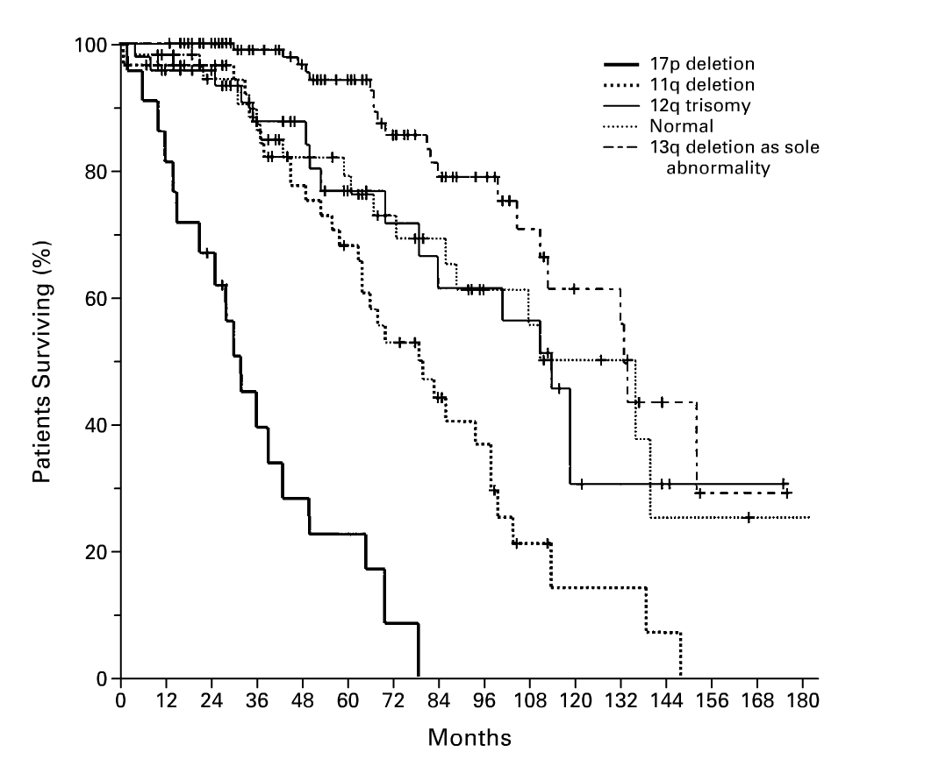
FISH in CLL

Slide 39
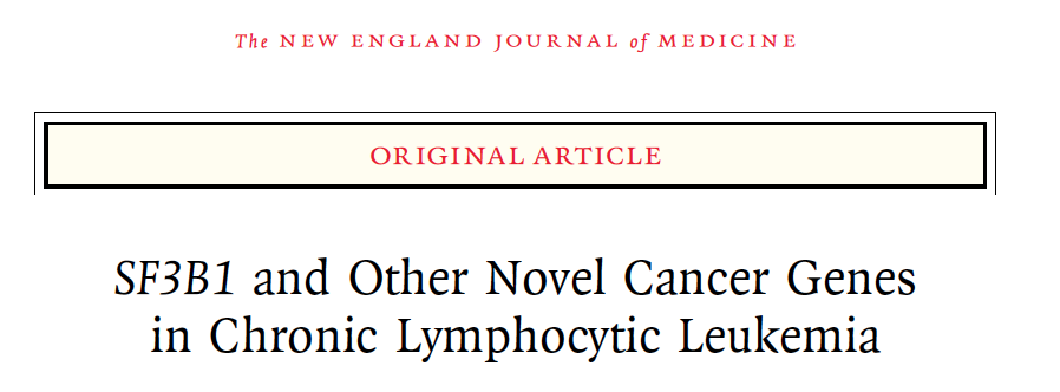
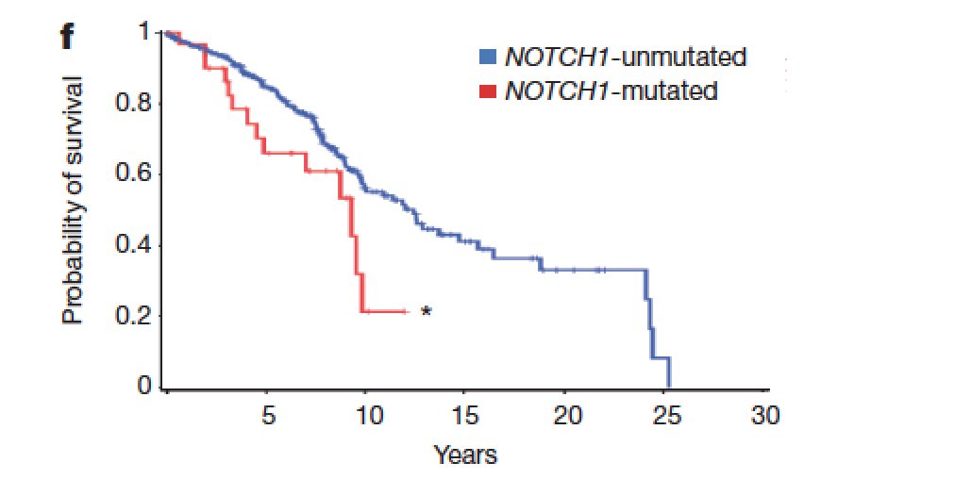
New Molecular Genetic abnormalities in CLL

Slide 40
Evaluating cytopenias in CLL
12
9.5
25
180
90
180
ANEMIA in CLL DDx:
BM infiltration from CLL cells
AIHA
PRCA
Anemia due to any other cause (e.g. bleeding from GI tract)
THROMBOCYTOPENIA in CLL DDx:
BM infiltration from CLL cells
Autoimmune

Slide 41
Basic points about CLL treatment
Not all patients with CLL need therapy.
Specific indications for therapy with CLL:
-Anemia or Thrombocytopenia due to BM infiltration with CLL cells (ie not
Autoimmune complications of CLL)
-SOFT INDICATIONS: disabling symptoms due to CLL such as night sweats
Or extreme LAD, repeated infections due to hypogammaglobulinemia of CLL
(not responding to IVIG)
Other than the above, patients with CLL are managed by expectant monitoring
Only.
-CLL is NOT CURABLE currently (except for possibly with allo-SCT).
-Randomized trials of immediate versus delayed treatment have no found no
survival benefit with immediate treatment.

Slide 42
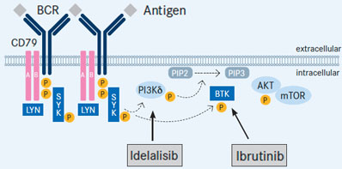
New Kinase Inhibitors in Therapy of CLL
Ibrutinib: FDA-approved for CLL patients who have failed one prior therapy or
Newly diagnosed CLL patient with 17p deletion.
Idelalisib: FDA-approved for CLL patients in combination with rituximab after
failing prior therapy.

Slide 43
Initial Therapy for CLL
Drug | Comment
“FCR”- fludarabine, cyclophosphamide, rituximab | Most common regimen. Lack of efficacy in 17p del.
“PCR”- pentostatin, cyclophosphamide, rituximab | Similar to FCR but pentostatin less myelosuppressive. Developed at MSKCC and Mayo Clinic, not commonly studied or used elsewhere.
“BR” | Bendamustine + Rituximab. Bendamustine = an alkylating agent + purine analog; FDA approved for initial tx and relapsed CLL.
Alemtuzumab (Campath) | Anti-CD52 Ab– depletes B and T cells. FDA approved for 17p del CLL but company removed from market.
AlloSCT | For young CLL patients following initial therapy.
Obinutuzumab + Chlorambucil | Obinutuzumab = new anti-CD20 Ab (type II Ab) enhanced binding to CD20 over rituximab (A type I Ab); may be superior to ritux; FDA approved in combination with chlorambucil.
Ibrutinib | Any CLL patient; newly diagnosed CLL patient with 17p deletion
Idelalisib | FDA approved for relapse with rituximab
Venetoclax | Newly diagnosed CLL patient with 17p deletion

Slide 44
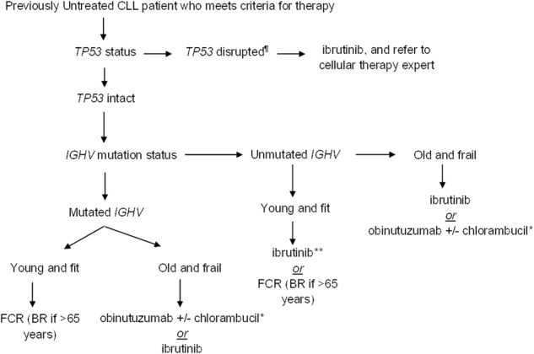
INITIAL THERAPY FOR CLL

Slide 45
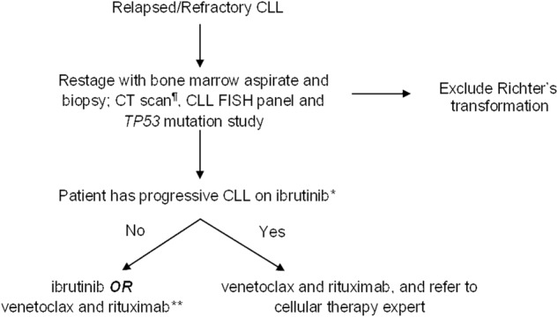
Treatment of R/R CLL

Slide 46
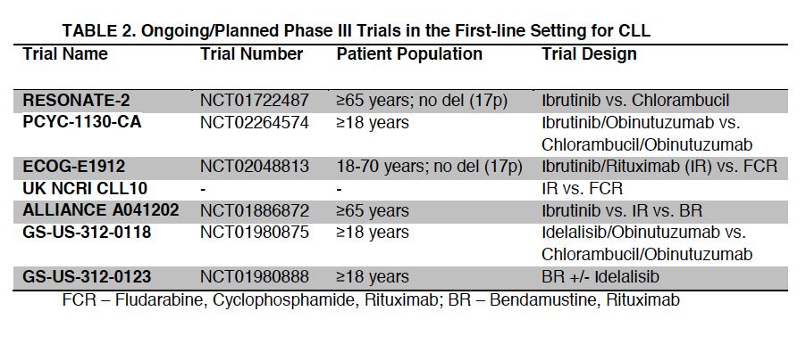
Initial Therapy for CLL
Jain, N, et al. Initial Treatment of CLL: Integrating Biology and Functional Status. Blood 2015

Slide 47
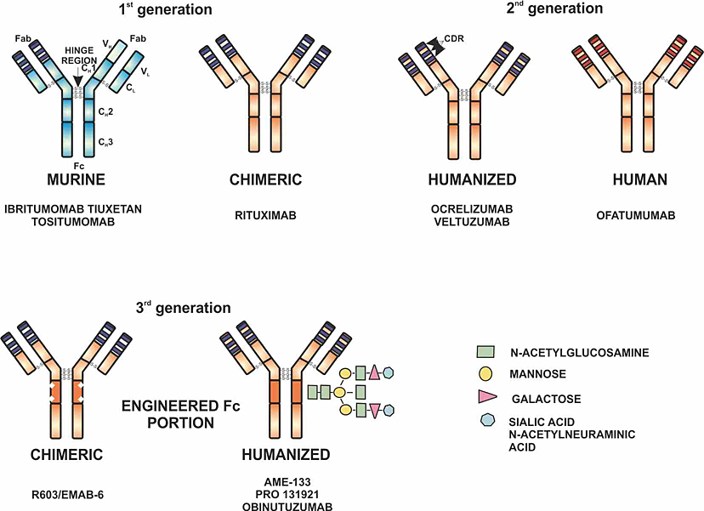
Monoclonal anti-CD20 Ab’s in CLL
Drug | Comment
Rituximab | Anti-CD20 (type I Ab)
Ofatumumab | Anti-CD20 (type I Ab)
Obinituzumab | Anti-CD20 (type II Ab)

Slide 48
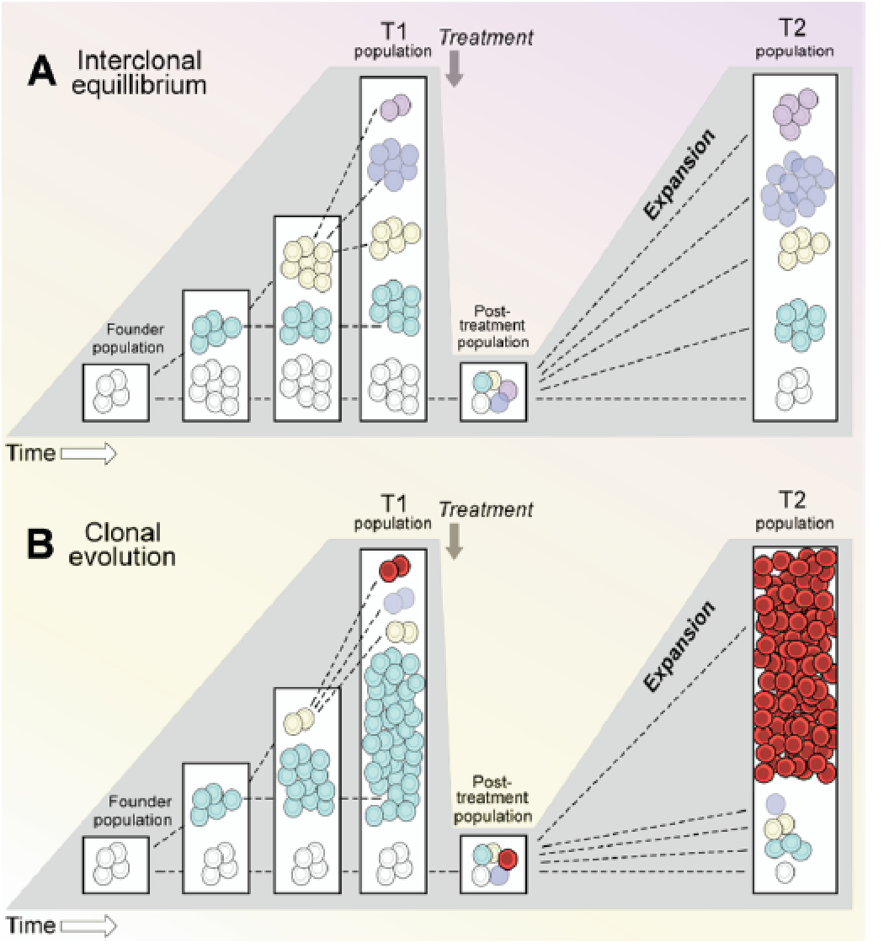
Patterns of clonal evolution in CLL
Wu et al. Blood 2012

Slide 49
Definitions of response, relapse, and refractoriness in CLL
Complete remission | No LN >1.5 cm, no hepatosplenomegaly. ANC>1.5 Plt>100 Hb>11 No clonal lymphocytes in peripheral blood.
Partial remission | 1 of these criteria + 1 of the heme criteria: -decrease in ALC by >50% -decrease in LN by 50% with no increase in LN size -liver/spleen reduce by 50% if previously enlarged ANC>1.5 Plt>100 Hb>11
Relapsed disease | Patients who previously achieved CR or PR develop progressive disease after > 6 months following CR/PR achievement.
Refratory disease | Patients who fail to achieve CR or PR with therapy or have progression wihtin 6 months of completing therapy.

Slide 50
Therapy for R/R CLL
Drug | Comment
Many of the same options as frontline: FCR, FR, BR, PCR, PCRM, Campath, AlloSCT. | Especially if relapse took > 6 months.
Investigational options | Similar to FCR but pentostatin less myelosuppressive. Developed at MSKCC and Mayo Clinic, not commonly studied or used elsewhere.
Lenalidomide | Risk of tumor flare, opportunistic infections, efficacy not clear.
CAR T cells | MSKCC
BTK inhibitors | Ibrutinib– recently FDA approved for mantle cell lymphoma. Works in 17p del patients. Increase in lymphocyte counts and WBC counts temporarily.
PI3K delta inhibitors | Idelalisib (CAL-101, GS-1101). Increase in lymphocyte counts and WBC counts temporarily.
BCL-2 inhibitor | ABT-199

Slide 51
Richter’s Transformation
Transformation of CLL to a large cell lymphoma.
Most commonly CLL → DLBCL but CLL can also transform to Hodgkin’s lymphoma and
T cell lymphoma (but this is rare)
(3) 2-9% of CLL patients undergo RT per year (slightly less common than transformation of
FL to DLBCL).
(4) Transformation is heralded by sudden clinical change:
-marked and sudden increase in LAD or hepatosplenomegaly
-marked worsening of B symptoms (weight loss, fevers, night sweats)
(5) Median survival is 5-8 months
(6) Diagnosis: biopsy affected site
-LN biopsy (focus on FDG-avid nodes with highest SUV)
and/or BM biopsy
(7) Treat as DLBCL with R-CHOP

Slide 52
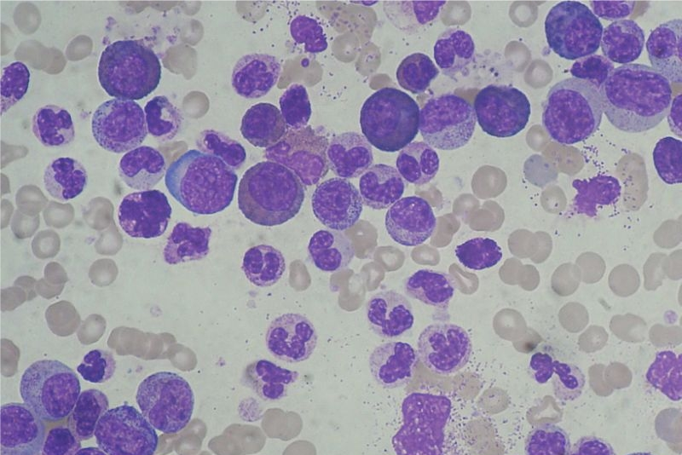
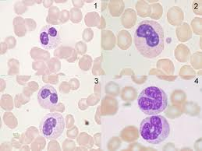
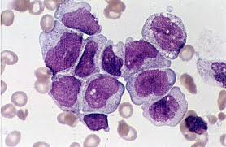
Overview of the myeloid leukemias
MYELOPROLIFERATIVE NEOPLASMS
MYELODYSPLASTIC
SYNDROME
ACUTE MYELOID
LEUKEMIA
ALL ARE CLONAL DISORDERS OF HEMATOPOIESIS
Increased mature-appearing
Cells
Less fulminant clinical course
than AML in many instances
(chronic)
Variable risk of transformation
To AML
Decreased circulating
Peripheral blood cells
Abnormal differentiation of
Blood cells in marrow
Less fulminant clinical course
than AML in many instances
(chronic)
Variable risk of transformation
To AML
Decreased circulating mature
Peripheral blood cells
Presence of immature cells
In BM and/or periphery
Fulminant clinical course,
Almost invariably lethal without
Therapy.

Slide 53
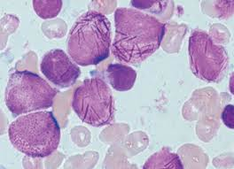
Acute Promyelocytic Leukemia
Majority of patients:
t(15;17)
PML-RARa translocation
Responsive to ATRA.
Current standard of care:
ATRA + Cytotoxic chemotherapy
Arsenic Trioxide consolidation
→ ATRA maintenance
Very high rate of cure
-Check Smear and DIC labs (PT, PTT,
Fibrinogen, D-dimer) whenever AML
Is suspected
-Start ATRA asap. Oral medication,
Minimal side-effects in short-term
Administration of a few days.

Slide 54
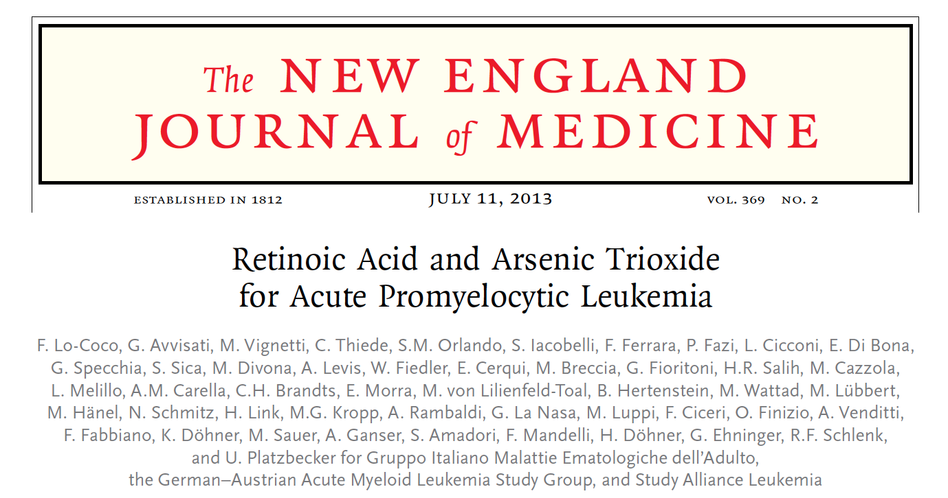
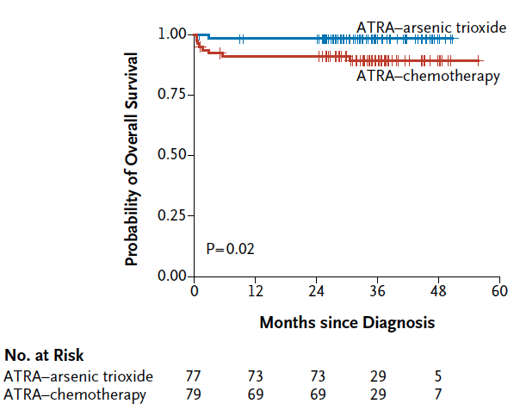
Acute Promyelocytic Leukemia Survival

Slide 55
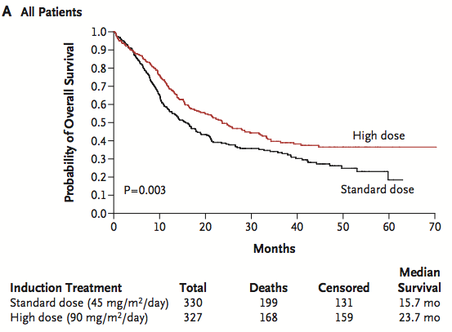
Low/Int-Risk APL
De Novo non-APL AML 16-60yo

Slide 56
Advances in Therapy of AML
1973: Cytarabine and daunorubicin (development of 7&3 protocol for AML)
1977: Bone marrow transplantation first employed

Slide 57
Advances in Therapy of AML
1973: Cytarabine and daunorubicin (development of 7&3 protocol for AML)
2000: FDA approval of gemtuzumab ozogamicin
1977: Bone marrow transplantation first employed

Slide 58
Advances in Therapy of AML
1973: Cytarabine and daunorubicin (development of 7&3 protocol for AML)
2000: FDA approval of gemtuzumab ozogamicin
1977: Bone marrow transplantation first employed
2010: Gemtuzumab ozogamicin removed from the market

Slide 59
Advances in Therapy of AML
Cytarabine plus daunorubicin combination for newly diagnosed therapy-related AML or AML with myelodysplasia-related changes
Gemtuzumab ozogamicin for CD33+ AML
1973: Cytarabine and daunorubicin (development of 7&3 protocol for AML)
2000: FDA approval of gemtuzumab ozogamicin
1977: Bone marrow transplantation first employed
2010: Gemtuzumab ozogamicin removed from the market

Slide 60
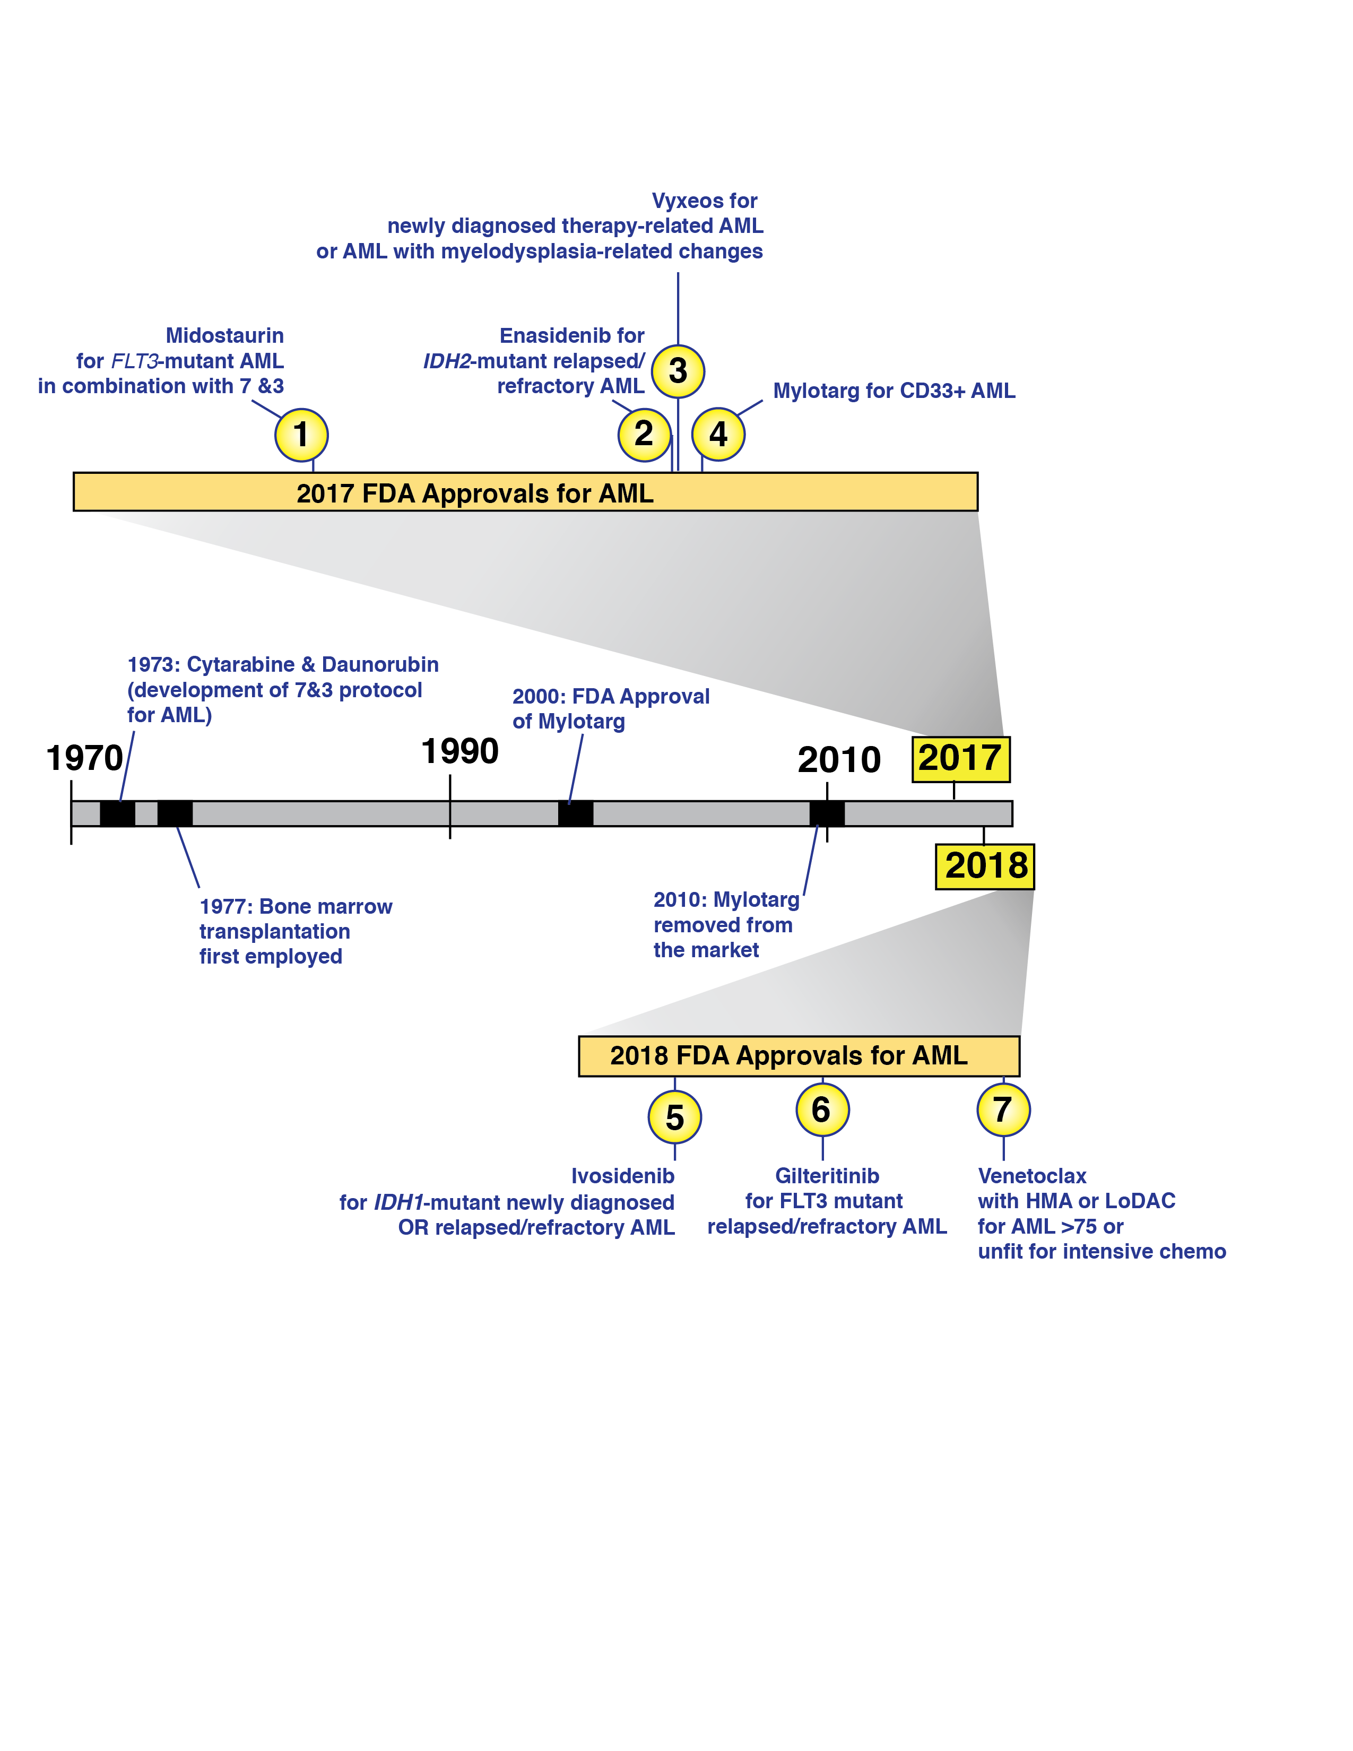
Advances in Therapy of AML
Cytarabine plus daunorubicin combination for newly diagnosed therapy-related AML or AML with myelodysplasia-related changes
Gemtuzumab ozogamicin for CD33+ AML
1973: Cytarabine and daunorubicin (development of 7&3 protocol for AML)
2000: FDA approval of gemtuzumab ozogamicin
2010: Gemtuzumab
ozogamicin removed from the market

Slide 61
Current AML Treatment Algorithm: Untreated AML <60
INDUCTION
Goal: reduce leukemia to achieve CR (no leukemia on histological exam & normal CBC
7+3 - Daunorubicin 60 or 90mg/m²/d x 3 days + Cytarabine 200mg/m²/d x 7 days
FLT3 mutant: add midostaurin (50mg BID day 8-21)
CBF: add Gemtuzumab ozogamicin (GO) 3mg/m2 day 1, 4, and 7
Antecedent myeloid neoplasm or t-MN: Vyxeos
TP53 mutant: Decitabine 20mg/m² x 10D + Venetoclax
POST-REMISSION
Goal: reduce microscopic disease present at CR to level that will allow long term cure.
CBF: High dose AraC (3g/m²/3h q12h D1, 3, and 5) x 4 cycles
NPM1 mutant/FLT3 WT: as above
Intermediate or Adverse risk: Allo-SCT with best available donor

Slide 62
Midostaurin + 7 & 3 for newly diagnosed AML
Stone et al, NEJM 2017

Slide 63
Gemtuzumab + 7 & 3 for newly diagnosed CBF AML
CBF
Intermediate
cytogenetics
Adverse
cytogenetics
Hill et al, Lancet Oncology 2014

Slide 64
Vyxeos
Liposomal coformulation of cytarabine & DNR.
Lancet, et al. JCO 2018

Slide 65
Current AML Treatment Algorithm: Untreated AML >60
AML Patients Age > 60
Fit for intensive therapy
Unfit or >75
TP53 mut
HMA + Venetoclax
FLT3 mutant
7 & 3 & midostaurin
10D Decitabine
(20mg/m2) +/-
Vyxeos (400mg/D)
IDH1 mut
Ivosidenib
CBF
7 & 3 & Gemtuzumab
NOS
7 & 3
Antecedent MDS, t-MN
Vyxeos

Slide 66
Hypomethylating agents + Venetoclax
Ven/Aza CR rate 36.7% vs 17.9% with control (P<0.001)
Ven/Aza median OS 14.7 months vs 9.6 months with control
DiNardo et al. NEJM 2020

Slide 67
HMA + Venetoclax
CR/Cri rate of 67% in older AML patients
Median DOR: 11.3 months
Median OS: 17.5 months
400mg venetoclax was the RP2D.
DiNardo et al. Blood 2019

Slide 68
Relapsed AML
Induce CR2 then send to allo-SCT if possible
Older salvage regimens: MEC, FLAG-Ida
IDH2 Mutant: Ensadenib
IDH1 Mutant: Ivosidenib
FLT3 Mutant: Gilteritinib
Clinical trial…….
IDH1 or IDH2
Inhibitor

Slide 69
IDH1/2 Inhibitors for R/R AML
Ivosidenib
ORR: 35%
CR: 15%
Most common AEs: diarrhea, fatigue, pyrexia
Differentiation Syndrome
Enasidenib
ORR: 37%
CR: 18%
Median DOR: 6.9 mos
Most common AEs: nausea, fatigue, diarrhea, increased bilis
DiNardo et al. NEJM 2018; Stein et al. Blood 2019

Slide 70
MRD Assessment in AML: Concept
Standard CR criteria (5%)
FISH & microscopy
Flow cytometry
NGS/qRT-PCR
Hokland et al.
Sem Hematol 2016

Slide 71
MRD Assessment in AML: NPM1 mutant disease
qRT-PCR for mutant NPM1 in a population of uniformly treated NPM1 mutant newly dx’d AML
OVERALL SURVIVAL
RELAPSE
Ivey et al. NEJM 2016

Slide 72
MRD Assessment in AML: flow vs NGS
Additive effect of combined NGS & flow for MRD in AML
Not all mutations predict
Relapse in AML. “DTA” mutations (DNMT3A, TET2, ASXL1) were not associated with relapse.
(study population 18-65)
Jongen-Lavrencic et al. NEJM 2018

Slide 73
αCD47 Ab for MDS & AML
Magrolimab (Formerly 5F9) = αCD47 Ab
Ongoing clinical trial for
Untreated AML ineligible for induction or
Untreated MDS intermediate to very high risk by IPSS-R
NCT03248479

Slide 74
Magrolimab + Aza in Patients With MDS and AML: Study Design
Multicenter, single-arm phase Ib study
Current analysis reports data from expansion phase
Primary endpoints: safety, efficacy
Secondary endpoints: magrolimab PK, PD, immunogenicity
Exploratory endpoints: CD47 receptor occupancy, immune activity markers, molecular profiling
Patients with untreated AML ineligible for induction CT or untreated MDS classed intermediate to very high risk by IPSS-R
(N = 68)
Safety Evaluation
Expansion
Magrolimab 1, 30 mg/kg QW* +
Aza 75 mg/m² Days 1-7
(n = 6)
Magrolimab 1, 30 mg/kg QW or Q2W* +
Aza 75 mg/m² Days 1-7
(n = 68)
*Patients received magrolimab 1 mg/kg priming dose, followed by dose ramp-up to 30 mg/kg by Wk 2, continued thereafter.

Slide 75
Magrolimab + Aza in Patients With MDS and AML: Response
Best Overall Response, n (%) | MDS (n = 33) | AML (n = 25)
ORR | 30 (91) | 16 (64)
CR | 14 (42) | 10 (40)
CRi | NA | 4 (16)
PR | 1 (3) | 1 (4)
MLFS/marrow CR | 8 (24)* | 1 (4)
Hematologic improvement | 7 (21) | NA
SD | 3 (9) | 8 (32)
PD | 0 | 1 (4)
Outcome, n (%) | MDS (n = 33) | AML (n = 25)
RBC transfusion independence | 11/19 (58) | 9/14 (64)
Complete cytogenetic response | 9/26 (35) | 6/12 (50)
MRD negativity in responders | 6/30 (20) | 8/16 (50)
Median DoR, mos | NR (0.03+ to 10.4+) | NR (0.03+ to 15.1+)
Median follow-up, mos (range) | 5.8 (2.0 to 15.0) | 9.4 (1.9 to 16.9)
Median TTR: 1.9 mos; median OS: NR (either arm)
6-mo CR rate, MDS patients: 56%
9 of 58 (16%) patients received alloSCT
*4 patients had marrow CR and hematologic improvement.

Slide 76
Magrolimab + Aza in Patients With MDS and AML: Response in Patients With TP53 Mutation
Outcome | MDS TP53 Mutant (n = 12) | AML TP53 Mutant (n = 4)
ORR, n (%) | 9 (75) | 3 (75)
CR, n (%) | 5 (42) | 2 (50)
CRi/marrow CR, n (%) | 4 (33) | 1 (25)
Complete cytogenetic response, n/N (%)* | 4/8 (50) | 3/3 (100)
MRD negativity in responders, n/N (%) | 4/9 (44) | 0
Median DoR, mos | NR (0.03+ to 15.1) | NR (0.03+ to 5.2+)
6-mo survival probability, % | 91 | 100
Median follow-up, mos (range) | 8.8 (1.9 to 16.9) | 7 (4.2 to 12.2)
9 of 58 (16%) pts received alloSCT
*Responders with cytogenetic abnormalities at baseline.

Slide 77
Comparison of agents in development on p53 mutant AML

Slide 78
Magrolimab Conclusions
Magrolimab (an anti-CD47 antibody) plus azacitidine was well tolerated in untreated patients with MDS and AML
No evidence of significant cytopenias, infections, immune-related AEs
Early efficacy appears promising
ORR: MDS, 91% (CR: 42%); AML, 64% (CR/CRi: 56%)
ORR in TP53-mutant disease: 75% across groups
Median DoR: not reached
Evaluation of magrolimab in MDS and AML ongoing

Slide 79
Overview of the myeloid malignancies
MYELOPROLIFERATIVE NEOPLASMS
MYELODYSPLASTIC
SYNDROME
ACUTE MYELOID
LEUKEMIA
ALL ARE CLONAL DISORDERS OF HEMATOPOIESIS
Increased mature-appearing
Cells
Less fulminant clinical course
than AML in many instances
(chronic)
Variable risk of transformation
To AML
Decreased circulating
Peripheral blood cells
Abnormal differentiation of
Blood cells in marrow
Less fulminant clinical course
than AML in many instances
(chronic)
Variable risk of transformation
To AML
Decreased circulating mature
Peripheral blood cells
Presence of immature cells
In BM and/or periphery
Fulminant clinical course,
Almost invariably lethal without
Therapy.

Slide 80
What is dysplasia?
Some common morphologic features characteristic of MDS:
-hypolobated neutrophils in peripheral blood
-increased reticulocytes in peripheral blood
-abnormal contours of erythroid precursors in bone marrow
-micromegakaryocytes in bone marrow
-increased RBC precursors with rings of iron around the nuclei
(ringed sideroblasts)
-Also MDS usually characterized by a hypercellular bone marrow
(but not always)

Slide 81
What is dysplasia?
(J) Myeloid dysplasia: binucleated or mitotic promyelocyte;
(K) cytoplasmic vacuoles, hyposegmentation, abnormal maturation;
(L) ring nucleus; (M) binucleated or hypersegmented eosinophil;
(N) hyposegmented neutrophil; (O, P, Q) hypogranulated granulocytes;
(R, S) erythroid dysplasia: binucleation; (T, U) nuclear budding;
(U) megaloblastic changes. (V, X) Abnormal plasma cells: multinucleated
plasma cells; (W) plasma cells with nuclear budding; and (Y) Mott cells
with numerous Russell bodies (arrow) representing stored immunoglobulin.
Psuedo-
Pelger
Huet
Anomaly

Slide 82
Pelger Huet Anomaly
Benign, Autosomal dominant
Condition
Mutation in B-laminin receptor
Resulting in incomplete
Neutrophil segmentation.
1928: Pelger, a Dutch hematologist described leukocytes with dumbbell-shaped bilobed nuclei.
1931: Huet, a pediatrician, identified it as an inherited disorder.

Slide 83
MDS: Updated 2016 WHO Classification
2016 NAME | Abbreviation
MDS with single lineage dysplasia | MDS-SLD
MDS with ring sideroblasts | MDS-RS
MDS with multilineage dysplasia (with ring sideroblasts) | MDS-MLD (MDS-RS-MLD)
MDS with excess blasts, type 1 | MDS-EB-1
MDS with excess blasts, type 2 | MDS-EB-2
5-9% blasts
10-19% blasts
Arber et al. Blood 2016

Slide 84
Refractory Anemia with Ringed Sideroblasts (RARS)
>15% ringed sideroblasts in the BM
Dysplasia in the granulocytic and megakaryocytic lineages is not present in RARS.
Blasts < 5%
Low risk of AML transformation
WRIGHT GIEMSA STAIN
Arrow: erythroid dysplasia
Arrow-heads: erytrhoid precursor hyperplasia

Slide 85
Refractory Anemia with Ringed Sideroblasts (RARS)
Ringed sideroblast Ddx:
Alcoholism
Lead
Benzene
Isoniazid Toxicity
Deficiency of copper
zinc toxicity.
Acute erythroid leukemia
Congenital dyserythropoietic anemias (CDA)
IRON STAIN
Too many ringed sideroblasts

Slide 86
MDS Prognostication: Revised IPSS
Steensma, D. The Hematologist 2012

Slide 87
MDS Treatment: 2020
Asymptomatic
lower-risk
Lower-risk
Higher-risk
Observe
until symptomatic/
progression
Anemia
With
del(5q)
Anemia
With
EPO<500 U/L
Other
Anemia
Other
Cytopenia
Transplant
candidate
Non-transplant
candidate
Lenalidomide,
HMA, a-TG,
Supportive care,
Clinical trial
Lenalidomide
ESA
HMA &
Allo-SCT
HMA until
disease
progression
Veneotoclax + HMA
Use instead of HMA single agent?
Reserve for HMA failure?
Enasidenib, Ivosidenib for IDH1/2 mutant
→ Combo with HMA?
If failed
ESA & MDS-RS:
Luspatercept

Slide 88
Luspatercept for ESA-refractory Anemia in low/intermediate risk MDS
% of patients with independence from RBC transfusions
Double-blind, RCT phase 3 trial very-low to intermediate-risk MDS-RS transfusion dependent
Fenaux, et al. NEJM 2020

Slide 89
αCD47 Ab for MDS & AML
Magrolimab (Formerly 5F9) = αCD47 Ab
Ongoing clinical trial for
untreated AML ineligible for induction or
untreated MDS intermediate to very high risk by IPSS-R
NCT03248479

Slide 90
αCD47 Ab + 5-AZA for MDS & AML
Salman, et al. ASH 2019

Slide 91
APR-246 for TP53-mutant MDS/AML

Slide 92
APR-246 for TP53-mutant MDS/AML
Two phase II trials of APR-246 + 5-AZA for TP53 mutant MDS:
US trial (NCT03072043):
88% ORR in 33 evaluable MDS patients (out of 55 total patients enrolled)
61% CR rate
French trial (NCT03588078):
HMA naïve intermediate-very high IPSS-R TP53m MDS and AML adult patients.
56% CR rate at 6 cycles, with deep molecular remission in all CR patients.
Ongoing Phase III trial (NCT0374571) comparing APR-246 + 5-AZA versus 5-AZA alone.

Slide 93
MPN, MPN/MDS overlap, MDS
JAK2
MPL
BCR-ABL
TET2
ASXL1
SRSF2
EZH2
del5q
MDS with
fibrosis
MPN
PMF
RARS-t
MDS/MPN
MDS
RA
RARS--SF3B1
PV
ET
CML

Slide 94
MDS/MPN overlap syndromes
Chronic myelomonocytic leukemia
Atypical CML, BCR-ABL1 negative
Juvenile myelomonocytic leukemia
MDS/MPN-U
RARS-t

Slide 95
CMML

Slide 96
CMML
Monocytosis of >1 X 109/l + dyplasia
(less than 20% of cells in bone marrow).
CMML-1: <10% blasts in BM
CMML-2: 10-19% blasts in BM
RARS-t
RA + Ringed Sideroblasts + Thrombocytosis
Mixed MPN (JAK2 or MPL mutation) and MDS
>15% ringed sideroblasts + Plt count >450K

Slide 97
MPN’s
BCR-ABL (t9;22) +
CML
BCR-ABL negative
“Classic MPN’s”
PV
ET
Primary myelofibrosis
Chronic neutrophilic leukemia (CNL)
Chronic eosinophilic leukemia

Slide 98
MPN’s

Slide 99
Case #2:
A 68yo M presents for routine physical exam. Routine CBC reveals WBC of 25,000, Hb of 12 and Plt of 600,000.
Prior CBC 1 year prior was normal.

Slide 100
CML
Pre-TKI’s
 | Chronic phase | Accelerated phase | Blast phase
Survival | 8+ years | <1.5 years | < 6 months
Basophils
Platelets | High or normal | High or low | Decreased
WBC count | >20 | - | -
Blasts | <10% | >10% | >30%
QUESTIONS NOW
Which TKI to start first? Imatinib, Dasatinib, Nilotinib
Can you ever stop the TKI?
Do the “T315I” drugs work?

Slide 101
PV, ET, PMF
JAK2V617F mutation
-95% PV
-50% ET
-50% PMF
JAK2 exon 12 mutations
~5% PV patients
MPL mutations
10-15% JAK2VF negative ET/PMF patients

Slide 102
PV, ET, PMF
PV
A
M
L
PMF
ET

Slide 103
PV
Median age @ Dx: 70yo
Compared to age- and sex-matched
controls total mortality is
1.2 higher in PV.
45% of deaths were due to
cardiovascular disease.
GRADE A Treatment Recommendation
Aspirin 75 - 100 mg/day
Grade B recommendation
Phlebotomy to maintain the Hct to <0.45
Cytoreduction should be given to:
All patients with platelets > 1.5 million
leukocyte count > 15 x109/L
IFN or Hydroxyurea

Slide 104
ET
It is unclear if ET shortens
Life expectancy on average.
Studies which found a shorter life expectancy:
Fenaux et al: 73.5% survival 7 years after diagnosis
Jensen et al: 76% survival
at 5 years
REACTIVE THROMBOCYTOSIS CAUSES:
iron deficiency, splenectomy, surgery,
infection, inflammation, connective tissue disease, metastatic cancer, and
lymphoproliferative disorders

Slide 105
Management of ET
Grade A recommendation
• Platelet lowering therapy should be given to;
- all patients over 60 years of age
- all patients with earlier thromboembolic complications
all patients with platelets >1.5million
• Aspirin 75-100 mg daily to all ET patients except when platelets are >1500 x 109/L, in
patients with bleeding symptoms or in patients with other contraindications to aspirin.
• The goal of platelet lowering therapy should be platelets < 400 x 109/L
(Grade B recommendation)
Choice of cytoreductive therapy in ET:
• Hydroxyurea is the best documented therapy in ET
• However, due to the concern of possible increased risk of leukemia transformation with
long-term use it is not recommended as 1st line therapy in younger patients
• <60 years: 1st line interferon-α or anagrelide, 3rd line Hydroxyurea
• >75 years: 1st line Hydroxyurea, 2nd line consider combination therapy (HU-Ana, HU-IFN),

Slide 106
PMF

Slide 107
PMF
SPLENOMEGALY
EARLY SATIETY
FATIGUE
CYTOPENIAS
HIGH RISK OF AML
TRANSFORMATION

Slide 108
2012 FDA-APPROVAL FOR JAK1/2 INHIBITOR Ruxolitinib for MF

Slide 109
2012 FDA-APPROVAL FOR JAK1/2 INHIBITOR Ruxolitinib for MF

Slide 110
Questions now in MPN’s
Do JAK inhibitors change the natural history of PMF?
Should we use combination strategies of JAKi + something else?
Many newer JAK inhibitors coming are they better than ruxolitinib? (JAK2 specific,
JAK1 specific, JAK2V617F specific)
4) What is the genetic abnormality present in the 50% of ET and PMF without
JAK2 or MPL mutations?
5) Are JAK2 mutations really driving the disease?

Slide 111
Myelodysplastic Syndrome
MDS with low blast % can be very difficult to diagnose and the true incidence of
MDS is likely not known.
Definition: >10% of the cells >1 myeloid BM lineage (erythroid, granulocytic, megakaryocytic
must show morphologic dysplasia.
Also, in setting of persistent cytopenia, if the patient has one of the following cytogenetic
Abnormalities, MDS may be diagnosed:

Slide 112
Case #3
78y F presents with CC of slight increase in DOE over last few months. She has a
h/o HTN and type II DM. Physical exam is unrevealing. CBC reveals Hb 8.2g/dL,
WBC 1.8, and Plt 170,000.

