Slide 1


MSK Global Cancer Research and Training (GCRT)
African Research Group for Oncology (ARGO)

Slide 2
Building your multi-disciplinary team

Slide 3
Where to Start?
Develop central hypothesis.
Develop key aims.

Slide 4
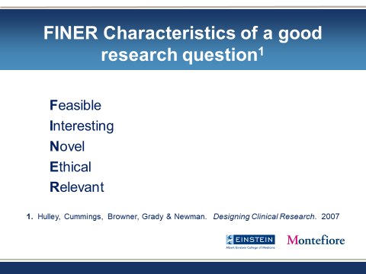

Slide 5
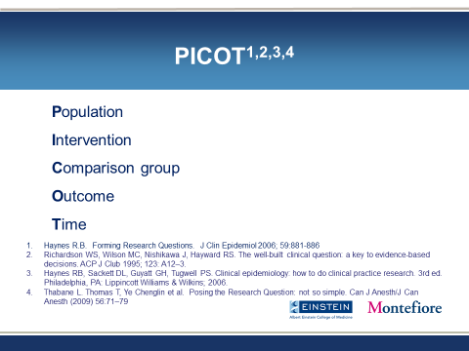

Slide 6
Build Multi-Disciplinary Team of Experts
What are the required expertise and backgrounds/training necessary to carry out your team science study?

Slide 7
Build Multi-Disciplinary Team of Experts
Consider the required (or perceived?) expertise and backgrounds/training necessary to carry out study
  Epidemiologists, Clinical specialists, Laboratory scientists, Geneticists, Exposure Assessors, Biostatisticians, Project managers, Ethicists

Slide 8
Recruiting team members
What are benefits?
  Technological
  Training
  Expertise growth
  Education
  Short/long term benefits
  Promotion

Slide 9
Setting expectations with the team
Project implementation
  Materials needed
  Staffing
  Accrual
  finances
Deadlines
Communications
Output

Slide 10
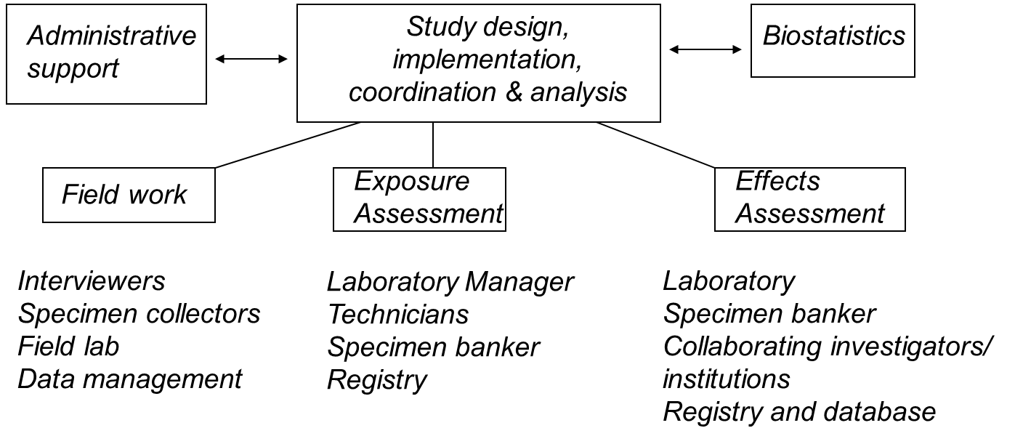

Slide 11
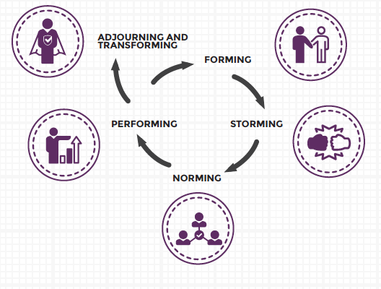
Understanding team evolution

Slide 12
Group Discussion
What expertise is needed for your team?
Where are those collaborators?
Do you have existing collaborations or relationships with those collaborators?
If not, how will you connect with them?

