Slide 1


MSK Global Cancer Research and Training (GCRT)
African Research Group for Oncology (ARGO)

Slide 2
Managing and working with your multi-disciplinary team

Slide 3
Leadership Considerations
Establish formal roles of collaborators?
  PI, MPI, co-I, consultant, post-doc, etc…
  Junior, Mid-career, Senior, etc….
  Mentoring structure / requirements?

Slide 4
Collaborative Guidelines
Establish formal collaborative guidelines?
  1st author?
  Last author?
  Co-authorships?

Slide 5
Ownership?
  Management and ownership of samples?
    Centralized, regional, spoke and wheel, etc…
  Management and ownership of data?
    Centralized, regional, spoke and wheel, etc…

Slide 6
Mentor-Mentee Relationship

Slide 7
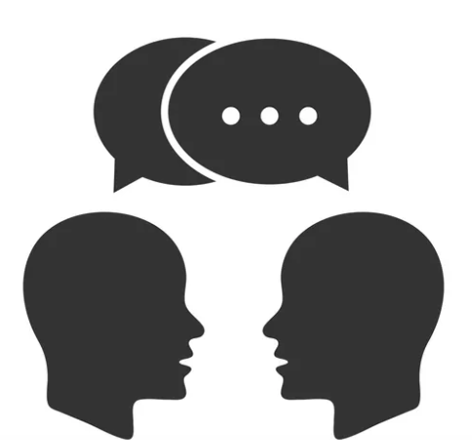
Mentoring Competencies
Maintaining effective communication
Aligning expectations
Enhancing cultural awareness
Addressing equity and inclusion
Enhancing motivation
Fostering independence
Promoting professional development
https://www.vectorstock.com/

Slide 8
Effective Communication
Good communication key to any relationship – mentoring included!
Critical to actively reflect on and identify characteristics of good communication and to practice these skills
Communication is integral to science

Slide 9
Why is effective communication vital for research mentoring relationships?
Types of conversations between a mentor and mentee:
  -discussing research results
  -giving feedback on a presentation/abstract/paper/grant proposal
  -advice on next training/career steps
  -concerns about productivity
  -promotion goals

Slide 10
Communication Styles
Supportive/Collaborating
  -Interested in getting to know skills/true interests
  -Open to input and feedback
  -Develops relationships and collaborations
  -Focus on inclusion and involvement of the team

Slide 11
Identify Barriers to Effective Communication
Passive neglect (“no news is good news”)
Micromanaging
Aversion to conflict
Relaying too much on written (e-mail) vs oral (face to face) methods
Making assumptions about the other person
Managing power differentials

Slide 12
Communication Tools
General Communication Skills
  Active listening
  Reflective listening
  Paraphrasing
  Summarizing
  Asking open-ended questions
  Probing
  Self-disclosure
  Confrontation

Slide 13
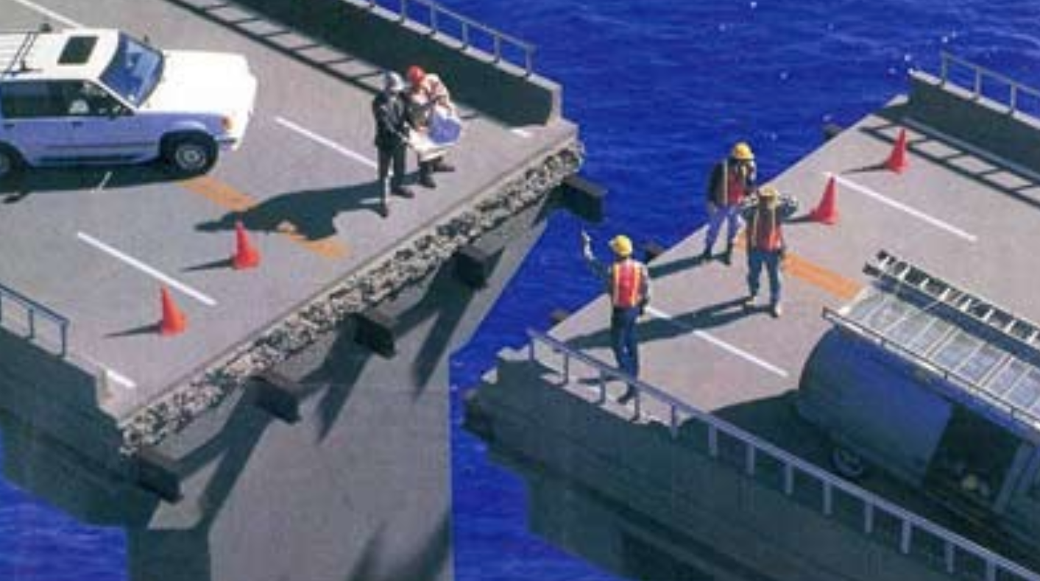
Discussion: Aligning Expectations
Why are defining and aligning expectations so vital in research mentoring?
  How might this be helpful?
  If expectations are not defined and aligned what negative impact might this have on mentoring?
  Any specific examples?
http://www.davidakka.com/wp-content/uploads/2013/09/bridge-fail.jpg
Huskins WC, Silet K, Weber-Main AM, Begg MD, Fowler VG Jr, Hamilton J, Fleming M. Identifying and aligning expectations in a mentoring relationship. Clin Transl Sci. 2011 Dec;4(6):439-47. doi: 10.1111/j.1752-8062.2011.00356.x. Epub 2011 Nov 18. PMID: 22212226; PMCID: PMC3476480.

Slide 14
Benefits of Aligned Expectations
Clear guidance can yield greater research productivity
Keeps mentor-mentee relationship on track
Helps coordinate your team of mentors
Process of aligning builds trust, communication skills, professionalism

Slide 15
Process of Defining Expectations
What do I expect of my research mentor?
  -What are the essential roles I want this person to play – in research, promoting professional development?
  -How should we interact? Best practices for communication method, frequency, etc.?
  -What does my ideal mentor-mentee research relationship look like?
What does my research mentor expect of me?

Slide 16
Logistics
Meetings?
  In-person, conference calls, zoom, email, etc…
  Frequency…
  Who…
Multiple time zones
Multiple languages
Cultural / Geopolitical differences
Funding, funding, funding

Slide 17
Project specific logistics
Do you and/or your organization have the capacity and motivation to participate in the project?
  Staff – skills, bandwith
  Financial structure
  Buy-in from leadership and community
  Rectruitment – can you meet requirements
  Space – is there physical space if needed?

Slide 18
Group Discussion
What modes of collaborative governance have you seen work or not work?
What are your preferences for collaborative governance?
How would you prefer to foster mentor-mentee relationships?
What is your ideal mode of communication between mentor and mentee?
Think about your past experiences in receiving feedback in your research training or career…
  -What kinds of feedback did you find most helpful? Most unhelpful? Why?
Think about your past experiences in giving feedback in your research training or career…
  -What challenges have you experienced doing this?
  -What approaches have you used successfully for giving

