Slide 1


MSK Global Cancer Research and Training (GCRT)
African Research Group for Oncology (ARGO)

Slide 2
Introduction to team science methodologies

Slide 3
Steps Taken in Research
Description of disease by time, place, persons
Formulation of hypotheses
Observational studies to test hypotheses
Cross-sectional studies
Case-control studies
Cohort studies
Analysis of results New hypotheses
Identification of etiological factors
Develop prevention/intervention procedures
Clinical trials to evaluate prevention/intervention
Notes:
Ultimate goal of measuring exposure-outcome relationships

Slide 4
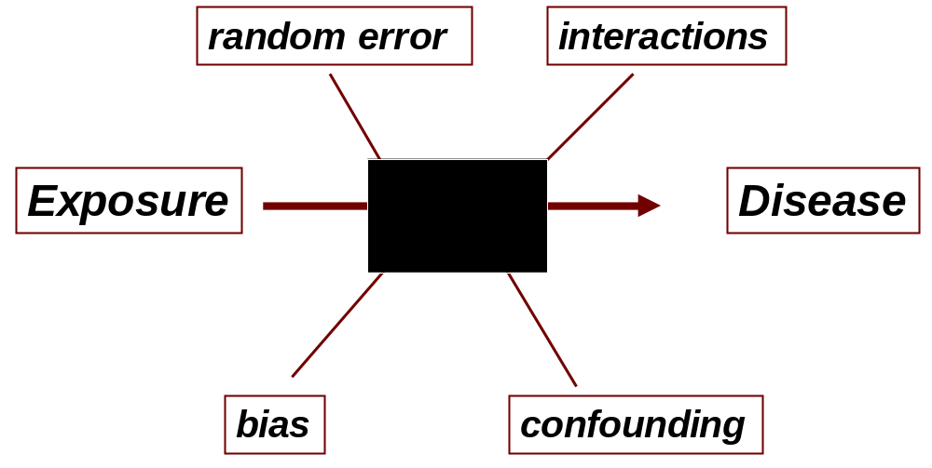
Types of Epidemiologic Studies
Observational
  Cross-sectional studies
  Case-control studies
  Cohort studies
Experimental
  Clinical trials

Slide 5
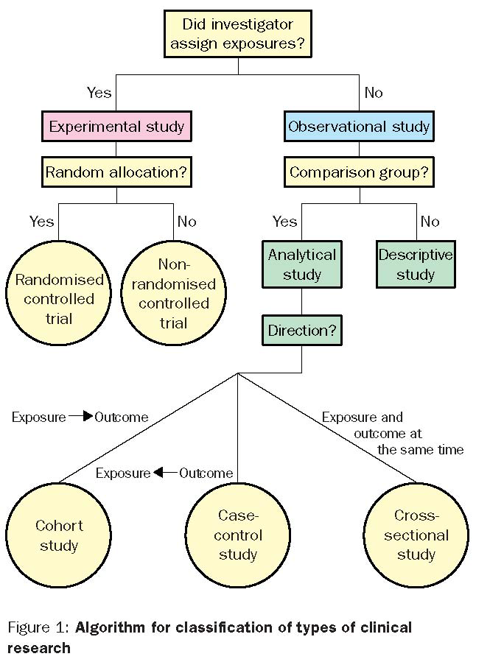

Slide 6
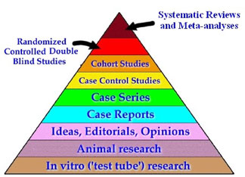

Slide 7
Types of Epidemiologic Studies
Cross Sectional Design
PAST
PRESENT
FUTURE
Cross-Sectional Study
Select/Classify cases & controls
Look for current exposure(s) to risk factor
Notes:
Non-prospective studies, on the other hand, include cross sectional and retrospective designs
Select a disease of interest, enroll cases and controls, then attempt to classify exposure
Cross-sectional looks a risk factors in one snap shot of time, while case-control allows for the ascertainment of historical information on risk factors

Slide 8
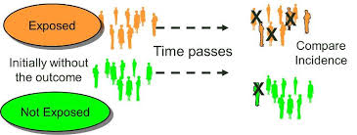
Cohort Studies Definition
The investigator starts with a group of individuals apparently free of the disease(s) of interest.
This group of individuals, or cohort, is divided into those exposed to a possible risk factor and those not exposed, and is then followed through time in order to determine the incidence rates (or mortality rates) among the exposed and unexposed.

Slide 9
Prospective Design
PAST
PRESENT
FUTURE
Prospective Study
Select cohort
Classify by exposure to risk factor
Follow for outcome development

Slide 10
Concurrent and Non-concurrent Prospective Studies
Non-Concurrent
Concurrent
Exposed and
unexposed
groups defined
Select exposed and unexposed groups
Outcomes
Outcomes
1988
Present

Slide 11
Nested Studies
Nested studies: when cases and a comparison group are identified within a well-defined cohort.
Nested case-control studies
Case-cohort studies

Slide 12
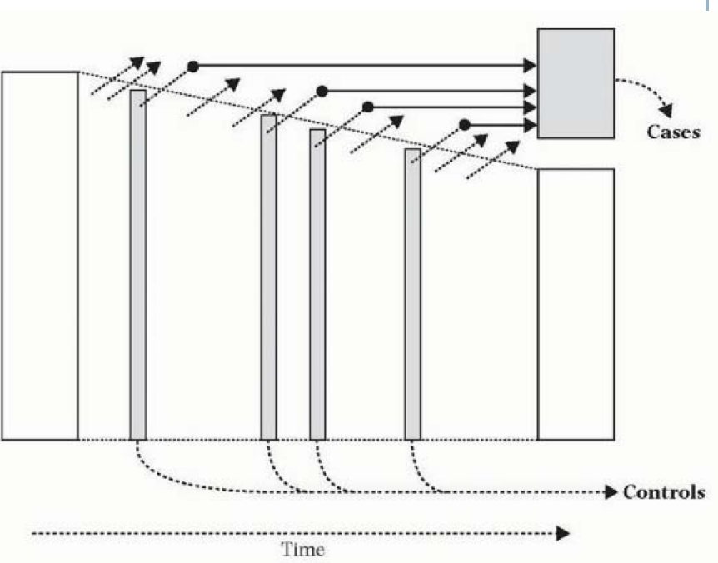
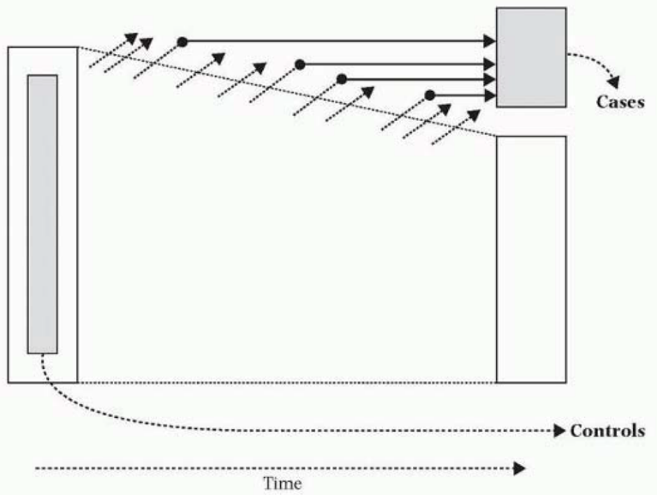
Hypothetical Nested Studies

Slide 13
Mixed Methods in Team Science
Types of Data
    Qualitative
    Quantitative
    Secondary
    Mixed
Sources of Data
    Primary Sources
      Obtained specifically for the purpose of the research and involves direct contact with respondents
    Secondary Sources
      Already existing in some shape or form obtained for another purpose other than the research
Why, When and How of using data

Slide 14

Notes about mixed methods data collection
Determine the source of qualitative and quantitative data
Data collection tools helps focus/address the study objectives
Each method is useful and appropriate for collecting different types of data
Document the methods used to collect data during the research planning stage
Avoid the common error of collecting too many data

Slide 15
The mixed methods continuum
Data collection methods vary along a continuum in which you have quantitative methods at one end and qualitative methods at the other.
How you mix and match methods along this continuum depends on your research questions, objectives, design, and more importantly resources

Slide 16
Before you mix and match…
Consider your research questions, aims and objectives
What type of data is needed?
Determine whether it is quantitative and qualitative data or both
Examine and decide on the source of the data
Understand the strengths and limitations of each type of data and the means for obtaining them
Complimentary nature of qualitative and quantitative data
Consider your resources and what is feasible to accomplish
Define your tools…use new or existing?
Determine the kind of tool to use
  What kind of research (Quant or Qual)?
  What kind of data (Quant or Qual)?
  What is the study population?

Slide 17
Examples of mixed methods data collection tools
Observations
Interview guide
Interview schedule
Questionnaire
Rating scale
Checklist
Document schedule and data sheet
Web based data collection tools (e.g. Open Data Kit)
Participatory methods
Rapid assessment methods

Slide 18
Artificial Intelligence and Mixed Methods Research
AI can be extremely powerful in mixed methods research because it helps integrate, analyze, and interpret both quantitative and qualitative data
  AI-Assisted Qualitative Coding + Quantitative Linking
  Text Mining + Survey Data Integration
  Predictive Modeling Informed by Qualitative Data
  Iterative Instrument Development
  Automated Data Integration (Joint Displays)
  Real-Time Mixed Methods Monitoring (Implementation Science)
  Triangulation and Meta-Inference Support
  Rapid Evidence Synthesis for Mixed Methods Studies
  Natural Language Generation for Reporting
In summary, AI strengthens all three core phases of mixed methods research
  Data Collection → instrument design, adaptive question in
  Analysis → coding, modeling, integration
  Integration → joint displays, triangulation, interpretation

Slide 19
Group Discussion
What types of methodologies are appropriate for team science?
How do you determine what methodologies to use in answering critical research questions?
In what ways can you utilize AI to support collection and analysis of mixed methods data in team science

