Slide 1
MSK Global Cancer and Research Training (GCRT) Program
African Research Group for Oncology (ARGO)
Working with a Statistician:
When to Engage, Best Practices When Creating a Dataset for Analysis, and Developing an Analytical Plan
Jacob Wale Mobolaji, PhD
Department of Demography and Social Statistics
Obafemi Awolowo University, Ile-Ife, Nigeria

Slide 2
Why Statistics Matter in Clinical or Epidemiological Research

Slide 3

Why Statistics Matter in Clinical or Epidemiological Research
  Statistics are not just numbers; it’s the foundation of credible, actionable clinical and epidemiological evidence.
  Without rigorous statistical design and analysis, even the most promising findings risk being misleading, unreliable, irreproducible, or clinically useless.
  "Statistics is the grammar of science."
  Karl Pearson

Slide 4
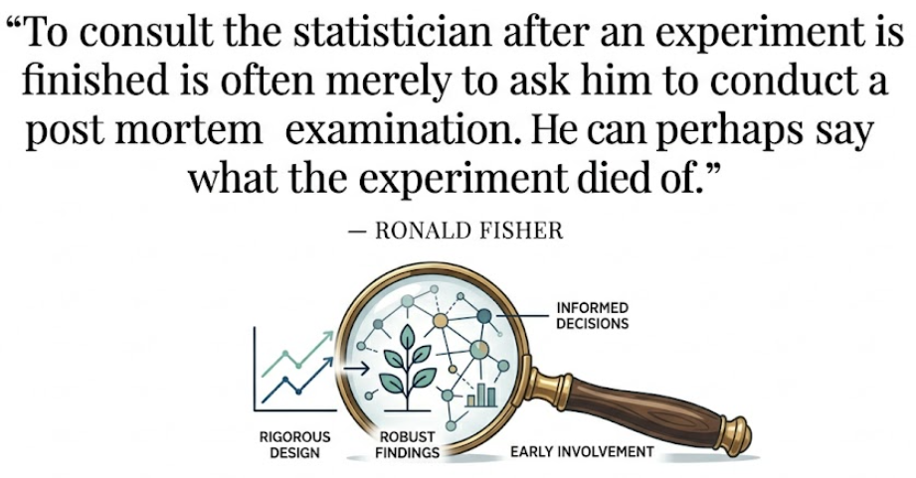
The Role of a Statistician
  Not a "data cruncher" you call after data collection.
  Strategic team member whose early and continuous involvement produces a credible, publishable, and clinically actionable evidence.
  A consultant, but mid-way consultancy is not the best for a clinical project
  Expertise is crucial in protocol development, research design, sample size calculation, analytical methods, and accurate result interpretation.
  Cannot rescue a poorly designed study after the study has begun.

Slide 5
Challenges in Clinician-Statistician Collaboration
  Paucity of “good and experienced” Statisticians
  Disappointment from overly busy statisticians
  Often, clinicians engage statisticians late in the research process, sometimes only after the data has been collected.
  This can lead to significant issues:
    Poorly designed studies, inappropriate analyses,
    Misleading conclusions that don't hold up under scrutiny.

Slide 6
When to Engage a Statistician?

Slide 7

When to engage a Statistician?
Not an afterthought
  Engaging a statistician should not be an afterthought but a foundational step in the research design process.
The Ideal Timeline for Collaboration
  Reach out early…well before the IRB application…
  Consider their busy schedule
  Win them over before others do
  Don’t force a statistician into your project, else you risk disappointment

Slide 8
Optimal Engagement Process (2)
Research Stage | When to Engage | What the Statistician Does | Risk of Late Engagement
1. Idea Conception | ✅IDEAL – Before writing the protocol or grant | - Refines research question into testable hypotheses - Advises on feasible and optimal study design (RCT, cohort, case-control, etc) - Identifies potential biases and confounders upfront - Provides "eagle-eye view" of how this study fits your broader research focus | - Unanswerable research questions - Wrong study design for objectives - Unrecognized sources of bias
2. Protocol & Grant Development | ✅CRITICAL – At least 2–3 months before grant deadline | - Writes rigorous sample size & power calculations with realistic effect sizes - Defines primary/secondary endpoints precisely - Drafts the Statistical Analysis Plan (SAP) - Ensures compliance with CONSORT, STROBE, SPIRIT guidelines - Justifies budget for statistical time and data management | - Underpowered studies (Type II errors) - Vague or inappropriate endpoints - Grant rejection due to weak methods section - Inability to publish in high-impact journals
3. Ethics & Regulatory Submission | ✅REQUIRED – Before IRB/ethics approval | - Ensures ethical randomization and blinding procedures - Designs interim monitoring plans for DSMB if any - Specifies data safety monitoring procedures - Validates informed consent around randomization and data use | - Ethics committee rejection - Unsafe trial conduct - Regulatory non-compliance
Notes:
DSMB – Data and Safety Monitoring Board/Committee

Slide 9
Optimal Engagement Process (2)
Research Stage | When to Engage | What the Statistician Does | Risk of Late Engagement
4. Data Collection (Ongoing) | ⚠️ LATE BUT salvageable – If not engaged earlier | - Reviews Case Report Forms (CRFs) and database structure - Monitors accrual rates and data quality - Identifies emerging biases or protocol deviations - Advises on mid-course corrections | - Poor data quality - Missing critical variables - Unbalanced treatment groups - Inability to adjust for confounding
5. After Data Collection | ❌ TOO LATE – "Post-mortem" territory | - Attempts to salvage analysis with suboptimal data - Applies post-hoc adjustments (with caveats) - Identifies fatal flaws that cannot be fixed - May only be able to conduct exploratory (not confirmatory) analyses | - Unpublishable results - Wasted time, money, and patient participation
6. Manuscript Preparation | ⚠️ Damage control – If not engaged earlier | - Ensures accurate reporting per guidelines - Responds to reviewer critiques on methods - Prevents misinterpretation of p-values, CIs, and effect sizes | - Rejection due to statistical errors - Retractions or corrections post-p
Notes:
DSMB – Data and Safety Monitoring Board/Committee

Slide 10
Best Practices in Setting up Research Datasets

Slide 11
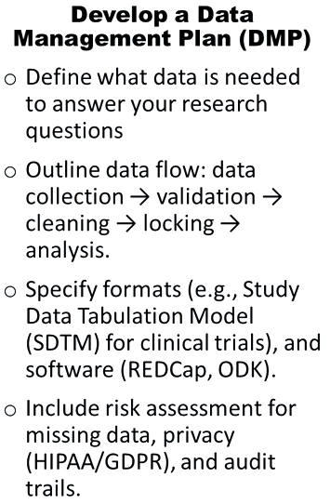
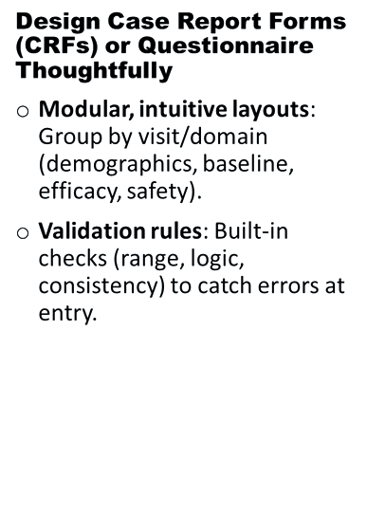
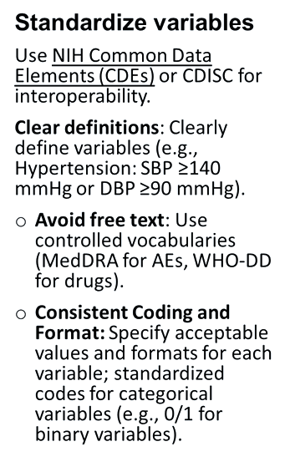
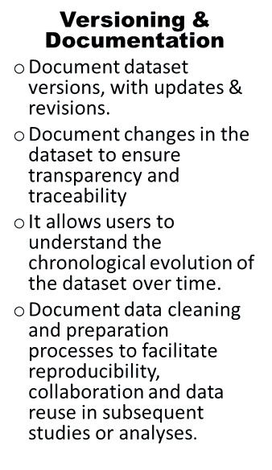
Best Practices in Setting Up Research Datasets (1)

Slide 12
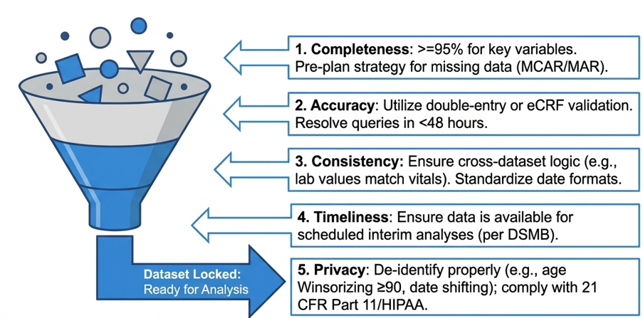
Pillars Data Quality Assurance

Slide 13

Best Practices in Setting Up Research Dataset
Conduct Preliminary Data Checks
  Perform basic descriptive statistics to understand the distribution of your data.
  Check for outliers or implausible values that may indicate data entry errors.
Structure Your Dataset for Analysis
  Organize your data in a format that is easily readable by statistical software (e.g., rows for observations, columns for variables).
  Include identifier variables for subjects and time points, if applicable.
Ensure Data Security and Confidentiality

Slide 14
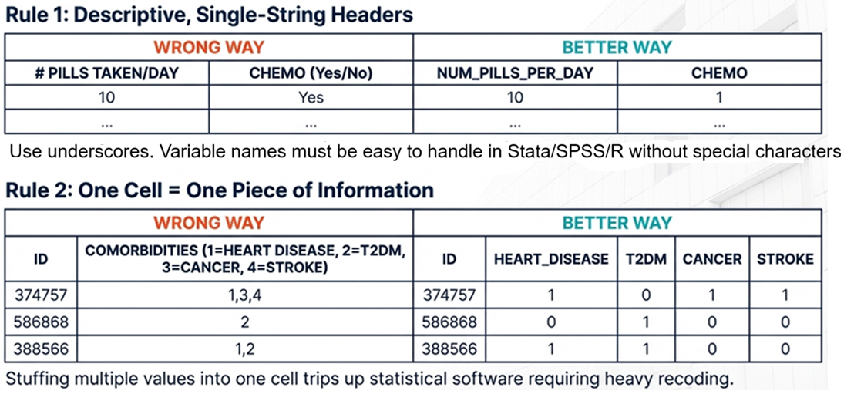
Preparing Your Dataset: Structure & Formatting

Slide 15
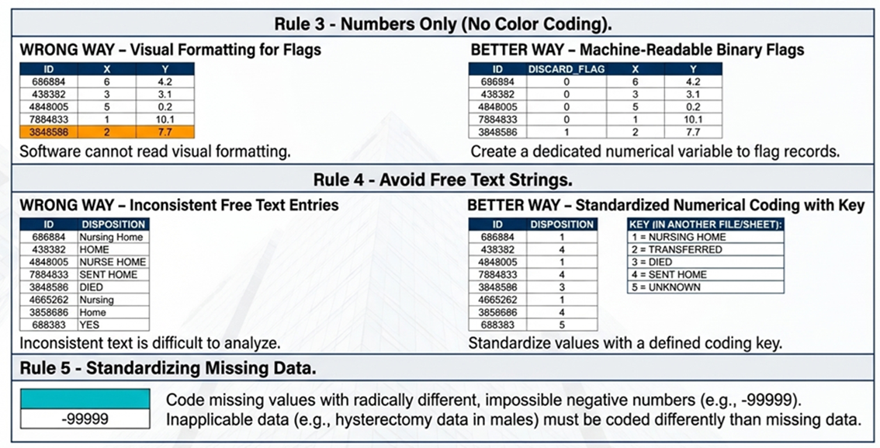
Preparing Your Dataset: Structure & Formatting

Slide 16
Developing an analytical plan

Slide 17
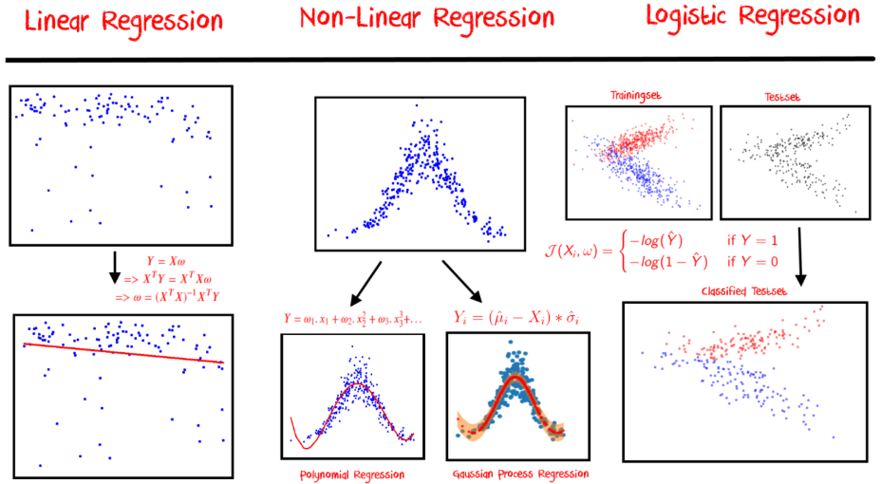
Developing an Analytical Plan
Clarify Research Questions and Objectives
  Begin with a clear articulation of what you want to investigate. Ensure your research questions are specific, measurable, achievable, relevant, and time-bound (SMART).
Specify the Statistical Methods
  Based on the study design and objectives, decide on the statistical tests and models to be used. Consider the nature of your data (e.g., continuous, categorical) and the hypothesis you aim to test.
What
How
Which
?

Slide 18
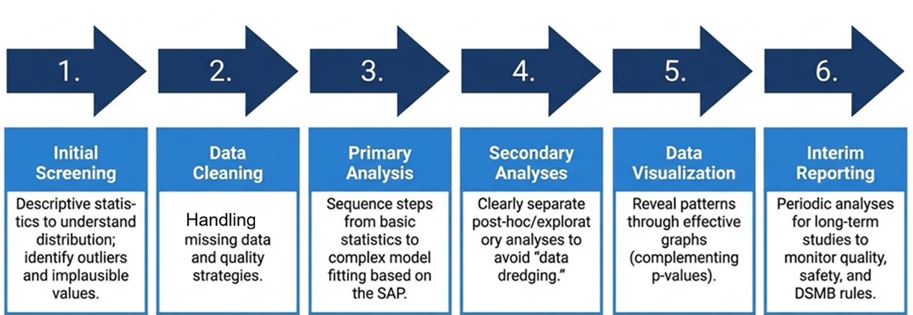
Considerations in Developing an Analytical Plan (2)

Slide 19
Communication with Statisticians

Slide 20
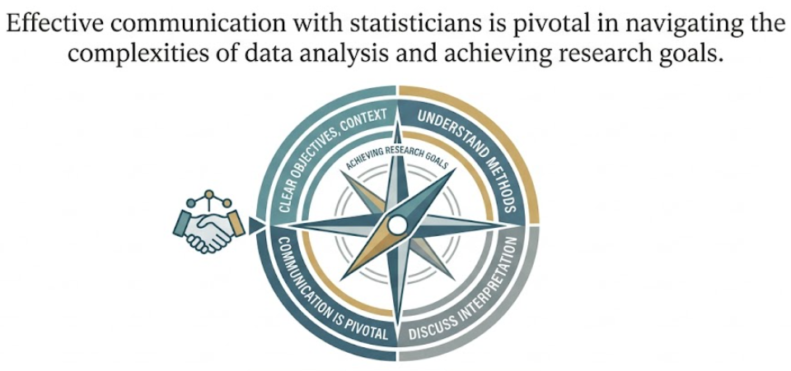
Communication with Statisticians

Slide 21
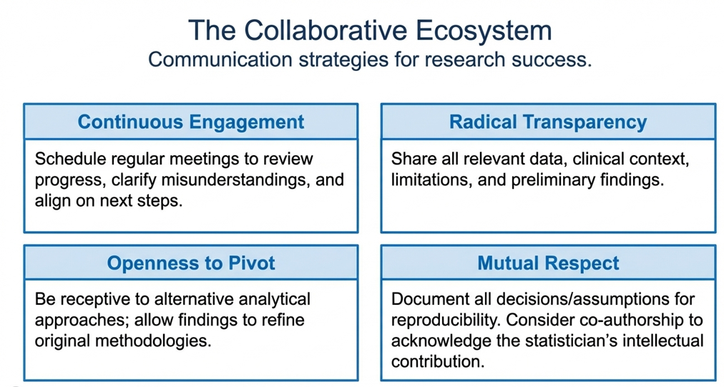

Slide 22
Group Discussion
How have your previous interactions with statisticians gone?
Are there opportunities for improvement?
What would you do better to ensure efficient and successful collaboration?
?

Slide 23
Thank you!
Q&A?

