Slide 1


MSK Global Cancer Research and Training (GCRT)
African Research Group for Oncology (ARGO)
Collaborative Writing in Team Science
Victoria Mango, Fatimah Abdulkareem, Adebola Adedimeji, Natalie Cain

Slide 2

What is Collaborative Writing?
The process of writing and creating any type of content simultaneously with other people
Multiple authors involved in:
-strategy/planning
-research
-writing
-revising
-peer review response
https://ckeditor.com/blog/Collaborative-writing-and-how-to-implement-it-in-your-application/

Slide 3

Collaborative Writing in Team Science
What are some examples of collaborative writing in team science?
https://www.edumaxi.com/blog/what-is-collaborative-writing

Slide 4
Collaborative Writing in Team Science
What are some examples of collaborative writing in team science?
  Research protocol development
  Abstract preparation
  Manuscript preparation
  Grant applications
  Scientific presentations
  ***Any time we need to communicate our science to a larger audience***

Slide 5
Collaborative Writing in Team Science
Why should we apply collaborative writing to team science?
What are some of the advantages and disadvantages of collaborative writing in team science?
Fox et al. 2016. Barlow et al. 2018

Slide 6
Advantages to Collaborative Writing in Team Science
Publishing in science teams has benefits for both the researcher and for science:
  -Brings together diverse thought
  -Encourages creativity
  -Often leads to better writing/science than a single person alone

Slide 7
Advantages to Collaborative Writing in Team Science
Publishing in science teams has benefits for both the researcher and for science:
  -Collaborative manuscripts are more likely to be accepted in scientific journals
  -Have higher citation rates once published
    Potential higher quality
    Higher impact science
Fox et al. 2016. Barlow et al. 2018

Slide 8

Challenges to Collaborative Writing in Team Science
Time
Navigating team dynamics
-hierarchy
-conflicts
-finding compromise
Communication
Requires patience
https://depositphotos.com/photos/communication.html

Slide 9
Personal Reflections- Small Groups
Please describe your own experiences with collaborative writing.
  -What worked well? What didn’t work well?
  -What did you learn from these experiences?

Slide 10
Guiding Principles of Collaborative Writing in Team Science
Transparency
Inclusion and Fairness
Protection and Promotion
Accountability
Efficiency and Productivity
Creativity
Oliver SK, et al. 2018

Slide 11
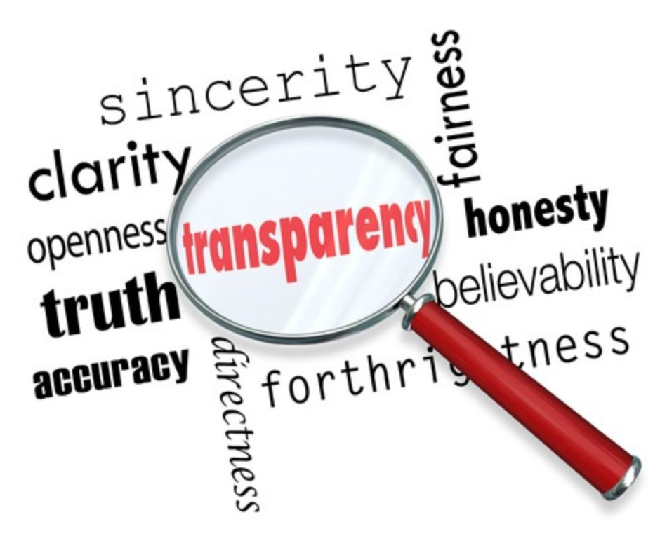
Guiding Principles of Collaborative Writing in Team Science
Transparency
  Clear communication at all stages
  Documentation of ideas, decisions and actions throughout project lifespan
  idea -> publication
Why is transparent communication important?
https://fusenetworking.net/the-art-of-being-transparent-in-business-how-to-break-down-the-walls-to-get-to-the-real-human/

Slide 12
Guiding Principles of Collaborative Writing in Team Science
Why is transparent communication important?
-prevent misunderstandings
-avert team conflict
-means to record and recognize individual contributions to a group effort
-align with open science goals
https://fusenetworking.net/the-art-of-being-transparent-in-business-how-to-break-down-the-walls-to-get-to-the-real-human/

Slide 13
Guiding Principles of Collaborative Writing in Team Science
Transparency
Inclusion and Fairness
Protection and Promotion
Accountability
Efficiency and Productivity
Creativity
Oliver SK, et al. 2018

Slide 14
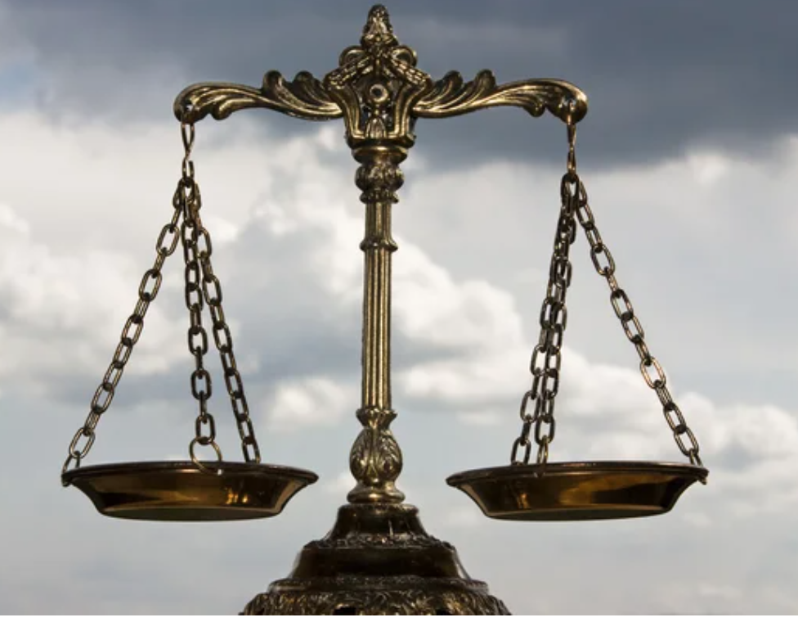
Guiding Principles of Collaborative Writing in Team Science
Inclusion and Fairness
  Across individuals, ideas, expectations
  Challenging with large collaborative groups
    Multiple disciplines
    Different career stages
    Diverse backgrounds
Why is inclusivity and fairness important?
Oliver SK, et al. 2018

Slide 15
Guiding Principles of Collaborative Writing in Team Science
Why is inclusivity and fairness important?
-Promotes innovation and increases creativity
brings together diverse ideas and approaches across disciplines -> high impact science
-Team members feel valued/sense of belonging
-Encourages future collaboration
Oliver SK, et al. 2018; Campbell et al 2013, Nielsen et al 2017, Leung et al 2008

Slide 16
Group Discussion
How have inclusivity and fairness affected your scientific writing in the past?
When has this guiding principle worked well? When has this not worked well?
Oliver SK, et al. 2018; Campbell et al 2013, Nielsen et al 2017, Leung et al 2008

Slide 17
Guiding Principles of Collaborative Writing in Team Science
Strategies for promoting inclusivity and fairness:
-Open communication amongst the team
-Leaders valuing fairness
-Social sensitivity amongst team members
-Teamwork exercises/directed training of the team
best at team level rather than individual manuscripts
-Focus on interpersonal skill development in scientific collaborations
Oliver SK, et al. 2018; Campbell et al 2013, Nielsen et al 2017, Leung et al 2008

Slide 18
Guiding Principles of Collaborative Writing in Team Science
Transparency
Inclusion and Fairness
Protection and Promotion
Accountability
Efficiency and Productivity
Creativity
Oliver SK, et al. 2018

Slide 19

Guiding Principles of Collaborative Writing in Team Science
Protection and Promotion
  Awareness of power dynamics and hierarchy
    Very few teams where all members have equal power
    Power differentials are a fundamental feature of scientific collaborations -> need to be considered to ensure fair practices
  Less influential members of research teams empowered
https://www.aihr.com/blog/hierarchy-culture/
Oliver SK, et al. 2018

Slide 20
Guiding Principles of Collaborative Writing in Team Science
Protection and Promotion
  Strategies to protect and promote team members who lack power to influence team decisions
  Alternate team structures -> Less hierarchical
    Flat-structured teams involve major decision-making among a larger group of individuals across career levels
    Can reduce power differences amongst team members
    Reduce likelihood that power will be abused
Oliver SK, et al. 2018, National Research Council 2015

Slide 21
Group Discussion
How have you observed hierarchy play a role in scientific collaborative writing?
What are effective ways to manage a pre-existing hierarchy?

Slide 22
Guiding Principles of Collaborative Writing in Team Science
Transparency
Inclusion and Fairness
Protection and Promotion
Accountability
Efficiency and Productivity
Creativity
Oliver SK, et al. 2018

Slide 23
Guiding Principles of Collaborative Writing in Team Science
Accountability
  Contributors to the writing are responsible and accountable for content
  In team science, we bring specialized skills and expertise together -> may require different distributions of accountability
  Strategies
    drafting author contribution statements
    transparency at all stages of manuscript development
Oliver SK, et al. 2018

Slide 24
Guiding Principles of Collaborative Writing in Team Science
Transparency
Inclusion and Fairness
Protection and Promotion
Accountability
Efficiency and Productivity
Creativity
Oliver SK, et al. 2018

Slide 25

Guiding Principles of Collaborative Writing in Team Science
Efficiency and Productivity
  Critical to foster so that research products are created and disseminated in a timely fashion
  Need to ensure scientists are incentivized to participate in team science
    Large groups may suffer efficiency and productivity loss if caught up in inefficient or ineffective group dynamics, debates or inactions
https://sachscenter.com/strategies-for-better-time-management/
Oliver SK, et al. 2018

Slide 26
Guiding Principles of Collaborative Writing in Team Science
Transparency
Inclusion and Fairness
Protection and Promotion
Accountability
Efficiency and Productivity
Creativity
Oliver SK, et al. 2018

Slide 27
Guiding Principles of Collaborative Writing in Team Science
Creativity
  Team science works best when individual and group creativity is maximized -> novel and innovative science
  Group creativity can exceed any one individual within a team
  High impact publications come for making connections across disciplines
  Use strategies that include time for individual reflection and team brainstorming
Oliver SK, et al. 2018, Woolley et al 2010

Slide 28
Guiding Principles of Collaborative Writing in Team Science
Small Group Discussion:
Which guiding principles are important to you/your team and why? Any principles missing from this list?
How do we balance using these principles in team science writing?
Transparency
Inclusion and Fairness
Protection and Promotion
Accountability
Efficiency and Productivity
Creativity
Oliver SK, et al. 2018
Notes:
For example, What do we do when one team goal (inclusivity) in direct conflict with other (efficiency)?

Slide 29
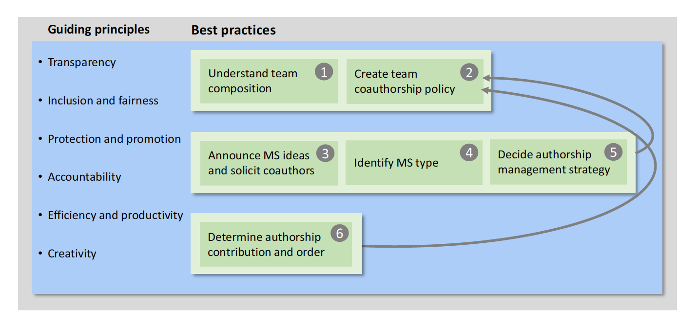
Six Strategies for Effective Collaborative Manuscript Development
Oliver SK, et al. 2018

Slide 30

Collaborative Writing in Team Science Strategies
Understand the team composition
  Individual backgrounds
  Multidisciplinary teams bring diversity
  Team strengths?
  Anticipated challenges? may inhibit team from achieving goals
  Did this team form organically or was the team put together by others?
  Are your goals aligned?
https://www.istockphoto.com/illustrations/team-building

Slide 31
Collaborative Writing in Team Science Strategies
  New versus established team members
    Need to be made aware of unwritten and unspoken practices
    Bring research cultures from past collaborations and experiences
    Used to operating under a different set of assumptions
https://www.istockphoto.com/illustrations/team-building

Slide 32

Collaborative Writing in Team Science Strategies
Create a team authorship policy
  Professional societies, journals and institutions have guidelines
  No single authorship policy works for all teams
  Helps to reduce uncertainty in the collaborative process!
https://www.vecteezy.com/free-vector/policy

Slide 33
Collaborative Writing in Team Science Strategies
Create a team authorship policy
  Discuss authorship early and often as needed
  Include all team members in creating the policy
  If warranted, consider tracking contributions throughout the life of the manuscript
  A living document that can be adapted to changing needs
https://www.vecteezy.com/free-vector/policy

Slide 34
Collaborative Writing in Team Science Strategies
Transparently Communicate
  Communicate manuscript ideas and solicit coauthors
  Identify and communicate manuscript type
  Timing depends on the project and needs -> broadly inclusive vs targeted solicitation

Slide 35

Collaborative Writing in Team Science Strategies
Chose and communicate author management strategy
  Refers to how the lead author(s) manage
    manuscript tasks
    communication
    file-sharing with coauthors
    establishing timelines
    soliciting intellectual contributions from coauthors
    delegating tasks
https://www.everypixel.com/image-1287701091645737355

Slide 36
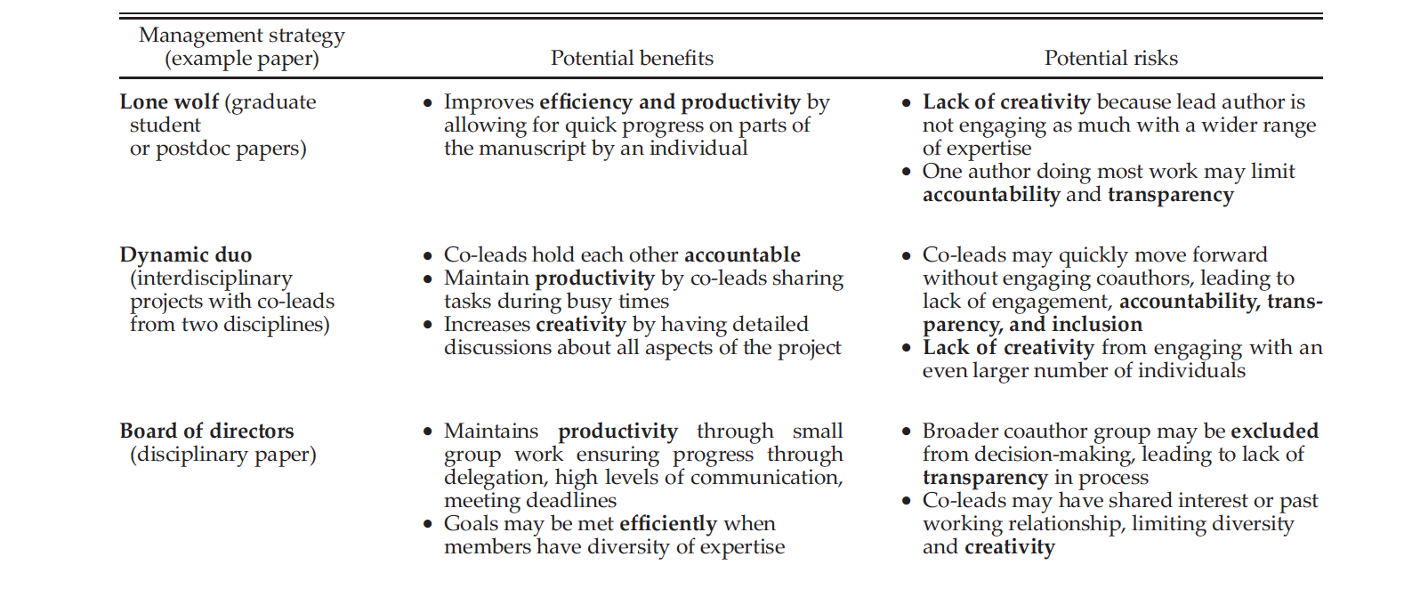
Oliver SK, et al. 2018
Notes:
All can be effective and collaborative when used appropriately

Slide 37
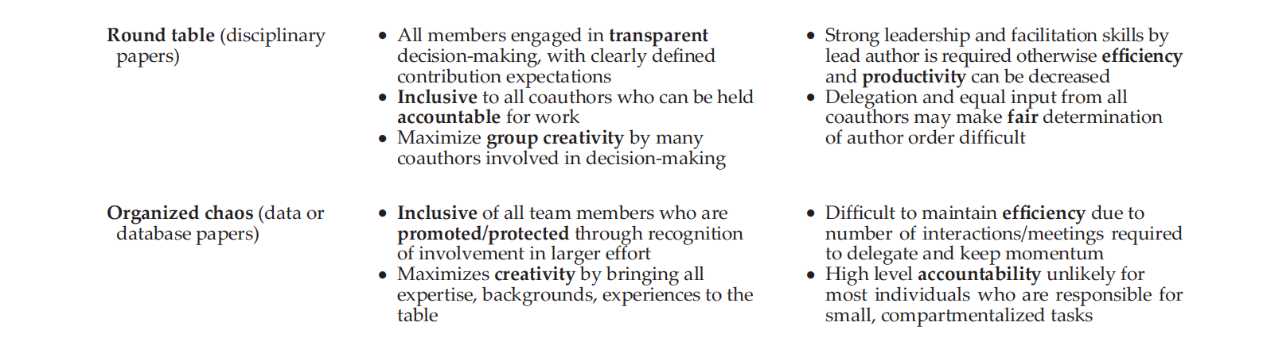
Oliver SK, et al. 2018

Slide 38
Defining Authorship Management Strategy
Clear communication to coauthors very helpful
Diversity of approach and writing styles in interdisciplinary research teams
Need to be open to different management styles

Slide 39
Discussion: Author Management Strategies
What lead author strategies have you experienced in collaborative writing?
What worked well? What didn’t?
Lone wolf
Dynamic duo
Board of directors
Round table
Organized chaos

Slide 40
Take home points:
Successful Collaborative Writing in Team Science
Essential skills: effective communication (verbal and non-verbal), time management, conflict resolution, meeting facilitation
Uphold individual and team values
Increased productivity -> high impact science
Notes:
For example, What do we do when one team goal (inclusivity) in direct conflict with other (efficiency)?

Slide 41
References
Oliver Sk, Fergus CE, Skaff NK, et al. Strategies for effective collaborative manuscript development in interdisciplinary science teams. Ecosphere 2018:9(4).
Barlow JPA, Stephens M, Bode MW et al. 2018 Journal of Applied Ecology 55:1-4.
Campbell LF, Mehtani S, Dozier ME, et al. 2013 PLoS ONE 8:e79147
Fox CW, Paine CE and Sauterey. 2016. Ecology and Evolution 6:7717-7726
Leung AK, Maddux MW, Galinsky AD, et al. 2008. American Psychologist 63:169-181.
National Research Council 2015. Enhancing the effectiveness of team Science. National Academies Press (US) Washington DC, USA
Nielsen MW, Algeria S, Borjeson L, et al. 2017. Academy of Science of the USA 114:1740-1742.
Woolley AW, Chabris CF, Pentland A. Et al. 2010. Science 330:686-688.

