Slide 1



MSK Global Cancer Research and Training (GCRT)
African Research Group for Oncology (ARGO)

Slide 2
Ethics in Team Science Research and Responsible Conduct of Research

Slide 3
Working with Research Constituents
Session learning objectives
Learn strategies for identifying and engaging with research constituents
Describe the researcher’s responsibilities in protecting the research constituents
Understand the principles and requirements for conducting a patient-focused research
Understand the principles and requirement for conducting community-based participatory research

Slide 4
Session Learning Objectives
The importance of ethics in team science research
Ethical principles governing research involving human (and animal) subjects
Guidelines for ethical conduct of research
Compliance with ethical guidelines in team science research (local and international collaboration)
Mechanisms for obtaining ethical approval
Ethical Dilemmas

Slide 5
Working with Research Constituents
Session learning objectives
Discuss the origins of ethics in research
Describe the researcher’s responsibilities in protecting the research constituents
Understand ethical responsibilities in team science
Case studies

Slide 6
Identifying and working with the research constituents

Slide 7
Defining research constituents
An individual, group(s) or institution(s) with a stake or interest in your research
Any individual, group(s) or organization(s) that can affect or be affected by the results of your research
Other terms used to describe research constituents
  Collaborators
  Stakeholders
  Partners
  Colleagues/investigators
  Study population/research participants
  Contributors (especially in the case of scientific writing)

Slide 8
Identifying and working with the research constituents
Understanding the research process
  Define the research/key questions, including specific aims and/or objectives
  Formulating appropriate study designs/frameworks/methodology
    Study population- (Human subjects, Types, Characteristics, Location, Sampling, etc.)
    Data collection (When, How, Why, Size, Depth, Resources and materials needed, etc)
  Planning for analysis of data
  Disseminating research results to critical stakeholders
Each stage of the research process involves different/multiple stakeholders
Developing a strategy and timing for engaging them

Slide 9
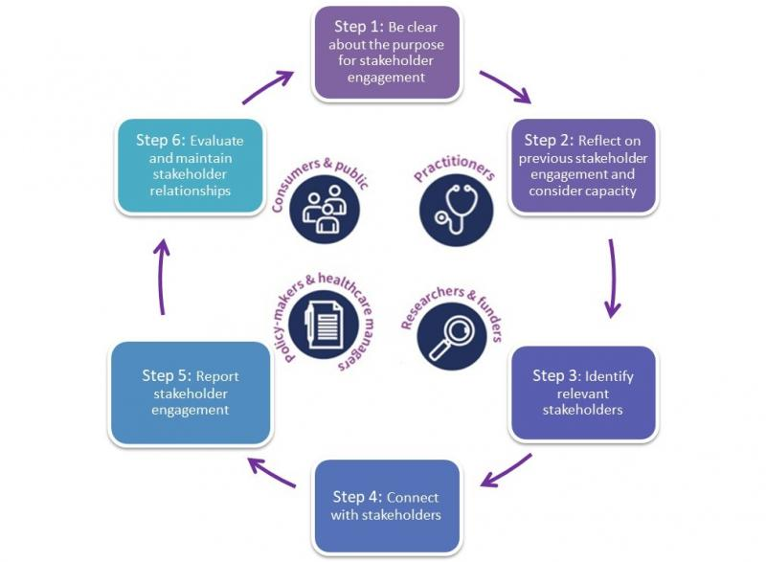
Strategies and processes for stakeholder engagement
Conduct a stakeholder mapping
Determine a process/methods for stakeholder engagement
  7Ps framework using deductive and inductive methods (Concannon, et. al., 2014, Bradley, et. al., 2007)
    Patients and Public
    Providers
    Purchasers/Users of research results
    Payers
    Policy makers
    Product makers
  6 Stages Model (Tomlison and Parker, 2021)
    Clarity on the purpose for engagement
    Reflection on previous engagements and their capacity
    Identifying relevant stakeholders
    Making the connection
    Providing routine feedback
    Evaluating and maintaining networks
Key Questions to consider
  When to engage?
  Where to engage?
  Why engage?
  How to engage?
Six Step Stakeholder Engagement Framework | Source: Cochrane Community

Slide 10
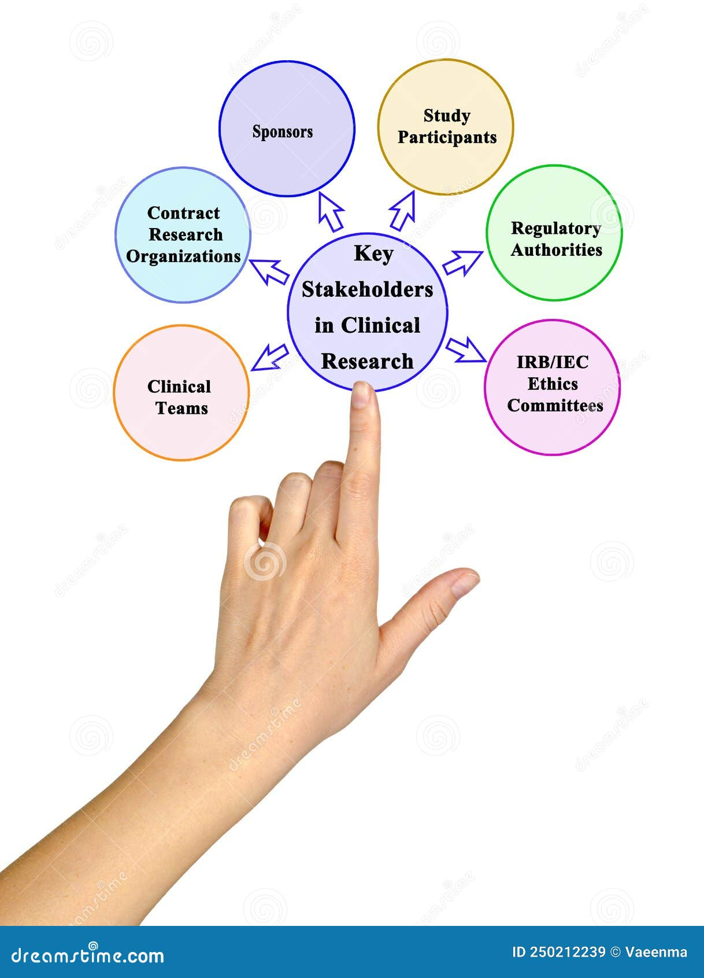
Stakeholders in Team Science research
Research subjects
Researchers and collaborators
Sponsors
Institution- main and host
Professional association
Public and others affected by the research
Each stakeholder has a right to be protected!

Slide 11
Ethical issues and approval in Team Science Research

Slide 12
Session Learning Objectives
The importance of ethics in team science research
Ethical principles governing research involving human (and animal) subjects
Guidelines for ethical conduct of research
Compliance with ethical guidelines in team science research (local and international collaboration)
Mechanisms for obtaining ethical approval
Ethical Dilemmas

Slide 13
Why is ethics important in team science research?
  Milestones in Research Ethics
  Nuremburg code- (Nuremburg Trials)
  Helsinki Declaration (World Medical Association) 1964
  US National Research Act, 1974 (Institutional Review Boards)
  Belmont report (1978)
  Council for International Organization of Medical Sciences (CIOMS)
  United States Office for Human Research Protections
The importance of ethical considerations in research
The importance of research in advancing scientific knowledge about health issues
Greater attention to both the objects and subjects of research
Ethical issues regarding human subjects have received increasing attention over the last 50 years
Protect research subjects (both human and animal)
Protect those working on the research (the researchers)
Protect the institution/professional body whose name is associated with the research

Slide 14
Traditional versus Modern views of research ethics
Traditional
  Rights, obligations and responsibilities
  Privacy and confidentiality
  Impartiality, neutrality, non-discrimination
  Fairness, justice and Equity
  Freedom and openness vs. regulation and control
  Discovery vs. responsibility
Modern
  Transparency
  Trust
  Openness
  Honesty
  Respect
  Autonomy
  Protection

Slide 15
Core principles of Ethical Research (Belmont Report, 1978)
Autonomy/Respect for persons
Research subjects make independent informed decisions whether or not to participate in the research. The recognition that everyone has a right make their own [informed] decisions
Beneficence
Researcher should aim to maximize the benefits and minimize the harm to research stakeholders
Justice
Equitable selection of participants and distribution of benefits
Fidelity
To be fair and treat equally
Non-maleficence
The principle of doing no harm
Veracity
Being open, truthful, having no deception

Slide 16
Researchers’ compliance with ethical guidelines
Promote aims of the research and the quest for truth about a phenomena
Promote the values that are essential for collaborative work:
- trust
- respect
- fairness
- responsibility
Promote accountability to various stakeholders in the research process, especially research subjects
Promote public support by establishing integrity
Promote shared moral values
It’s the Law!

Slide 17
Obtaining Ethical Approval- The role of Institutional Review Boards (IRBs)
What are they?
  Regulating bodies set up to oversee the conduct of research and ensure compliance with ethical guidelines
Operate at various levels including
  Institutions- Universities, Colleges, Research Institutes
  Professional bodies
  Local, National and International
Oversight over ethical issues relating to research carried out under institutional brand or name
Anyone who seeks to conduct research under the brand or name is required to seek ethical clearance and approval from the appropriate committee charged with the responsibility.
Ethics approval for research involving human subjects may be a lengthy process in certain situations
Power to approve or deny ethical clearance for research to commence
Ethics committees are made up of scientists, clinical faculty, and administrators who review research according to the procedures set out in the ethical guidelines
Discussion:
Ethical approval in Local and International contexts for Team Science Research

Slide 18

Ethical Dilemmas- dos and don’ts
Ethical guidelines are applicable in any context, but their interpretation implementation are mediated by the culture and circumstances where the research is undertaken.
Even when ethical approval has been granted, circumstances may arise that warrant a change in research procedure. Under such circumstances, what is acceptable?
Ethical issues that might arise with vulnerable populations
Dealing with ethical conflicts
What constitutes ethical misconduct?
  Intention to deceive (Fabrication, Falsification and Plagiarism)
  Reasonable disagreements

Slide 19
Community-based Participatory Research (CBPR)

Slide 20
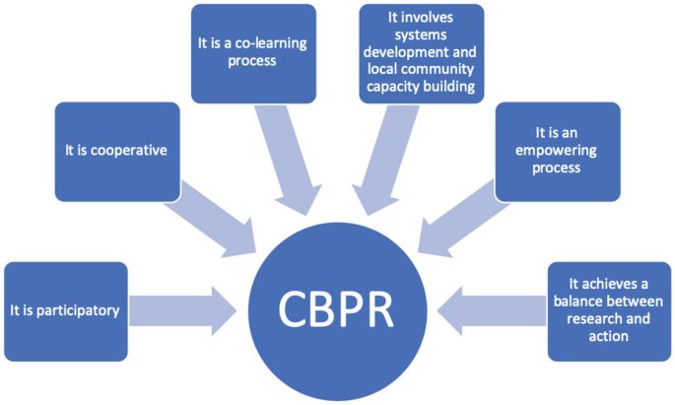
Community Based Participatory Research (CBPR)
The existence/recognition of a community regarded as a partner
Aims to increase knowledge and understanding and apply these to resolving an identified problem [mostly health related]
Community involvement in the entire research process from conception to implementation
Community members seen as ‘researchers”, not as subjects/objects of research.
Useful in both defining a research question or conducting experimental research
Rigorous yet flexible allowing for follow up of issues and concerns which emerge during the research process

Slide 21
Defining CBPR
A partnership approach that engages diverse partners in every aspect of the research process; where all partners contribute their expertise and in which influence, decision-making and ownership is equally shared (Israel et.. al, 1998)
In this context, participatory connotes…
  An equal balancing of the responsibilities, power, influence and control over the research process between researchers and community partners

Slide 22
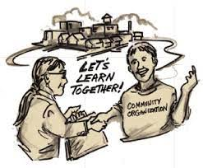
Principles of CBPR
1 2 3 4 5 6 7 8 9 | Recognize community as a unit of identity Identify and build on the strengths and resources within the community Facilitates equal collaborative partnership in all phases of the research by especially taking account of social inequalities between partners Promotes cooperative learning and capacity building among all partners Integrates a balance between knowledge generation and intervention for mutual benefit of all partners Focus on local relevance of health problems and its multiple determinants Focus systems development through a cyclical and iterative process Disseminates results to all partners and encourages their involvement in the process A commitment to sustainability

Slide 23

Characteristics of CBPR
It is an approach and a process to identify relevant research questions, study designs and data collection
Mostly used to empower marginalized groups by encouraging and facilitating their participation in the research process
Generates trust and confidence in the research process among community partners
Engages community members and researchers in a joint process
Provides opportunities for joint learning while facilitating local capacity building
Achieves a balance between research and action
Ensures community partners ownership and commitment to sustainability of research

Slide 24
Types of research where CBPR is relevant
Descriptive research to identify or elucidate social determinants of health
Experimental research to understand disparities in health status or risk factors for health outcomes, especially among marginalized groups
Exploratory research to define needs, problems and assets in specific communities
Intervention and/or evaluation research for programs and policies to improve health outcomes

Slide 25
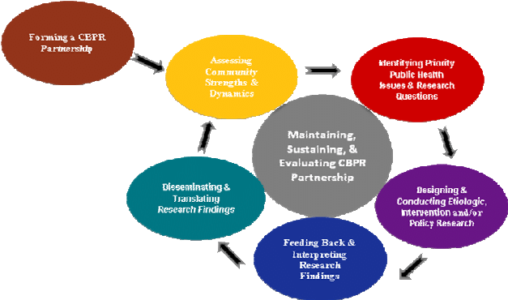
Stages of CBPR
Forming and maintaining community partnerships
  Who is the community?
  Leadership/representativeness
  Dynamics of interaction and relationships and ongoing conflict resolution measures
Assess community dynamics
  Understand history of relationships , values, norms, language, communication
Identify local [health and other] concerns
  Must be relevant to community partners and issues of concerns
Mutual commitment to take action
  All partners must jointly decide on solutions and be committed to taking action
Document/evaluate effectiveness of partnerships
  Requires ongoing assessment and evaluation

Slide 26

Critical questions for engaging CBPR
Who are the partners and what is the nature of their involvement?
Who identifies or defines the research question?
What is the aim, purpose and goal of the research?
Is the process and context of the project suitable for CBPR?
What opportunities exist to address issues of interest to the local community?
What is the nature of the desired outcome?
How do you identify and address imbalance in power dynamics?

Slide 27
Issues in using CBPR
Is community partners’ role Advisory or Participatory
  Sharing power and control over decision making process
Using community partners only to generate information
Consider resources needed
Clarify social and authority structure among partners
Working with and managing diversity
Generating balance between research and change
Facilitators- Trust, Process and Resource allocation

Slide 28
Critique of CBPR
Power and influence of the poor/underprivileged
Group selection and composition
Extent of changes proposed

Slide 29
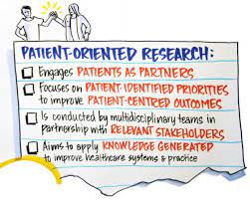
Patient-focused Research
Different conceptualizations still exist, but it is generally agreed that PoR have common characteristics
Research intended to benefit individual patients and that meaningfully partners with patients to plan, conduct, or interpret the study (Baumgardner, 2019).
US NIH defines it as research with human subjects (or on material of human origin) in which an investigator directly interacts with the patients, their families and caregivers.
Canadian Institutes for Health Research defines it as a continuum of research that engages patients as partners with a focus on patient-identified priorities to improve patient outcomes
Features of PoR
  Patients are engaged as research partners (often by multidisciplinary teams)
  Mostly applied in clinical and translational research
  Researcher competencies- participation, communication and teamwork, conflict
  management and resolution
  Patient competencies- research knowledge, cultural competence/context and participation
Strategies for conducting PoR

Slide 30
Group Discussion
What are best practices for identifying and working with research constituents?
Which view (traditional vs modern) should prevail in ethical considerations for research stakeholders?
Under what circumstances is community-based participatory research relevant?
What are the benefits of patient-oriented research?

Slide 31
Small Group Exercise
What are the ethical concerns related to the conduct of your proposed research study?
How will you ensure that your proposed research study is carried out ethically?

Slide 32
Small Group Exercise
Should unethically collected data, and subsequent results, be utilized or destroyed?

