Slide 1
Robust methodology, sample size justification and pre-specified analyses plans
Alexia Iasonos, PhD, FASCO, FSCT
Attending Biostatistician
Department of Epidemiology and Biostatistics, MSKCC, New York
President, Society for Clinical Trials

Slide 2
YOUNG INVESTIGATOR AWARD: criteria
Strength of the hypothesis-driven proposal with a clinical research focus or with the goal of generating the rationale for future clinical studies. (May include pre-clinical in vitro and/or animal experiments that are designed to address a clinical question.) (~35%) o Significance and originality of the proposed study and hypothesis
  Appropriateness, feasibility, and adequacy of the proposed experiment and methodology
  Appropriate and detailed statistical analysis plan
  A focus on patient-oriented or translational and, ultimately, clinical research
Strength of the mentor in supporting the applicant's proposal and in facilitating the applicant's career development (~30%) o Quality of the mentor and the plan for mentoring interactions with the applicant
https://www.asco.org/research-guidelines/grants-awards/funding-opportunities
https://www.asco.org/research-guidelines/grants-awards/funding-opportunities/young-investigator-award
https://www.asco.org/sites/new-www.asco.org/files/content-files/research-and-progress/documents/2021-YIA-RFP-20-0629.pdf

Slide 3
Secondary Criteria
Potential for the applicant to pursue an academic clinical oncology career (~25%)
Potential favorable impact on career development of the applicant The qualifications and experiences of the applicant. Factors considered include the quality and extent of past education, scientific training, research experience, research originality, productivity, potential for independent investigation, and commitment to a career in clinical oncology research.
Availability of institutional resources to support the proposed project (~10%)

Slide 4
Personal Statement (required)
Please answer the following questions in the text box areas on the online application. Cutting and pasting from a Word document is allowed. Please answer as briefly as possible. Each question has a maximum limit of 2,000 characters.
  What is the applicant's career plan?
  How would receiving this award affect the applicant's career?
  What is the percentage of time the applicant spends on research activities?
  What is the applicant's role versus the mentor’s role in the proposed research study?
  What are the sources of salary support?
  Who will collect and analyze the data?
  What is the clinical potential of this research project?
  Was this research proposal submitted and/or will be submitted to other funding agencies/organizations?
  Will your proposal involve the use of drugs (yes/no)? If yes, please specify the drug and the drug manufacturing company.
DO NOT INCLUDE IN PERSONAL STATEMENT THAT YOU WILL BE DOING THE ANALYSIS
YOU COLLECT THE DATA,
YOU INTERPRET THE DATA
YOU WRITE THE REPORT
You rely on a statistician for the experimental design and data analysis

Slide 5
Scoring
NIH scoring scheme: 1 (good)-10 (bad)
Reviewers are encouraged to use the full scale
5 is not bad but it is very likely not funded
1-3 is high (desirable)

Slide 6
Competitive process among the top scoring 1-3
Applicant’s background
Mentor (institution)
Overly Ambitious aims
Strength of the hypothesis-driven proposal
Appropriateness, feasibility, and adequacy of the proposed experiment and methodology
  Experimental Methods
  Analysis Plan
  Feasibility

Slide 7
Contact the statistician early
Get them involved early
A last minute application is obvious
Collaboration
  Understand aims and objectives and what are we going to learn
  What data we will collect to address these aims – what variables?
  How often are we collecting data? On whom?
  What design should we use?
  What are the limitations?
  What are the future plans based on the lessons learned?
September
1-2 weeks for your mentors to review the final draft
July – August (2 months)
September is a deadline for many other grants (NIH)
July- August (other deadlines e.g. abstracts ASH, SGO)

Slide 8
Biostatistical Plan (required)
1
A detailed statistical plan is required for all applications. The plan is limited to one (1) typewritten, single-spaced page with one-inch margins and 11-point Arial font type. For clinical and in-vivo studies, this section should include the primary objective/hypothesis and primary endpoint of the study, description of experimental design and study groups that will be compared, justification of the proposed study sample size, detailed procedures for data analysis, and appropriate statistical considerations. An appropriate sample size justification will include all parameters required for the computation of the sample size: the effect size, power and type I error rates for each Aim. When relevant to the project, it will also state median follow-up, prevalence of mutations in a given population, and accrual rate, for example.
Laboratory-based in vitro research proposals should also include the primary objective/hypothesis and primary endpoint of the study, procedures for data analysis, and appropriate statistical details that describe the summary measures that will be used to meet the objectives of the study.
Applications will be reviewed by a biostatistician. Applicants should work with a biostatistician to develop the application. If statistics are not applicable to the project, the applicant should upload a document stating that “Biostatistics are not applicable”, and the reviewers will evaluate.
1
2
3
4

Slide 9
Descriptive – myths
Exploratory
Hypotheses generating
No hypotheses in a non clinical trial or clinical trial (this study will develop hypotheses)
No statistics are needed (WRONG)
No power, no definitive conclusions, you might need a follow-up study (all valid) but
What will you learn after this project is completed?
Cannot be asking for funding to think ;
Asking funding TO ANSWER a question or multiple questions
  Do an experiment
  Learn from the experiment (negative studies inform future studies)

Slide 10
Example: mice studies
For each mouse, the area under the tumor volume curve (AUC) summarizes the tumor volume over time.
Survival time is defined as the minimum of the time to death or maximum follow-up. In contrast to the clinical setting, the maximum follow-up time is constant across all animals.
The primary reason for censoring is sacrifice. Ignoring this type of informative censoring results in a bias of the AUC-based test statistic. To account for informative dropouts, the area under the curve in the two treatment groups (AUC1 and AUC2) is calculated up to the minimum follow-up time for each pairwise difference in the double sum where i=1,2,…,n and j=1,2,…,m mice in the two groups [Vardi et al].
Is the reason for the sacrifice unrelated to the potential failure time?
The AUCs or survival times are ranked after pooling the data in the two treatment groups, and a permutation test is employed to determine if the observed outcome between treatment groups occurred by chance
The test statistic used to perform this comparison is the sum of the ranks in the experimental group after pooling the outcome data (survival times or tumor volume AUCs). If the outcome data in the experimental population were greater we would expect the ranks in the observed statistic to be large. To determine just how large the rank sum should be before we are confident that the endpoint in the two groups is different, a critical region is developed under the null permutation distribution, where each ordering has equal probability of occurrence. A power function is constructed under the semiparametric specification 1-F(x) = [1-G(x)]^{ˠ} , where F and G are the unknown distribution functions of the outcome data from the two groups and the parameter γ is defined as the odds an experimental group measurement is greater than a control group measurement. This specification is known as the Lehmann alternative. When the outcome measure is survival time, γ is the odds the experimental group mouse will have the longer survival time. A similar parameter can be defined in terms of the AUC for tumor volume.

Slide 11
Lessons learned
Dependent censoring (sacrifice mice when tumor grows)
Missing data
Right censored data
Comparing survival in small sample sizes (resampling procedures)
AUC as a summary measure (single number) vs entire curve
Separate the design from the analysis
  What we collect: how/design, how often (burden on pts, cost)
  What we analyze: how, one time point, many; summary measures

Slide 12
Example: mice studies cont.
Note that γ=1 corresponds to the null hypothesis of no difference in the survival times. The table shows the sample sizes needed for a 0.05 level two-sided test, with 0.80 power as a function of the odds parameter γ (Table 1). For example, for ten mice in the experimental and control groups, the odds need to be 5:1 in favor of an experimental group mouse having a longer survival time than the control mouse to have sufficient power. The odds parameter also has an interpretation as a fold change in the population average outcome measure between groups. Thus, for example, an odds parameter of five suggests that the experimental group has an average survival time that is five times greater than the control group. In some experiments, not all the mice are followed for the full length of the study.
Table 1. Power analysis
# of Mice (per group) | Odds
5 | 14.0
10 | 5.0
20 | 3.0
45 | 2.0
References:
Heller G. Power Calculations for Preclinical Studies Using a K-Sample Rank Test and the Lehmann Alternative Hypothesis . Statistics in Medicine. 2006; 25(15):2543-53.
Vardi Y, Ying Z, Zhang CH. Two-sample tests for growth curves under dependent right censoring. Biometrika.2001; 88: 949-960.
Heller G and Venkatraman ES . Resampling procedures to compare two survival distributions in the presence of right censored data. Biometrics. 2006; 52:1204-1213.

Slide 13
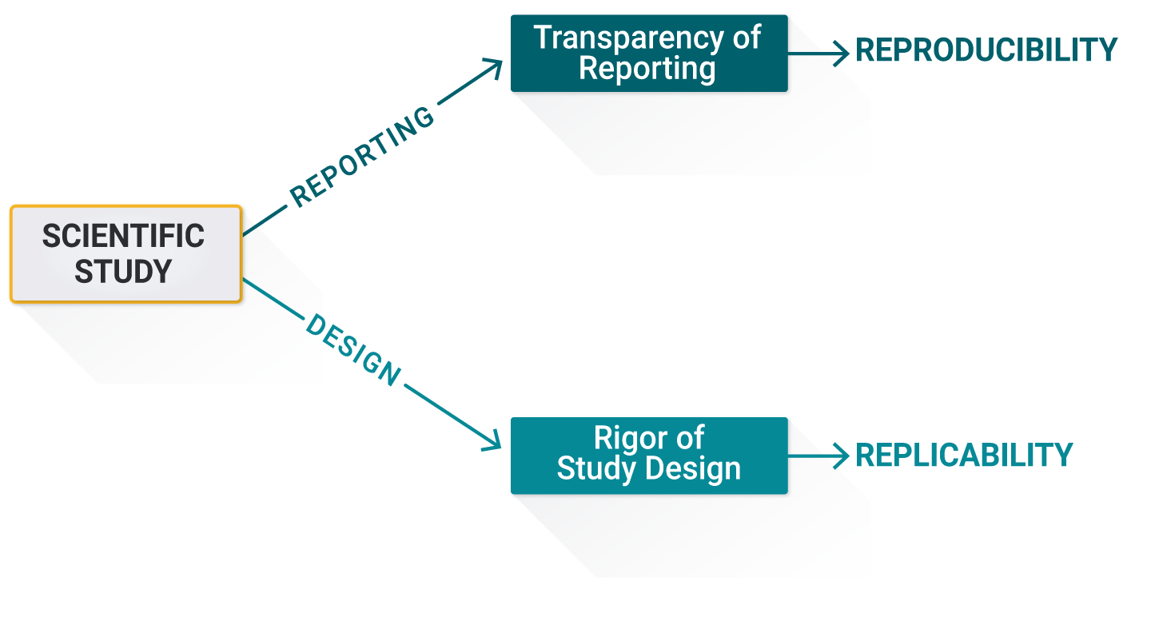
TERMINOLOGY

Slide 14
Reproducibility
“A study’s results are reproducible if the data summaries and statistical analyses performed are calculated correctly and without error.”
In the NSF definitions this term is defined in the context of the reporting and/or analysis of the data. In practice the term is used much more loosely to encompass what we will refer to as replicability.

Slide 15
REPLICABILITY
“The ability of a researcher to duplicate the conclusions of a prior study by repeating the experiment and collecting new data.”

Slide 16
Transparency
“A study is reported transparently if all inferentially critical steps taken in the design, conduct and analysis of the study are reported fully and accurately.”
Note that Reproducibility is enhanced by Transparency in that it is only possible to reproduce the findings if all the relevant technical details of the original data processing and analysis steps are reported

Slide 17
RIGOR
“A study is scientifically rigorous if it is designed and conducted in a valid manner to critically evaluate and if necessary refute the hypothesis under investigation.”
Replicability is enhanced by the quality and integrity of the design and conduct of the original investigation – a study is more likely to be replicated if it is rigorous

Slide 18
Workshops
How to write grants?
How to write papers?
How to write protocols?
How to explain your science in lay terms?
Authorship guidelines (library and Journal)
Mentorship – many, many, many drafts

Slide 19
RESOURCES -Library
Library: Policies, procedures and guidelines
Workshops: how to write grants, manuscripts, how to explain your research in Layman’s terms
Library can help you contact systematic reviews, meta analysis, points you to material and guidelines up front
Available material online

Slide 20
RTM internal web page:
  Research outreach and compliance
    education and training / videos and presentations
    RTMROC@mskcc.org
    https://mskcc.sharepoint.com/sites/pub-RTM/SitePages/roc/ROC-Home.aspx
    https://www.mskcc.org/research-advantage/support/rtm/policies-procedures
TBD | ​NIH Grant Writing Workshops - T, F, K, R01 | ​Virtual | ​
TBD | Rigor and Transparency | Virtual
Notes:
RTM research and technology management

Slide 21
THANK YOU
Questions
iasonosa@mskcc.org
For help, contact a consulting statistician or a collaborator at your center
Notes:
”

