Slide 1
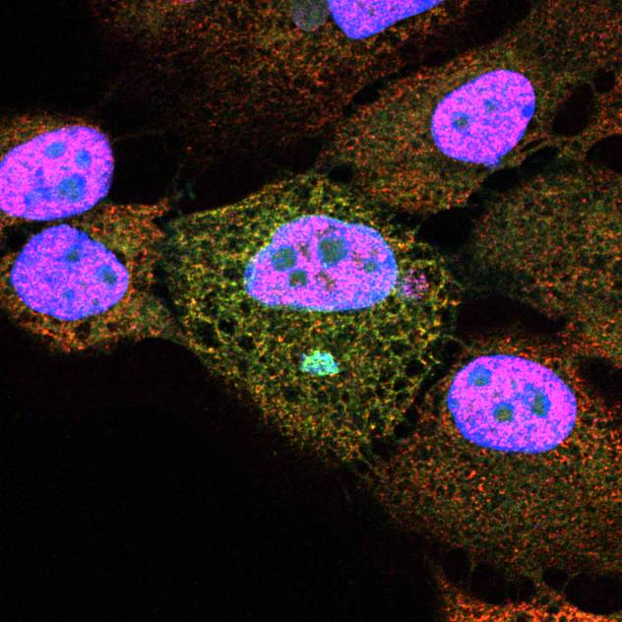
Chromosomal Instability
John Maciejowski
Molecular Biology Program
Sloan Kettering Institute

Slide 2
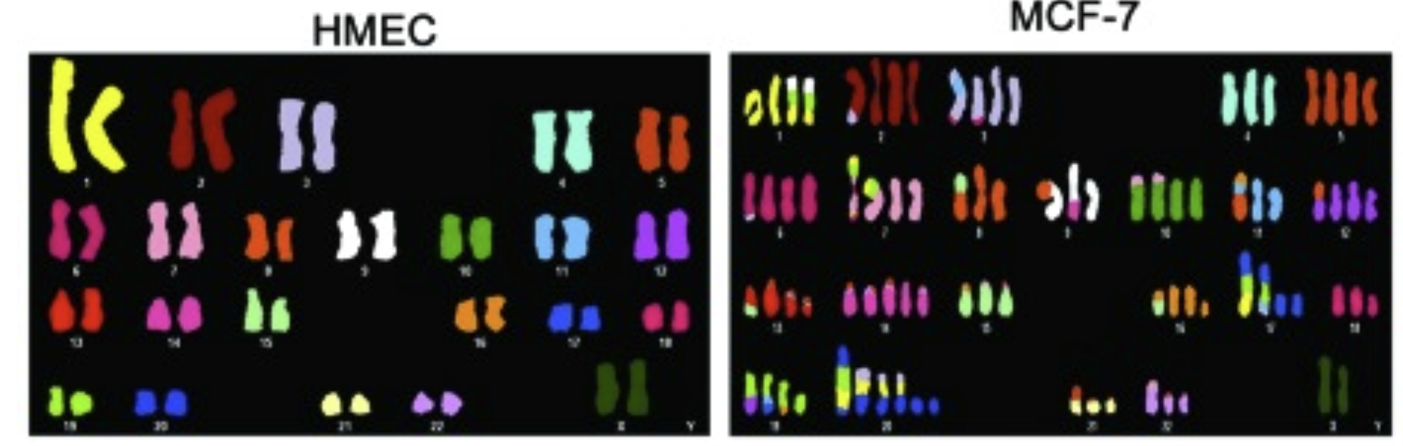
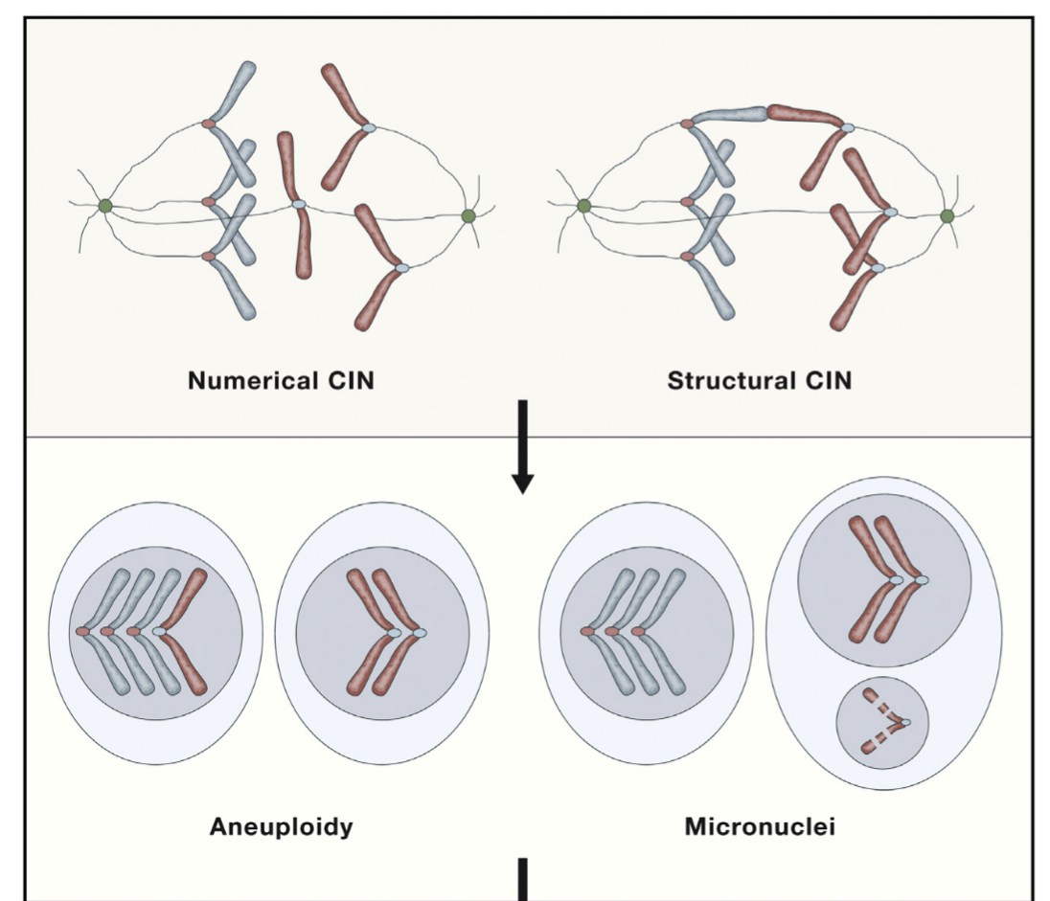

Chromosomal instability and aneuploidy in cancer
What goes wrong in cancer?
Aneuploidy: The state of having an abnormal chromosome number
Chromosomal instability: The process of frequent errors in chromosome segregation
How could you distinguish between aneuploidy & CIN?

Slide 5
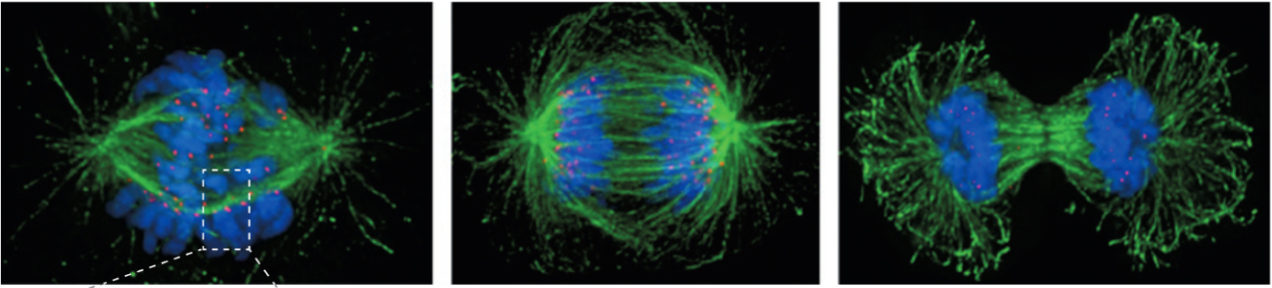
Chromosome alignment and sister separation
DNA
Centromeres
Microtubules

Slide 7
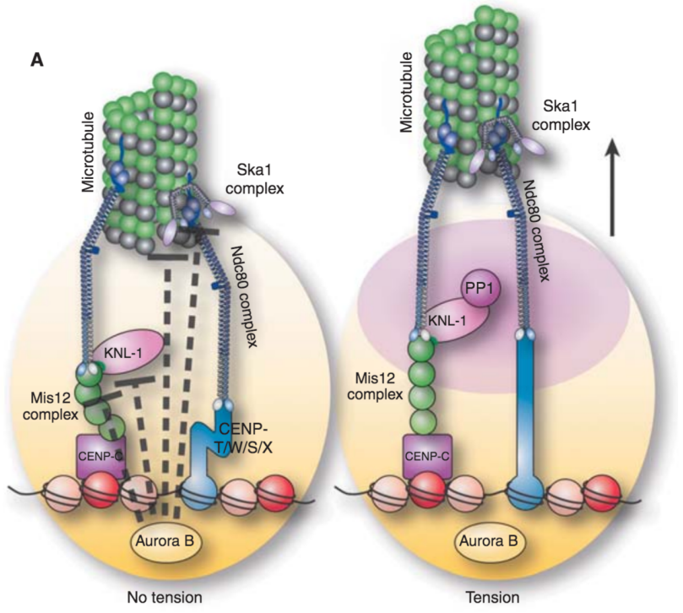
Attachment correction
Faulty attachments can be released and tried again.
Biorientation helps stabilize productive attachments.

Slide 8
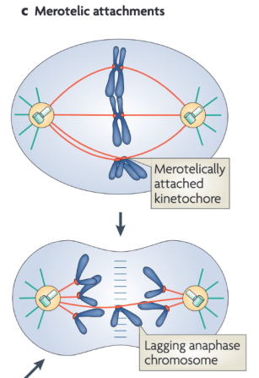
One kinetochore can attach to both poles
Opposing forces can leave a chromosome behind during anaphase.
A lagging chromosome is an observed event.
The chromosome can rejoin a main nucleus or form a micronucleus.

Slide 9
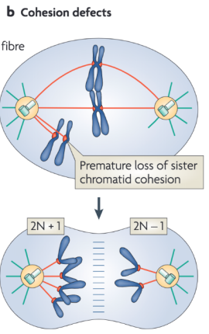
Cohesion holds sisters together until anaphase
Cohesion provides resistance while sisters establish biorientation.
Premature separation disrupts that geometry.

Slide 10
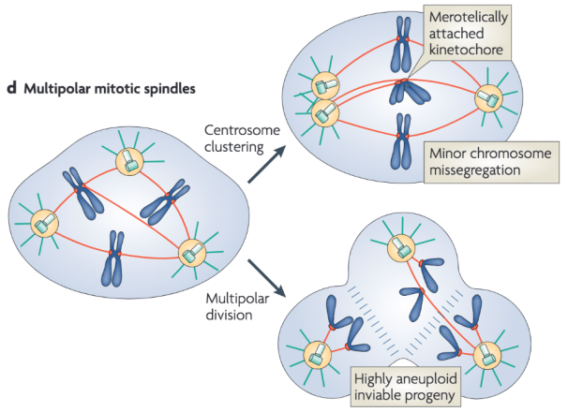
Extra centrosomes alter spindle geometry
Multiple poles can distribute chromosomes to more than two daughters.
Centrosome clustering can restore two poles after faulty attachments form.

Slide 12
Segregation errors and selection
Generation
Segregation errors create new chromosome states.
Fate
Cells with different states may survive and divide differently.
Observed population
The endpoint reflects both processes.

Slide 18
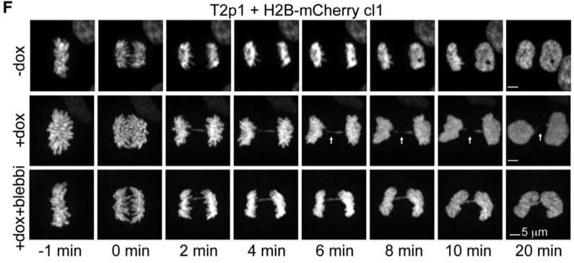
Live-cell imaging
Principle
Follow labeled DNA through a division.
Advantages
Preserves event order and mother–daughter relationships.
Limitations
Labels, illumination and sampling can alter or miss events.

Slide 19
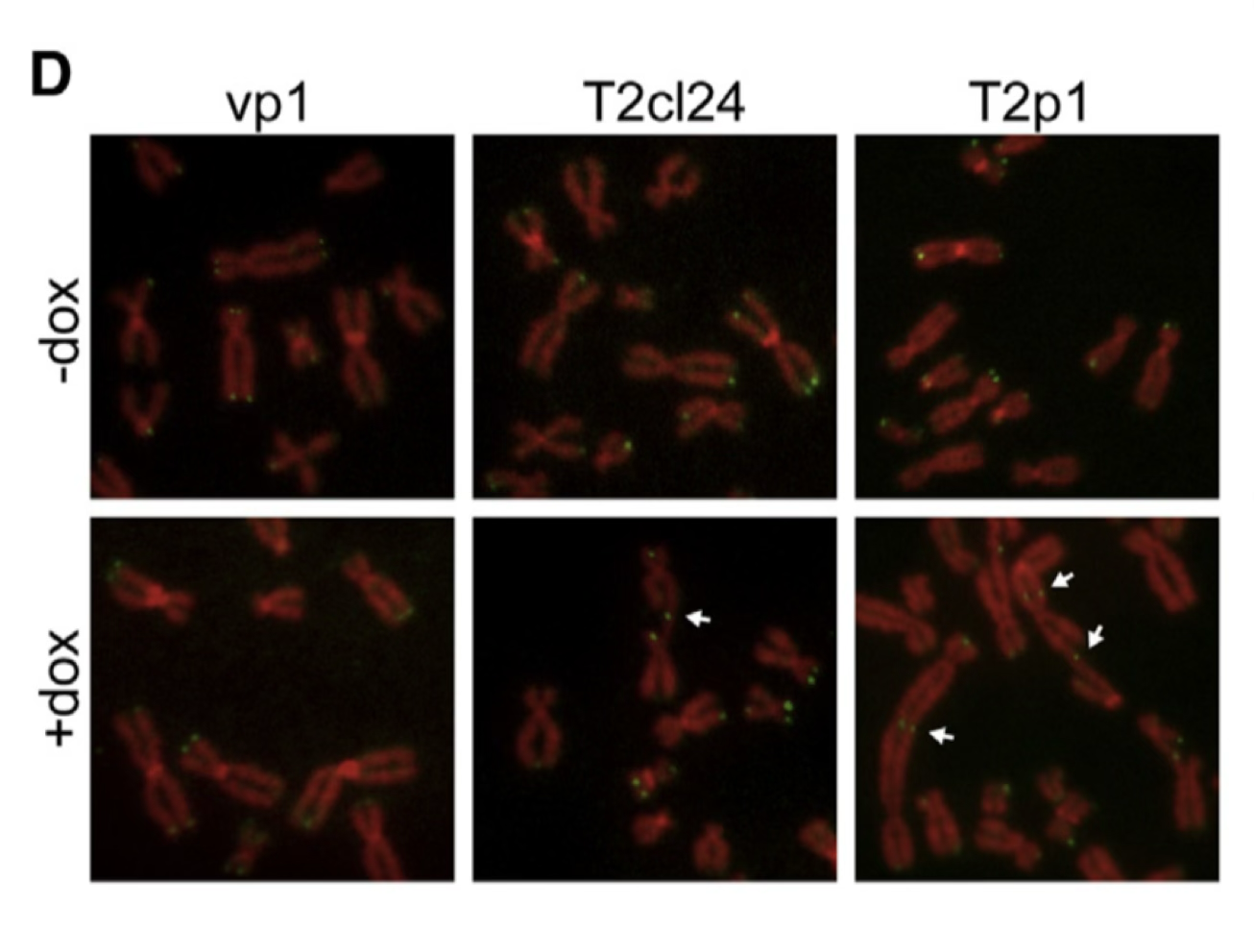
Metaphase karyotyping
Principle
Spread chromosomes from one mitotic cell. Count them and identify large structural changes.
Advantages
Shows the chromosome complement of an individual cell. Chromosome paints help establish identity.
Limitations
Samples cells that reach mitosis. Preparation can lose chromosomes. Small changes remain unresolved.

Slide 20
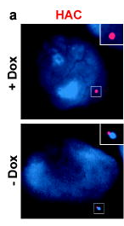
Fluorescence in situ hybridization (FISH)
Principle
A labeled probe recognizes a complementary DNA sequence in fixed cells.
Advantages
Connects sequence identity to nuclear or chromosomal location.
Limitations
Selected loci only. Signals can overlap, split or fail.

Slide 21
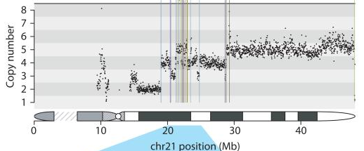
DNA copy-number measurements
Principle
Measure DNA abundance across reference-genome intervals.
Advantages
Detects gains, losses and amplification. Single cells reveal variation.
Limitations
Copy number alone leaves order, orientation and location unresolved.
Could two populations have the same average copy number?

Slide 22
Reading a copy-number profile
Reference position on the x-axis. DNA copy number on the y-axis.
Li et al., Nature, 2014, Fig. 1A

Slide 23
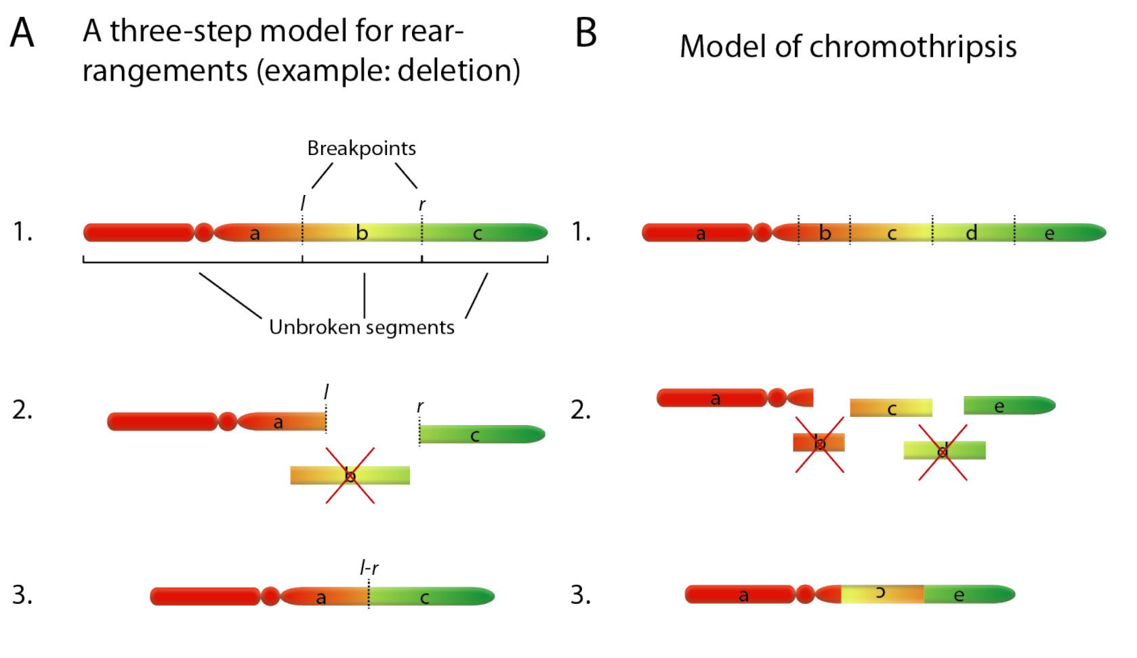
Chromothripsis: fragmentation and reassembly
Inversion changes orientation while preserving copy number.
Li et al., Nature, 2014, Supplementary Fig. 4A–B

Slide 24
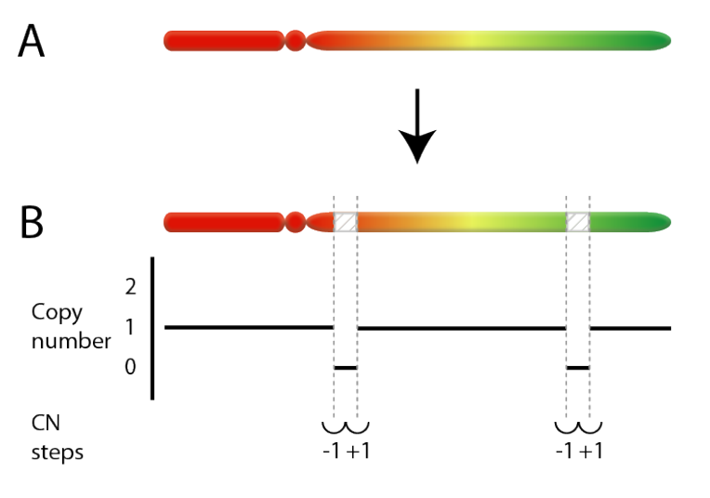
A deletion followed by amplification
Two segments have been deleted.
Now amplify the chromosome that remains.
Amplification copies the retained DNA. The deleted intervals remain absent.
Li et al., Nature, 2014, Supplementary Fig. 7A–B

Slide 25
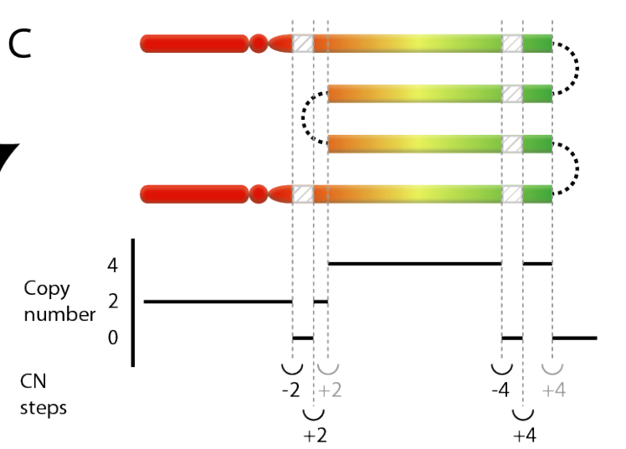
Later amplification magnifies an earlier deletion
The gaps remain absent.
Their neighbors now have two or four copies.
An early deletion can become a larger copy-number step after amplification.
Li et al., Nature, 2014, Supplementary Fig. 7C

Slide 26
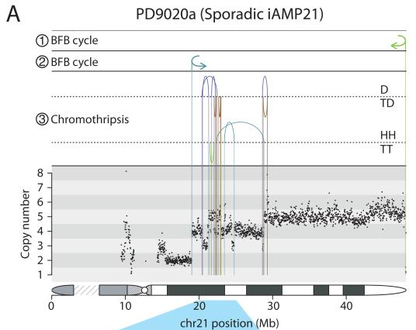
Junctions add adjacency and orientation
Arcs connect newly adjacent reference positions.
Junction classes identify the orientations of the joined ends.
Copy number measures abundance. Junctions reveal adjacency and orientation.
Li et al., Nature, 2014, Fig. 1A

Slide 28
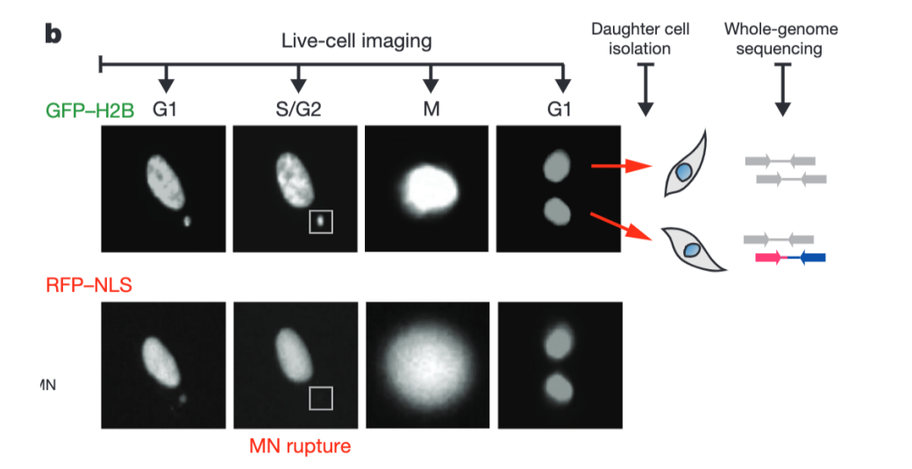
Connecting a cellular event to the inherited genome
Link the observed cell history to the genomes inherited by its daughters.
Zhang et al., Nature, 2015

Slide 29
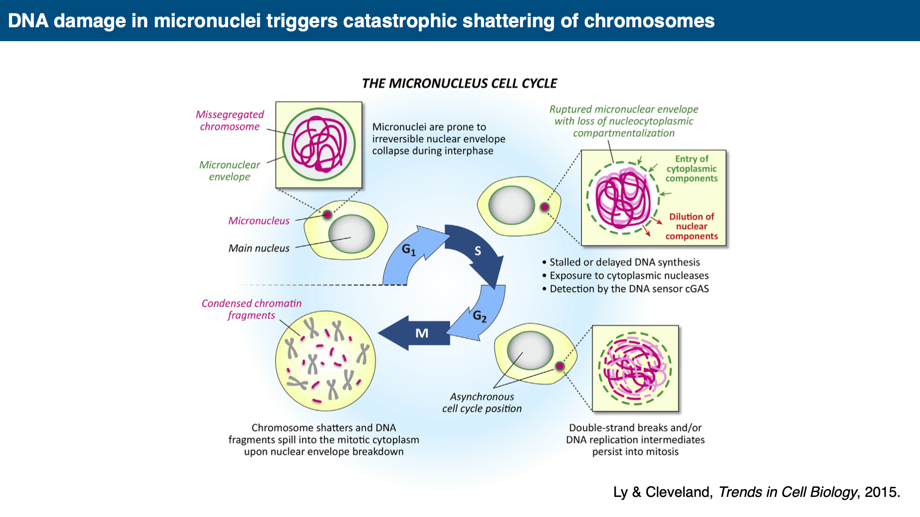

Slide 30
A junction establishes sequence adjacency
A–B B–C C–A
What kind of DNA structures could satisfy this kind of linkage pattern?

Slide 31
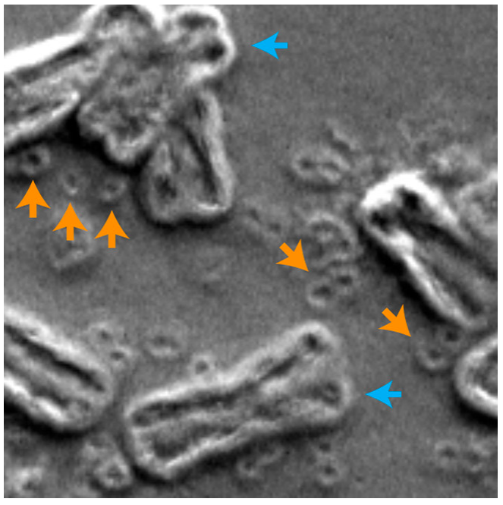
Extrachromosomal DNA
Amplified DNA physically separate from the chromosomes.
Large cancer-associated ecDNA are usually circular and lack conventional centromeres.

Slide 32
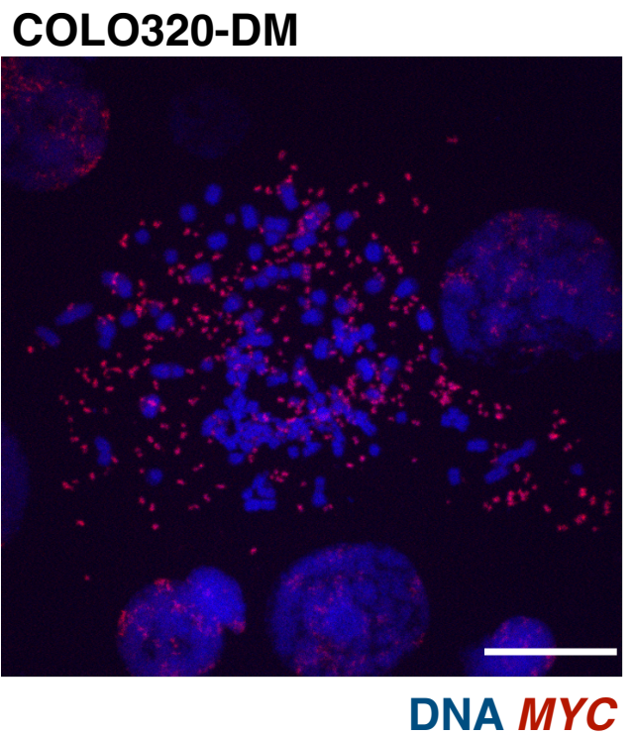
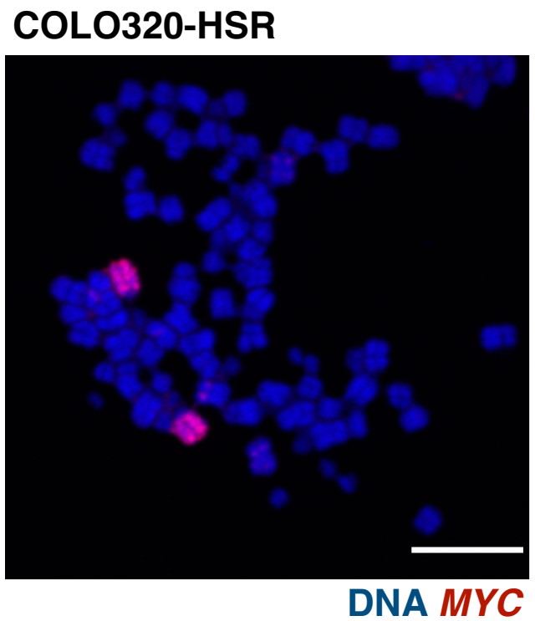
ecDNA and chromosomal amplification
ecDNA / double minutes
HSR: chromosomal amplification

Slide 33
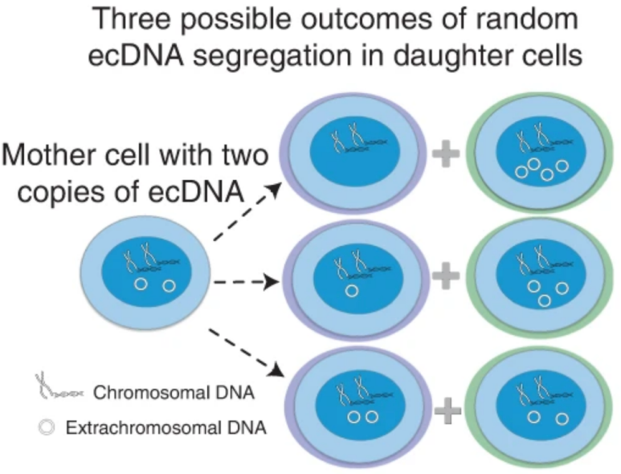
Unequal ecDNA partition creates copy-number variation
Daughters can receive different numbers of copies.
Survival and growth then change the population distribution.

Slide 34
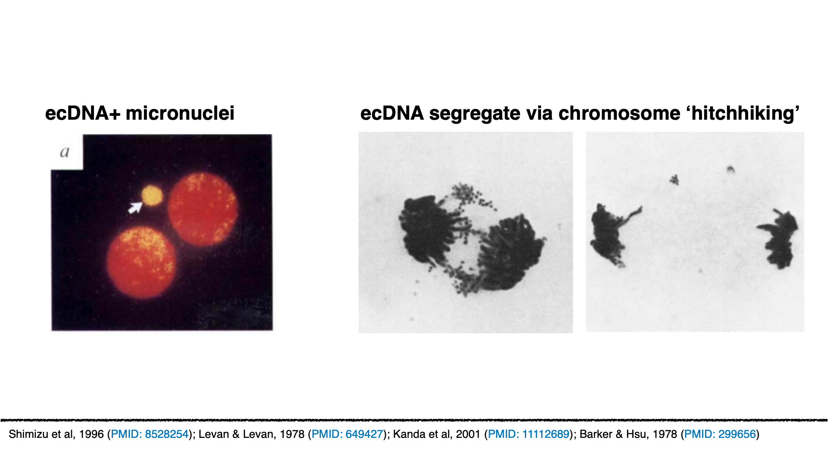

Slide 35
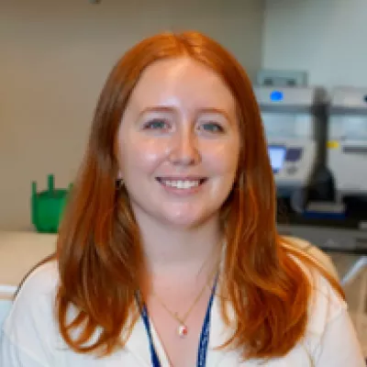
How does ecDNA reach daughter nuclei?
No conventional centromere.
Yet the DNA persists through many divisions.
Ashley Nichols

Slide 36
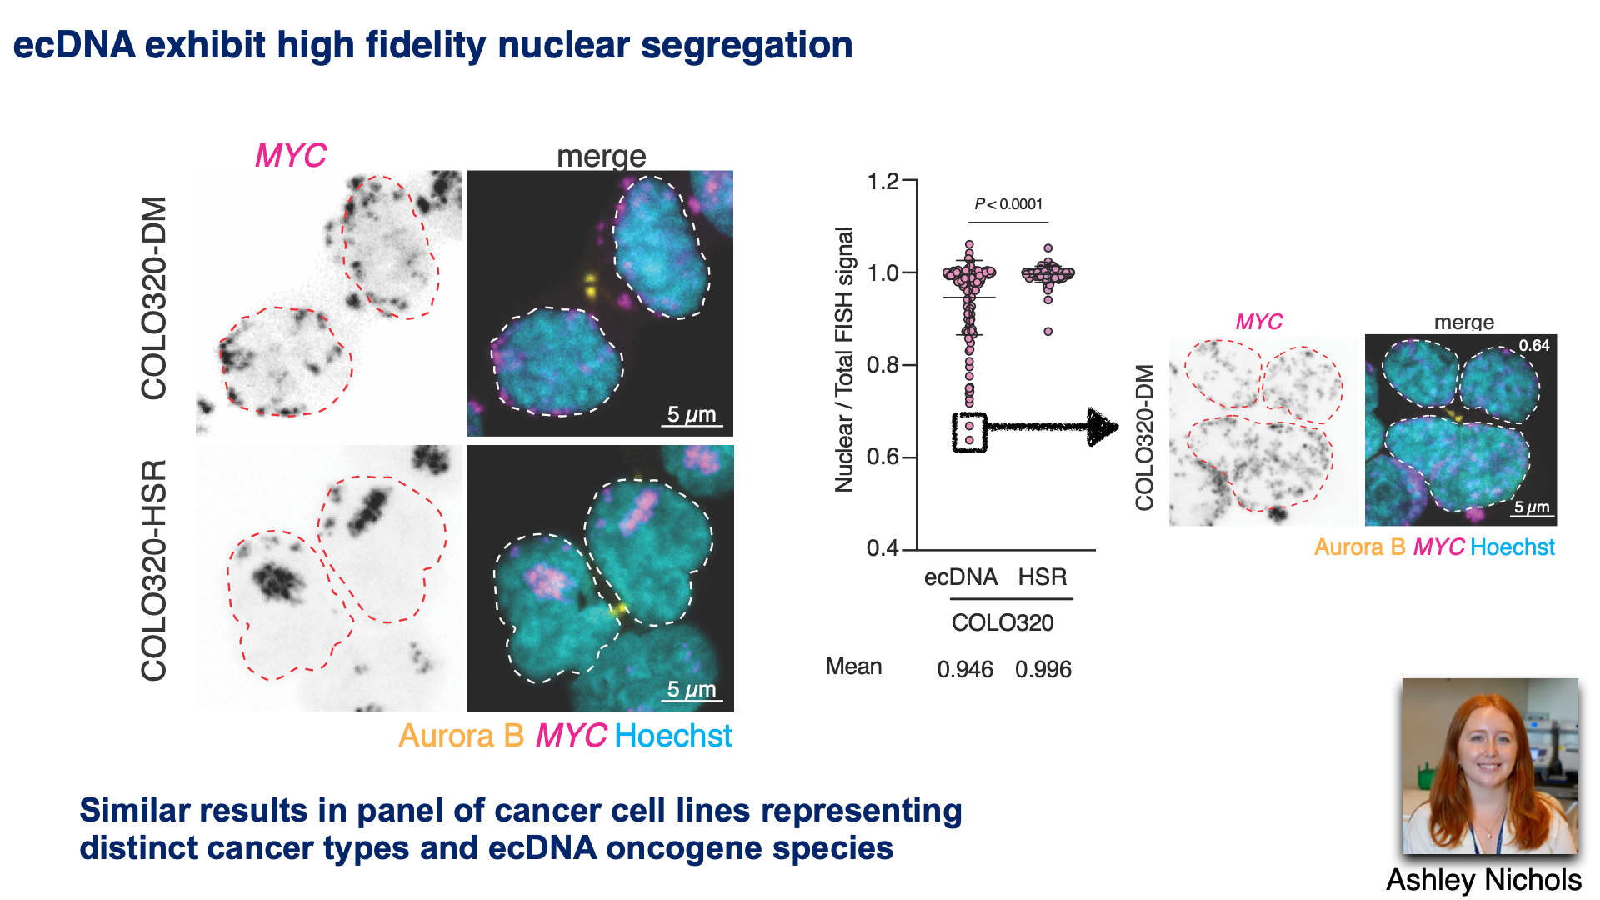

Slide 37
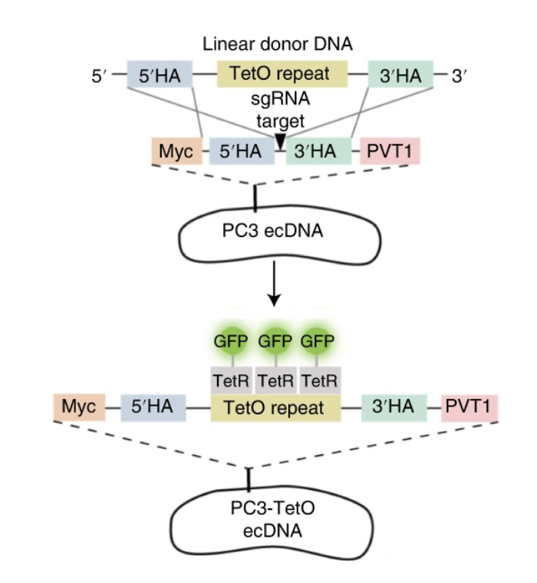
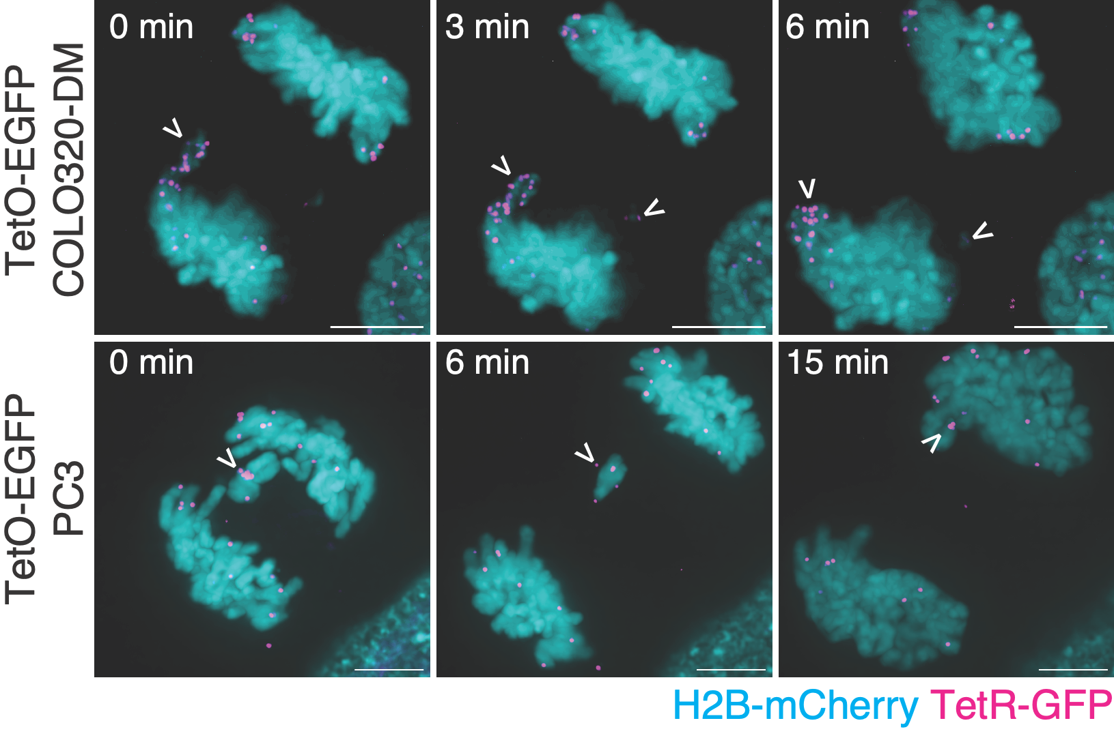
Live-cell imaging of ecDNA segregation confirms frequent chromosome ‘hitchhiking’
ecDNA contacts appear enriched towards chromosome ends
Lange et al, 2022 (PMID: 36123406); Levan & Levan, 1978 (PMID: 649427)
Ashley Nichols

Slide 38
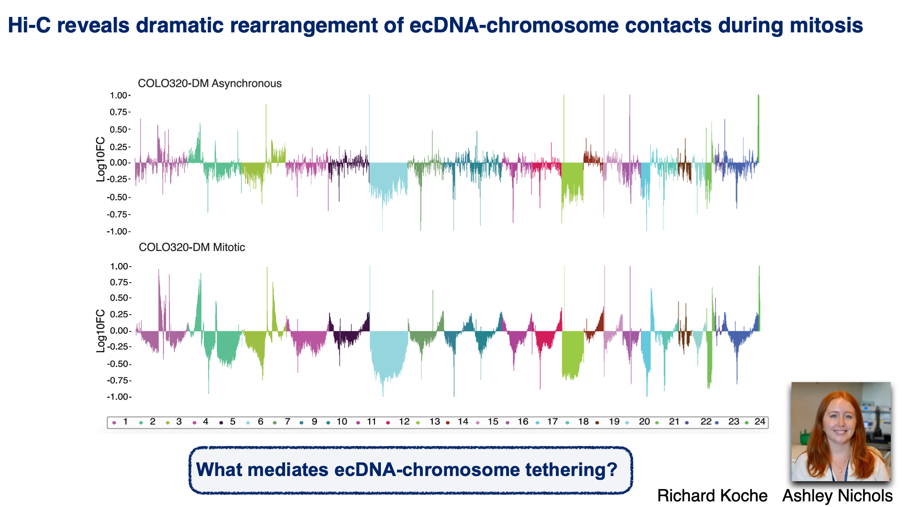

Slide 39
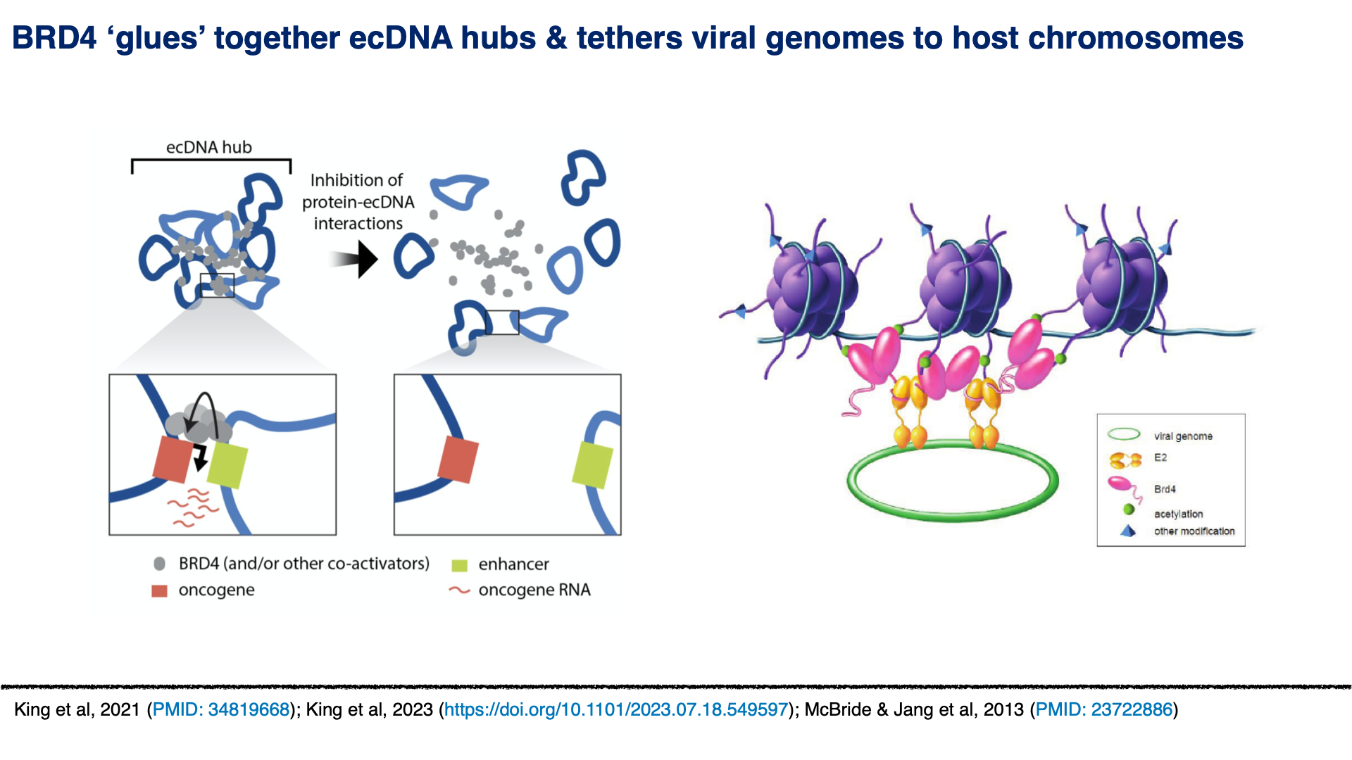

Slide 40
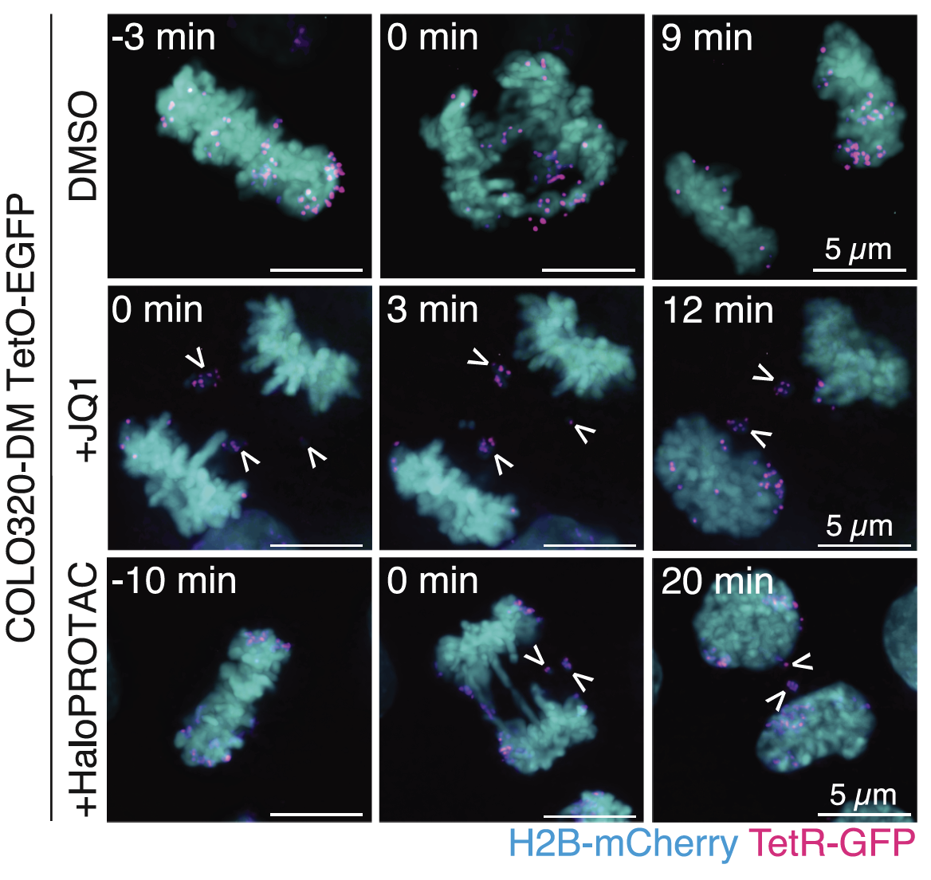
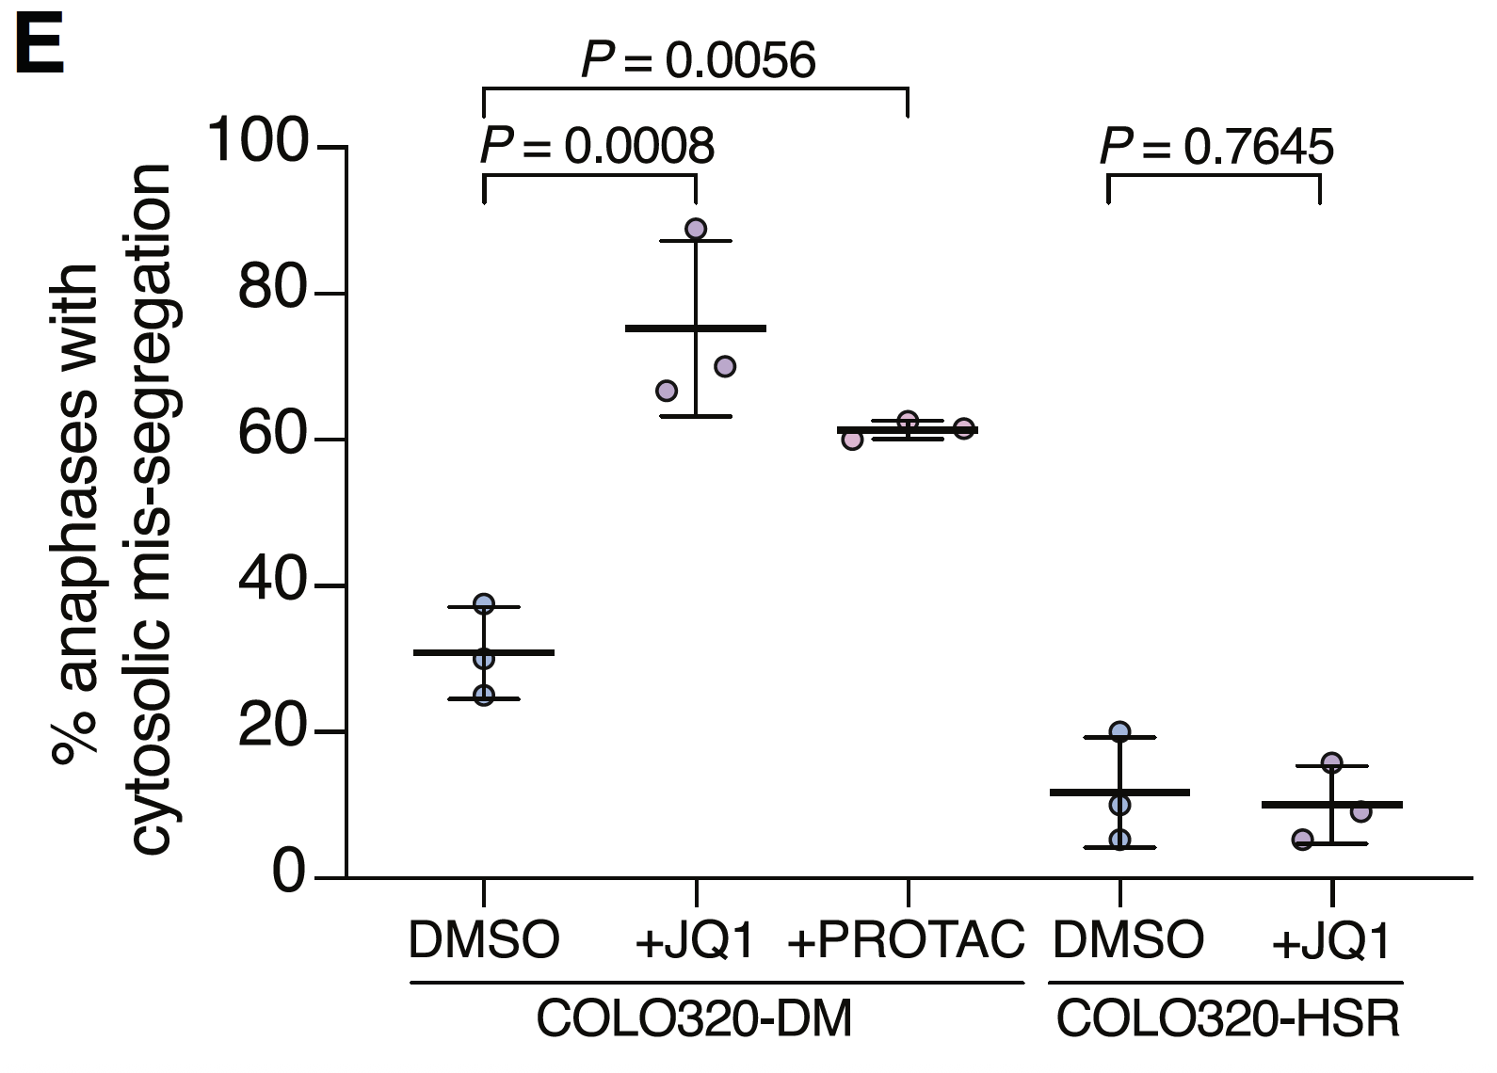

BRD4 inhibition drives mis-segregation of MYC-amplifying ecDNA
BRD4 inhibition increases ecDNA micronucleation
Segregation of DHFR-amplifying ecDNA not impacted by JQ1
Ashley Nichols

Slide 41
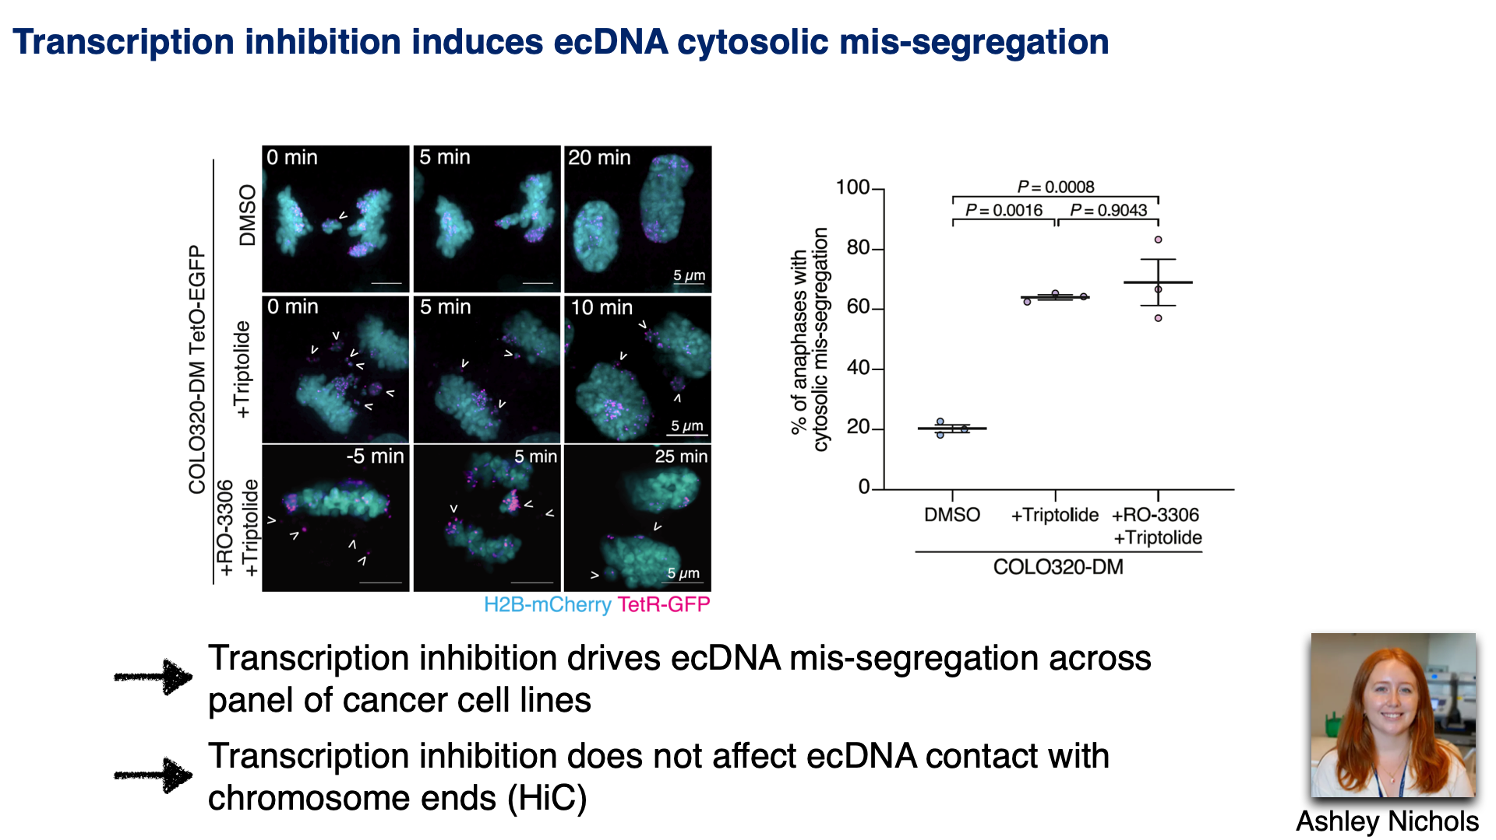

Slide 42
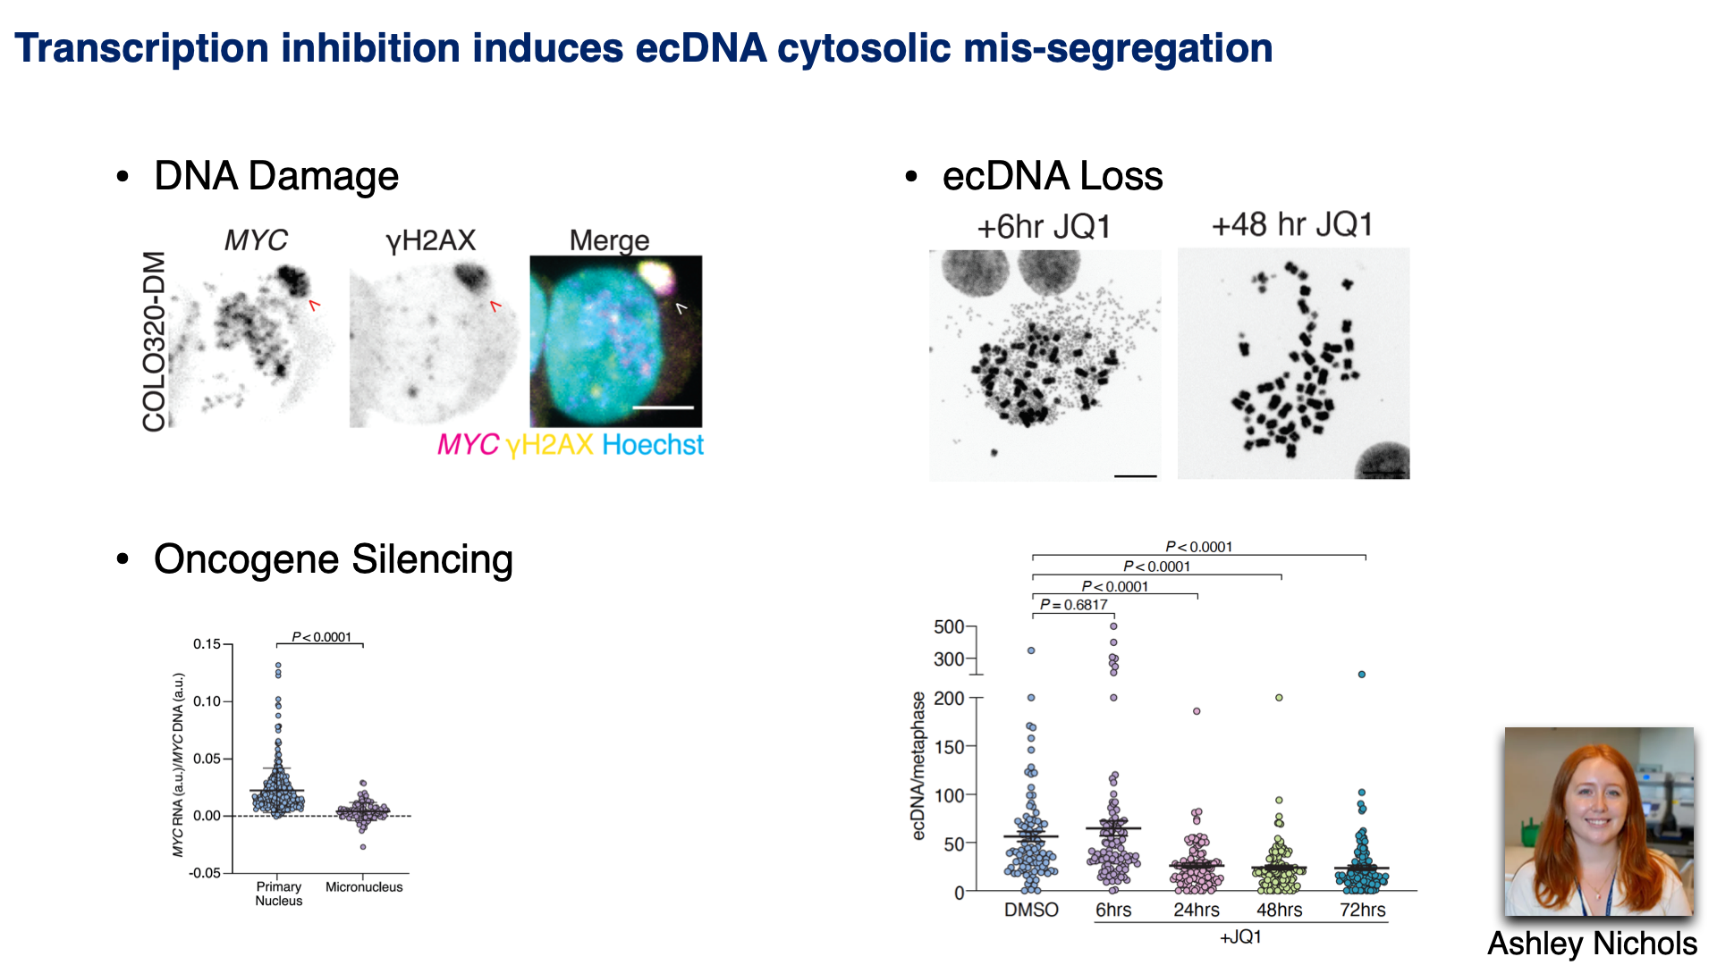

Slide 43
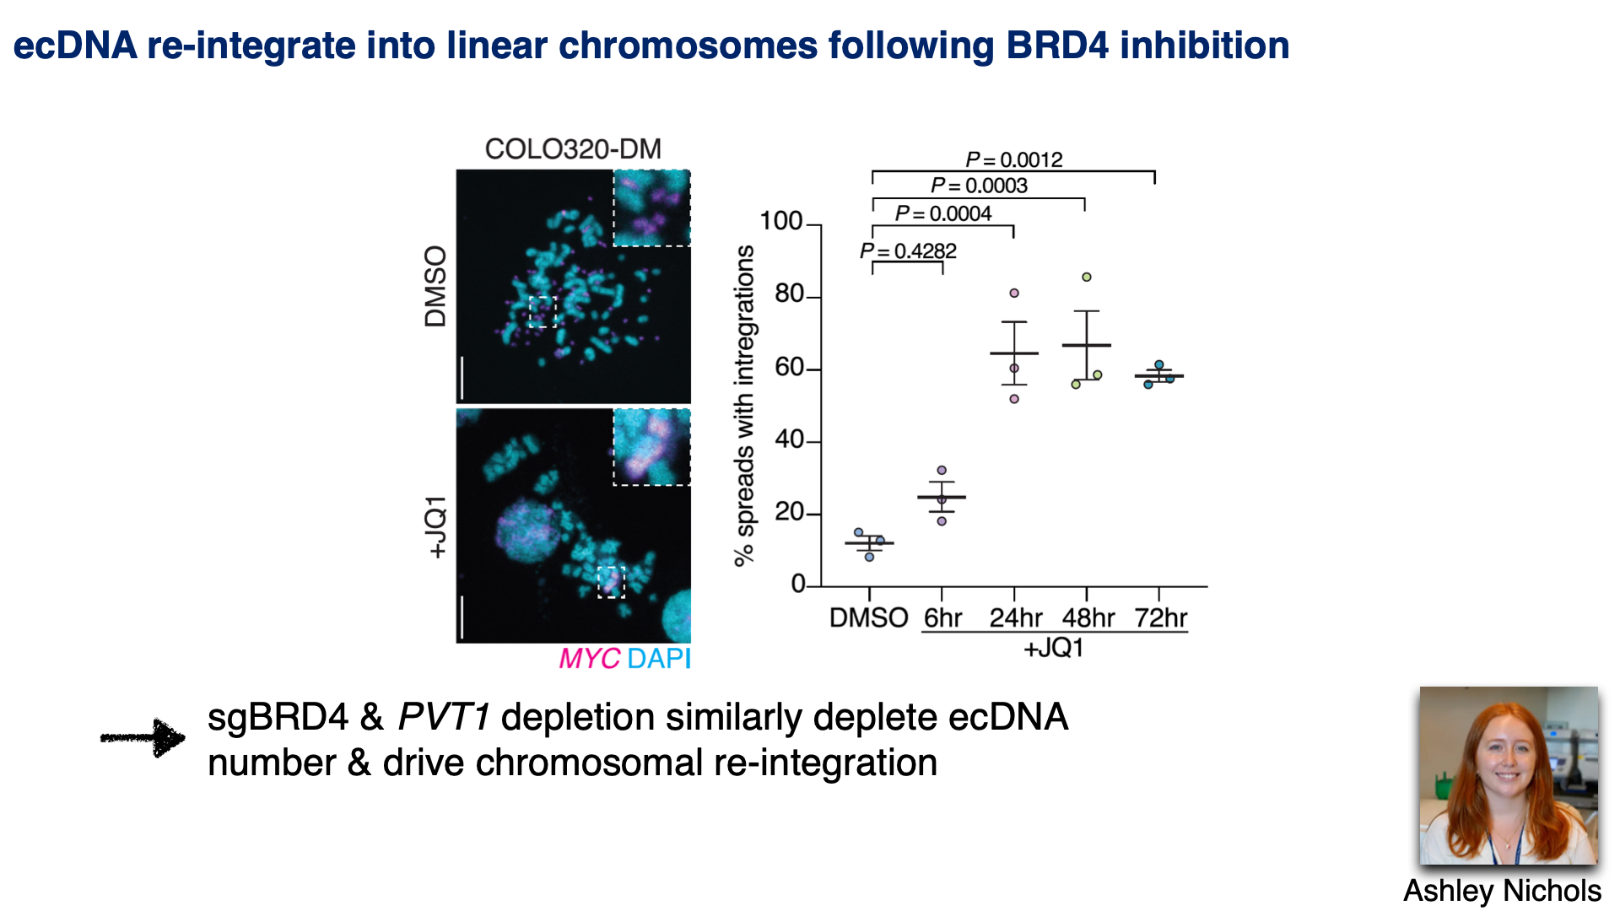

Slide 44
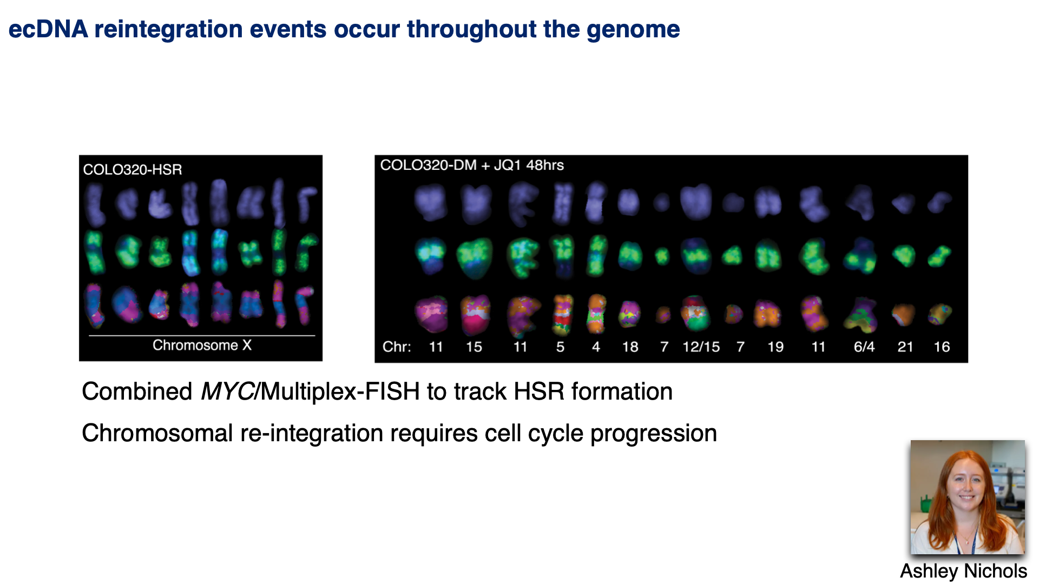

Slide 45
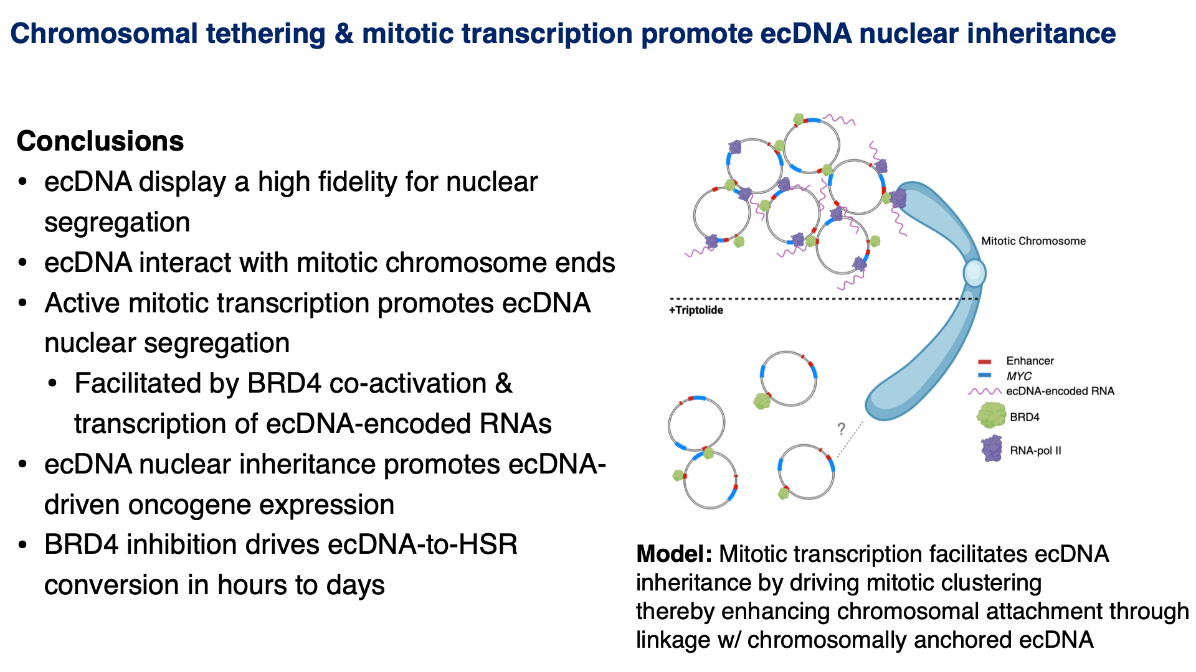

Slide 46
Chromosome inheritance connects cell biology to genome change
Segregation changes which DNA a daughter receives.
Compartmentalization changes what happens to that DNA.
Survival and growth shape the genomes we eventually observe.

